Slide 1
Computer Assisted Drug Design – The Enediyne Story
Elfi Kraka, Bruna Marcial and Dieter Cremer
Computational And Theoretical Chemistry
GrOup (CATCO) http://smu.edu/catco/
Department of Chemistry, SMU, Dallas, USA
Notes:
This is my opening slide. I have to check what else it should conmtain

Slide 2
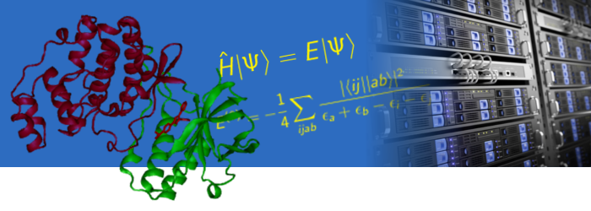
Computational Chemistry
Performing chemical experiments on the computer
  to predict properties of chemical compounds and materials
  as well as the outcome of chemical reactions
  to provide guidelines for the experimentalists

Slide 3
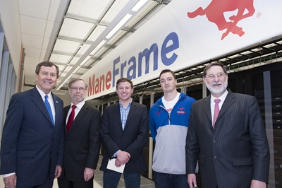
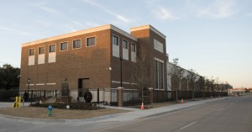

High-Performance Computing @ SMU
SMU’s latest addition to the computer computer facilities: ManeFrame
(ranked among the top 500 fastest supercomputers in the world)
Total Capacity in 2015: 10,900 cores, 120 teraflops, 1.5 PB storage
25,000-square-foot facility
housing both the high-
performance and general-
purpose computing equipment

Slide 4
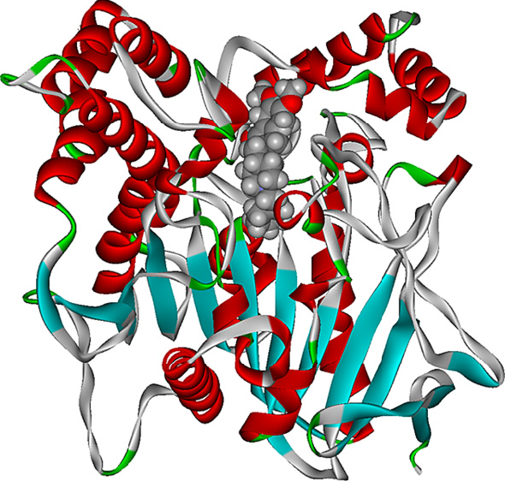
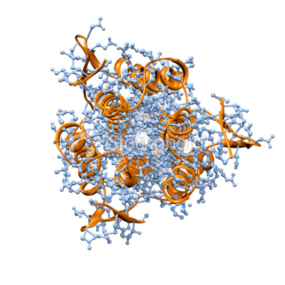
Large scale high accuracy computations
Influenza hemagglutinim
antigen-antibody system
8,409 atoms
Fight against Alzheimer’s disease
Donepezil hydrochloride (drug) -
acetylcholinestrase complex
14,086 atoms

Slide 5











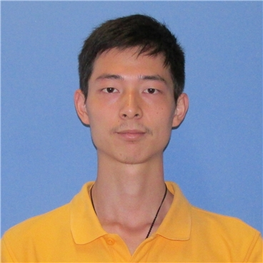



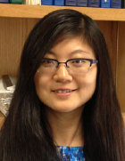









Computational And Theoretical Chemistry Group, CATCO:http://smu.edu/catco/

Slide 6
http://smu.edu/catco/research/
375 papers published 65 at SMU

Slide 7
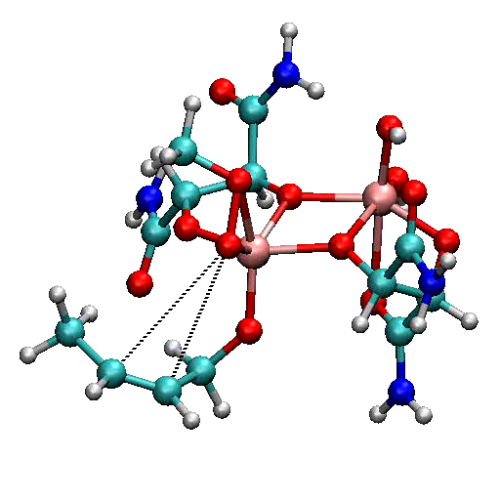
Calculation of the complete reaction path for the Sharpless Reaction
Technically challenging: 1500 bfns; 2000 path points, analytical 1st, 2nd and partial 3rd derivatives
at each path point!

Slide 8
Computer Assisted Drug Design
(CADD) education
Notes:
8

Slide 9
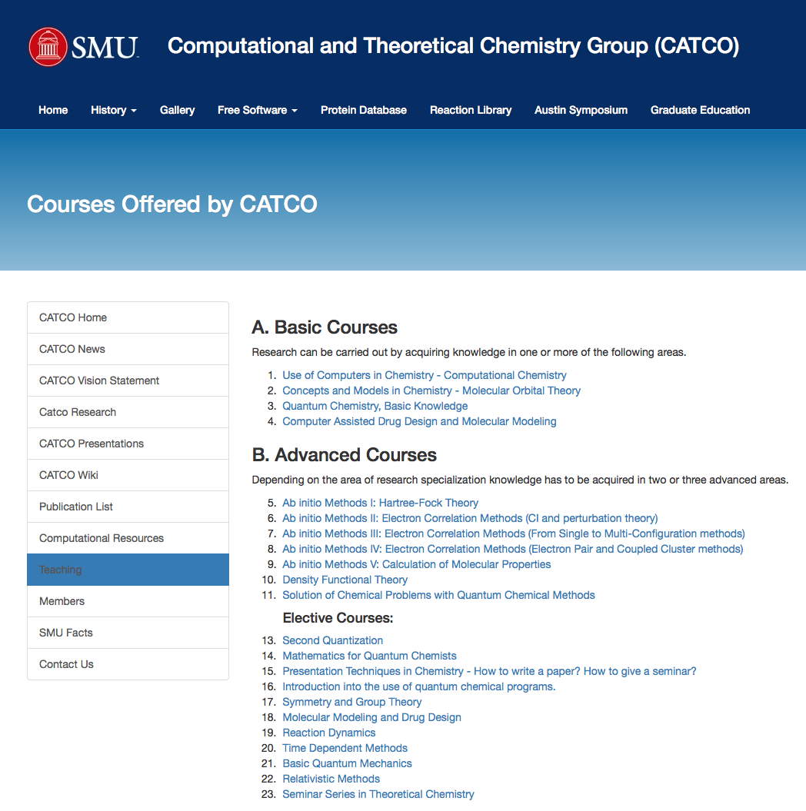
http://smu.edu/catco/

Slide 10
Part of CATCO’s new graduate curriculum
http://smu.edu/catco/graduate-program.html
CHEM 6344

Slide 11
Computer Assisted Drug Design
(CADD) research
Notes:
11

Slide 12
http://smu.edu/catco/research/
375 papers published 65 at SMU

Slide 13
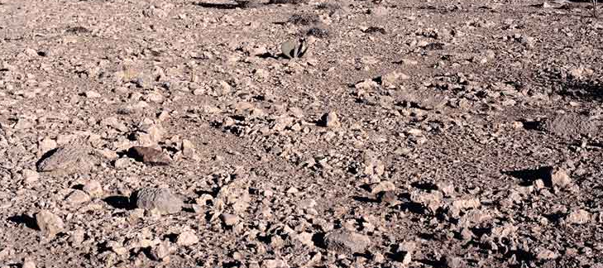
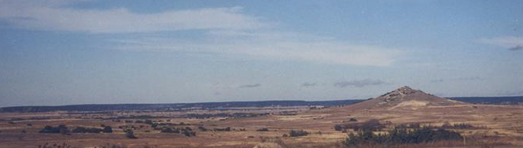
National Screening Program,1985
Caliche stones
Discovery: Certain microorganism found in the
soil near Waco, Texas, protect themselves against
viruses and bacteria by an unusual chemical defense
mechanism that leads to DNA double-strand scission
and cell death.
Can we use this in drug design ?

Slide 14
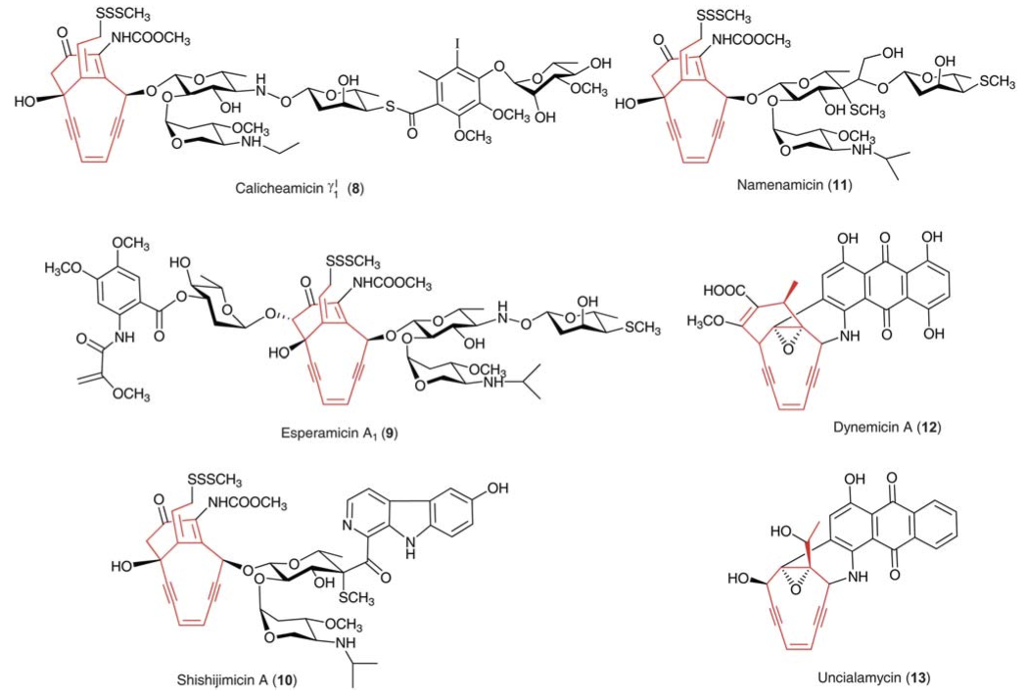
10-membered ring enediynes

Slide 15
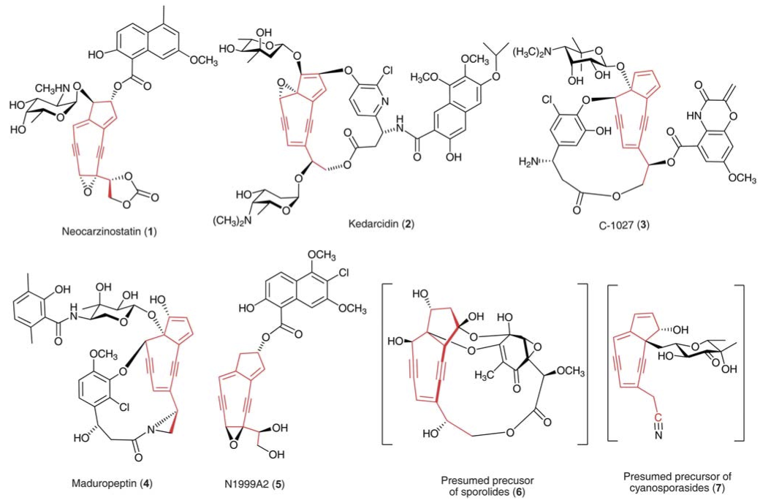
9-membered ring enediynes

Slide 16
C
a
l
i
c
h
e
a
m
i
c
i
n
γ
'
1

Slide 17
Bergman cyclization
A useful chemical reaction?
29 kcal/mol

Slide 18
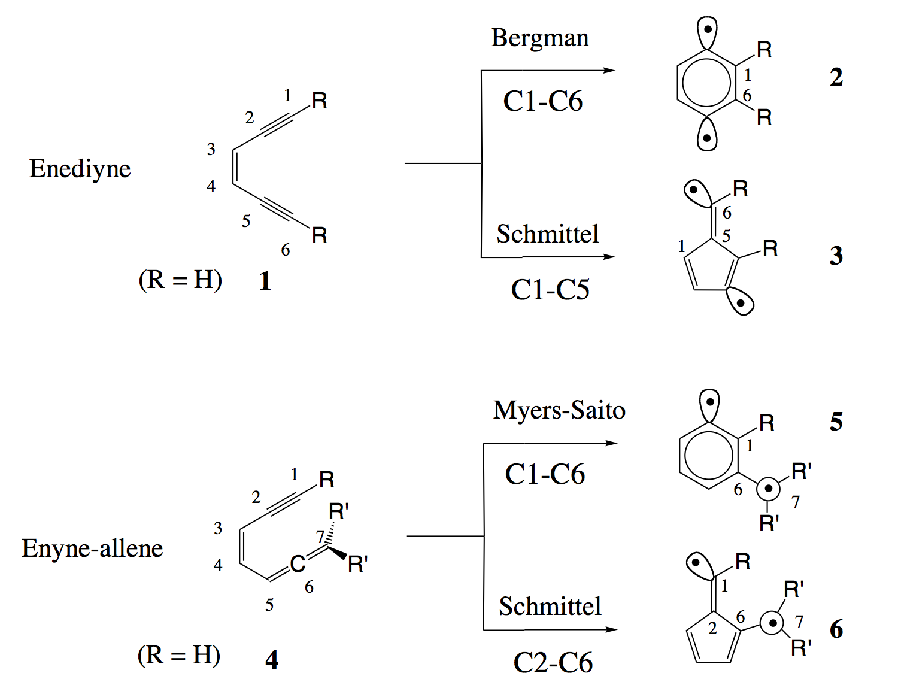

Slide 19
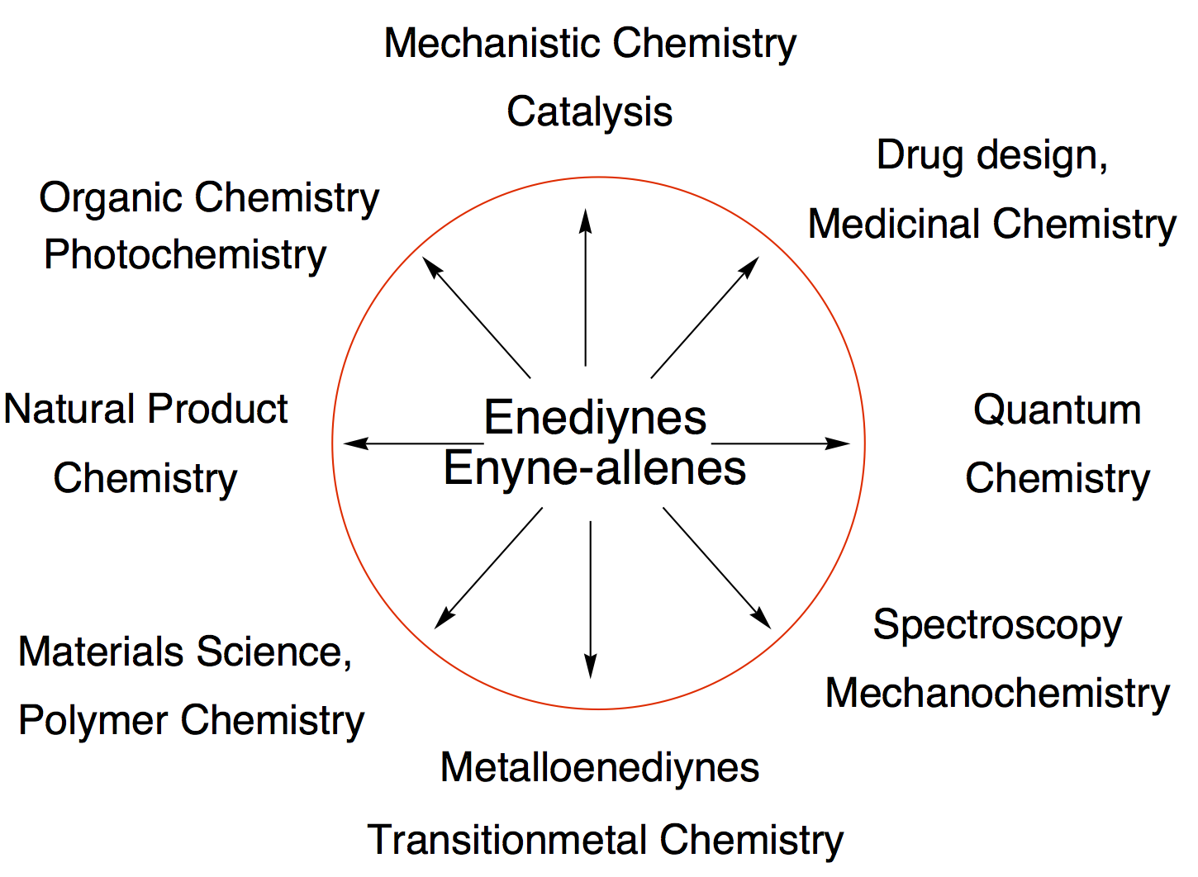

Slide 20
Docking of Caliceamicin
Notes:
20

Slide 21
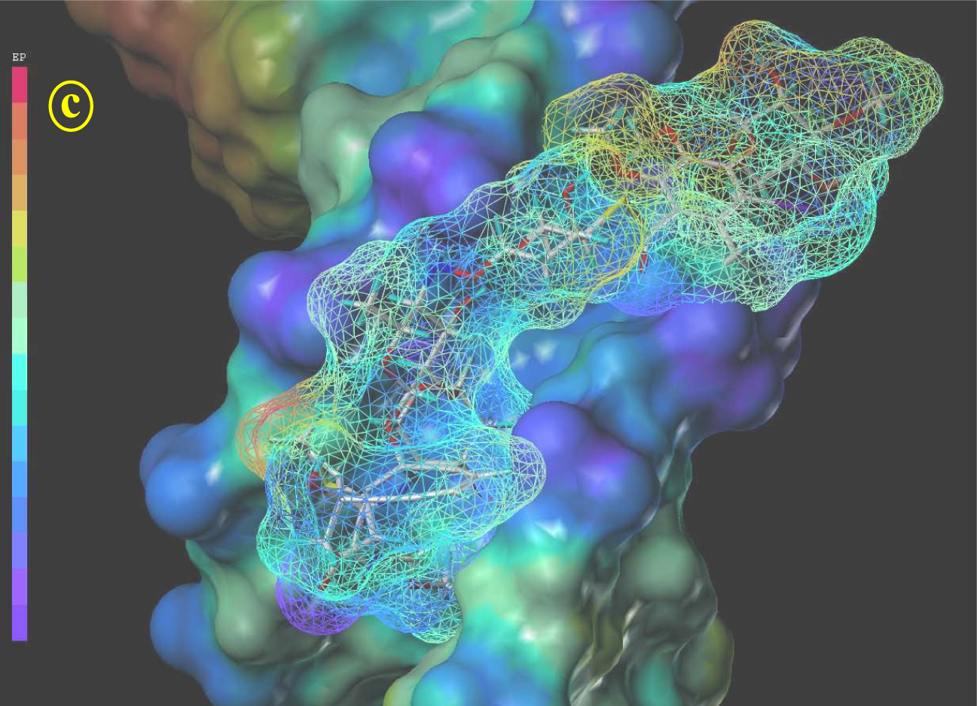

Slide 22
QM/MM Calculations
DNA modelled with 10-mer B-DNA: d(CTACTACTGG)
CHARMM minimized
Docking of triggered dynemicin A into minor groove using AutoDock
utilizing DFT geometry (rigid docking).
Adding of counterions: 2 Mg²⁺ ande 17 Na⁺.
Adding 30 Å sphere of TIP3P water.
Minimization of system: 500 steepest descent + 10000 ABNR steps.
1 ns equilibration (Langevin Dynamics) using 1 fs time-steps +
SHAKE for H atoms.
MM parameters of dynemicin generated with QUANTA98 using the
CHARMM force field.
QM/MM optimization: active region r = 18 Å (2853 active atoms;
QM region: 60 atoms; MM region: 10406 atoms)
Calculations along Bergman reaction path; TS verified by QM/MM
frequency calculation.
Notes:
22

Slide 23
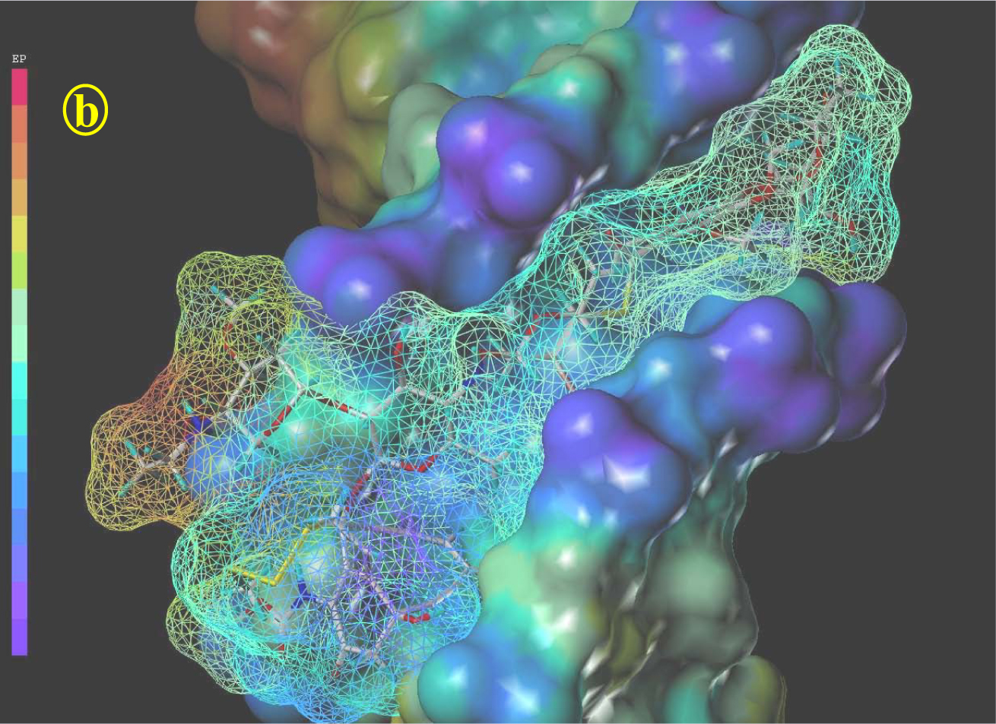
Minor groove
Calicheamicin
DNA strands
E_{bin} = -12.5 kcal/mol

Slide 24
Triggering of Caliceamicin
Notes:
24

Slide 25
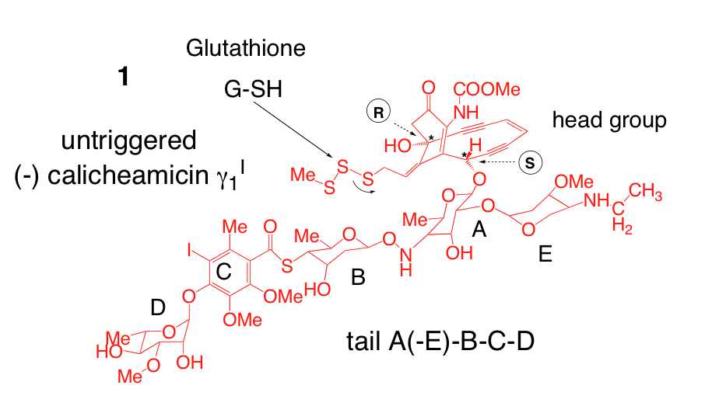

Slide 29
CCSD(T)/pVTZ

Slide 30
Outside the DNA

Slide 31
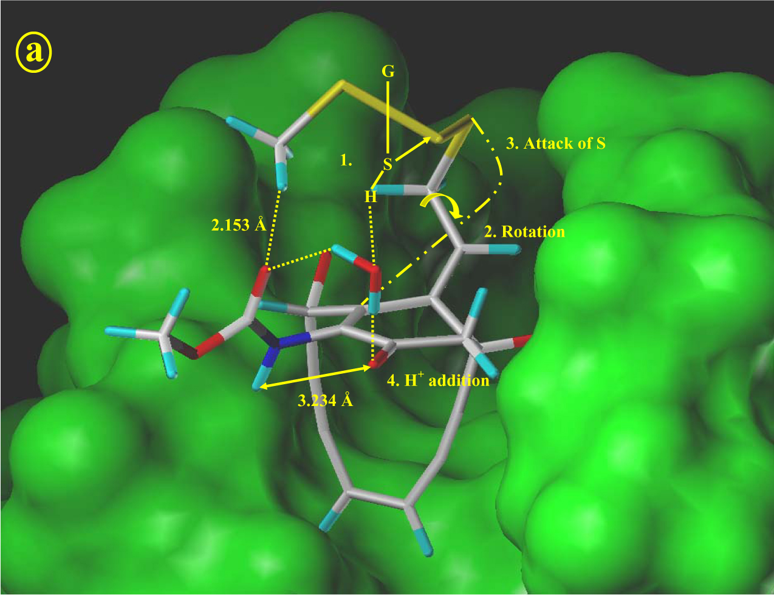
Confined in the space
of the minor groove
attack by glutathione
Notes:
31

Slide 34
Biological activity of
Calicheamicin

Slide 35
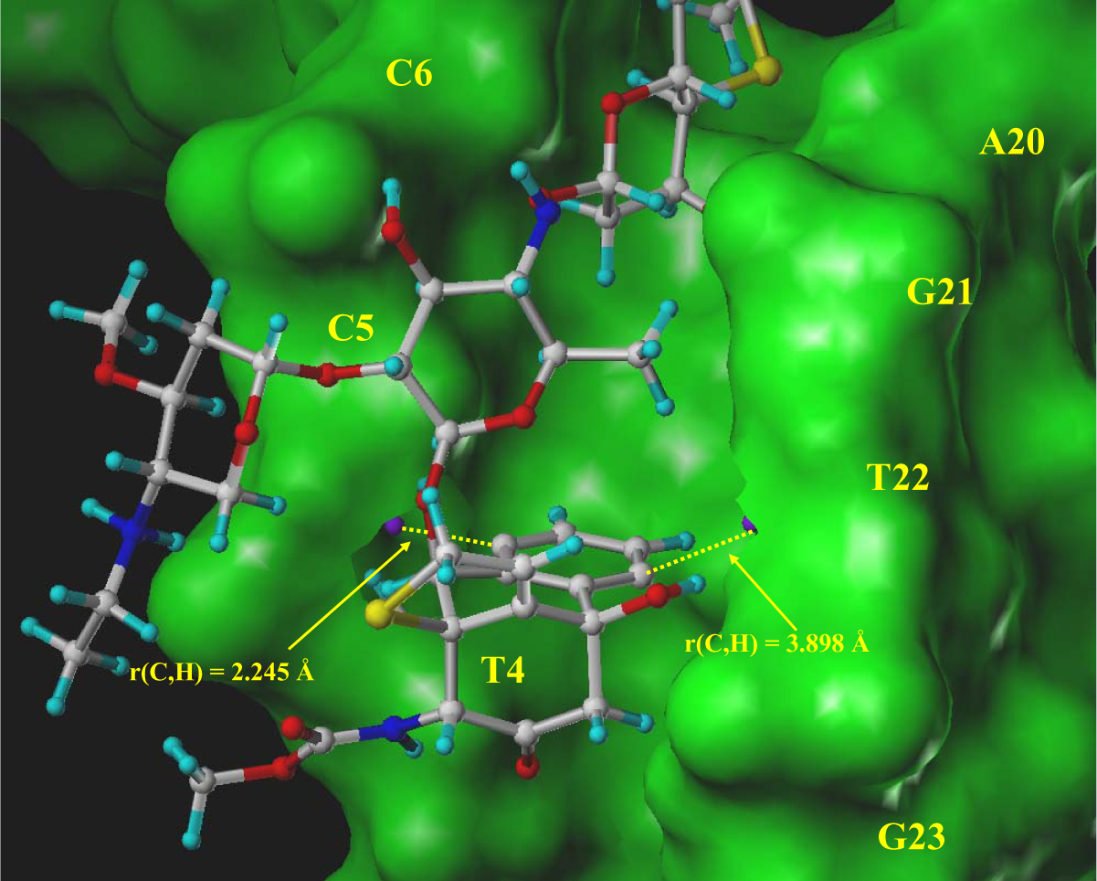
radical centers

Slide 36
What works for microorganism,
does it work for humans too?
Problem
All naturally occurring enediynes are toxic!
They destroy both cancer and normal cells.

Slide 37
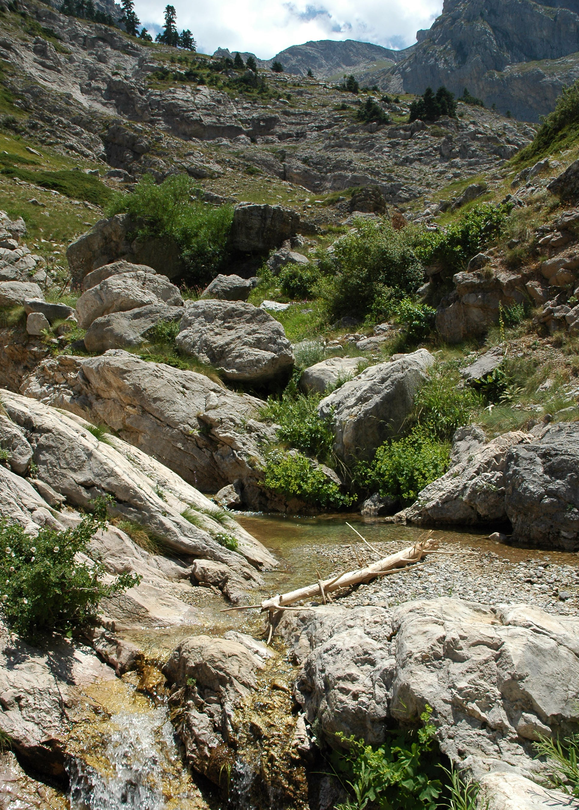
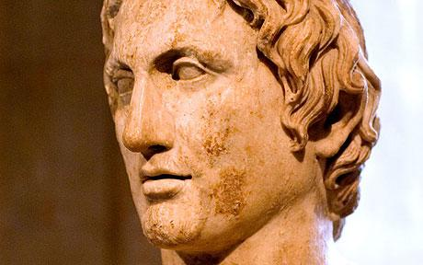
Toxicity of enediynes
Scientists believe that
Alexander the Great was poisoned by drinking water of the river Styx being contaminated by
microorganisms producing calicheamicin
The calicheamicin drug Mylotarg (Pfizer) applied against
acute myeloid leukemia (FDA approved 2000) was withdrawn
June 2010 because of serious liver conditions

Slide 38
Can we fine-tune the enediyne warhead
to attack only cancer cells?

Slide 40
The design strategy

Slide 41
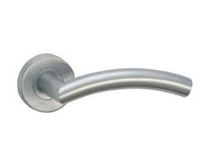
Design of New Warhead: Door handle principle
sensor for environmental acidity
+
X
R
3
HX
R
3
R
3
+
R
H
1
Y
Y
R
2
R
4
R
4
R
4
non-active
in the normal tissue
activated
in the tumor tissue
n
o
r
m
a
l
e
n
e
d
i
y
n
e
m
o
d
i
f
i
e
d
e
n
e
d
i
y
n
e

Slide 42
synthesis
Design of new warheads
1-2 years
of all possibilities
CADD
1-2 months
etc.

Slide 43
Result of our CADD studies
Use an amidine
door handle
Which R₁ and R₂ are best suited to work at a pH of 6?
The pK_{A} value of a substance is decisive
Henderson-Hasselbalch equation:

Slide 44
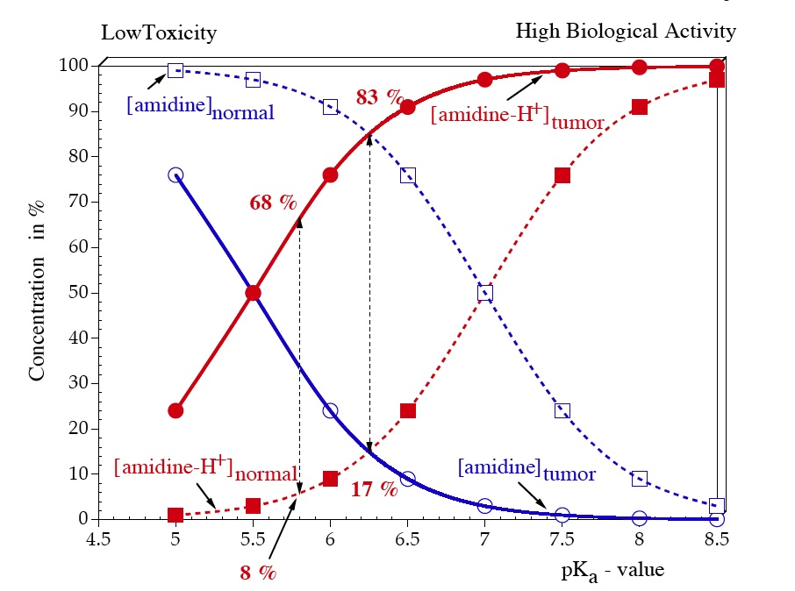
pH 6
pH 7
pK_{a} (target) 5.8
Notes:
44

Slide 45
R
a
n
g
e
o
f
p
K
v
a
l
u
e
s
f
o
r
a
m
i
d
i
n
e
s
a
4
.
6
1
3
.
6
Target: pK_{a} = 5.8

Slide 46
Fine-tuning of the pKa value

Slide 47
G(H⁺_{gas}) = -6.28 kcal/mol, ΔG(H⁺_{sol}) = -265.9 kcal/mol (recently accepted exp. values)

Slide 49
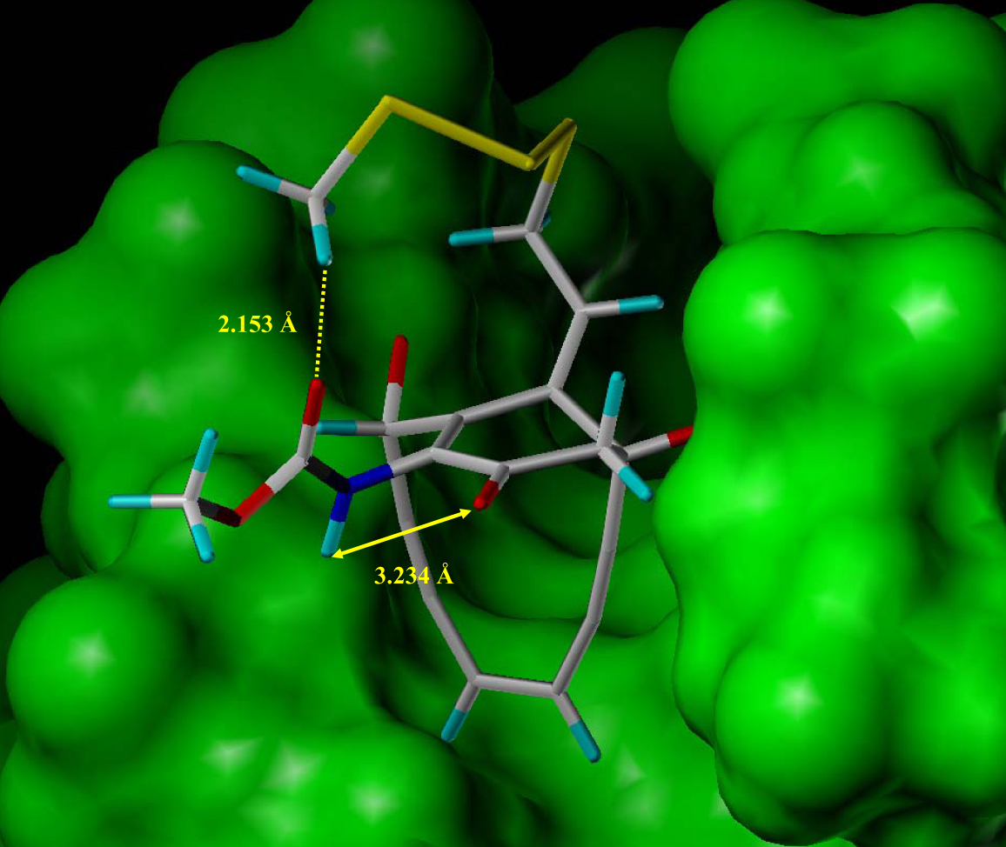
No space for
an amidine
modification!

Slide 53
Barrier for Bergman reaction ~ 55 kcal/mol

Slide 54
Barrier for Bergman reaction: 19 kcal/mol

Slide 55
Docking of Dynemicin
Notes:
55

Slide 56
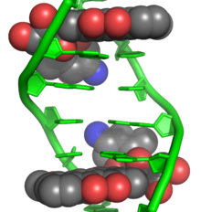
Typcial DNA Intercalators

Slide 57
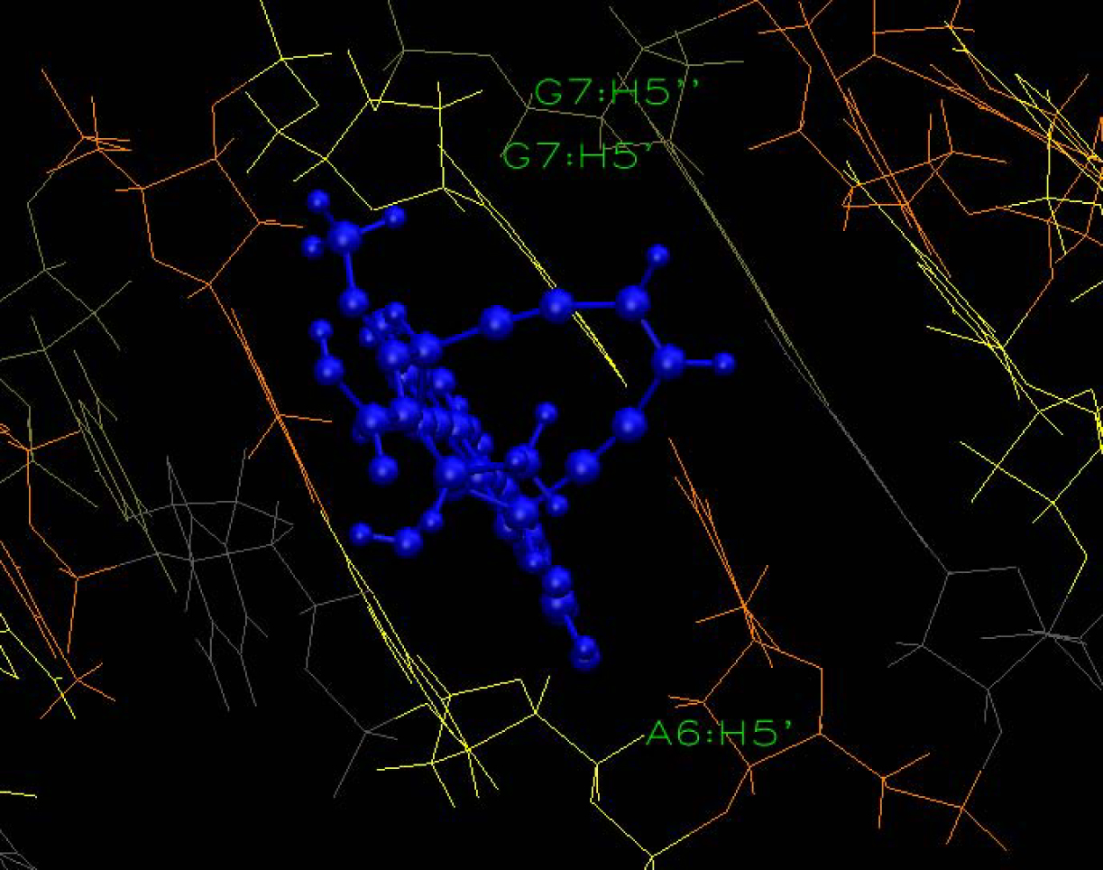
Enediyne intercalated

Slide 58
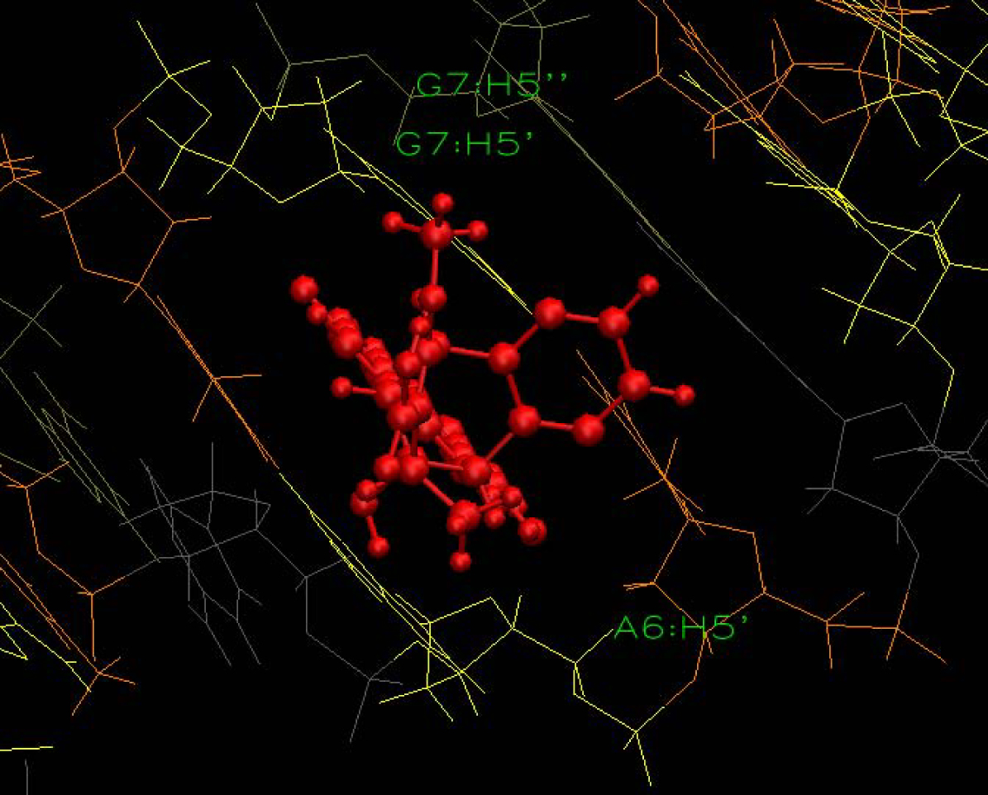
Biradical intercalated

Slide 59
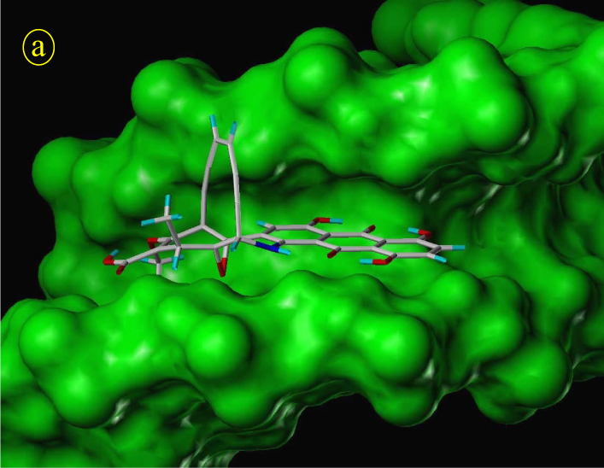

Slide 60
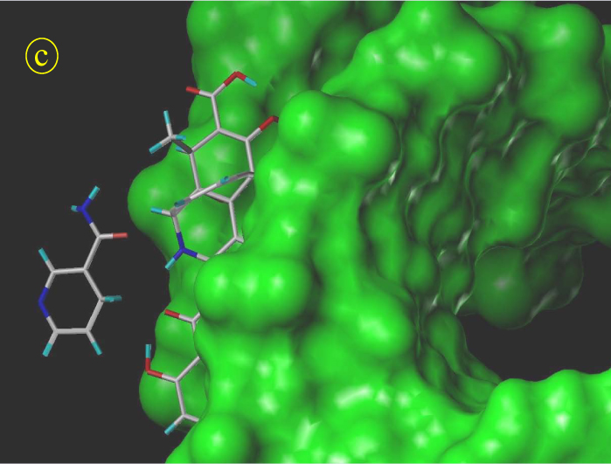

Slide 61
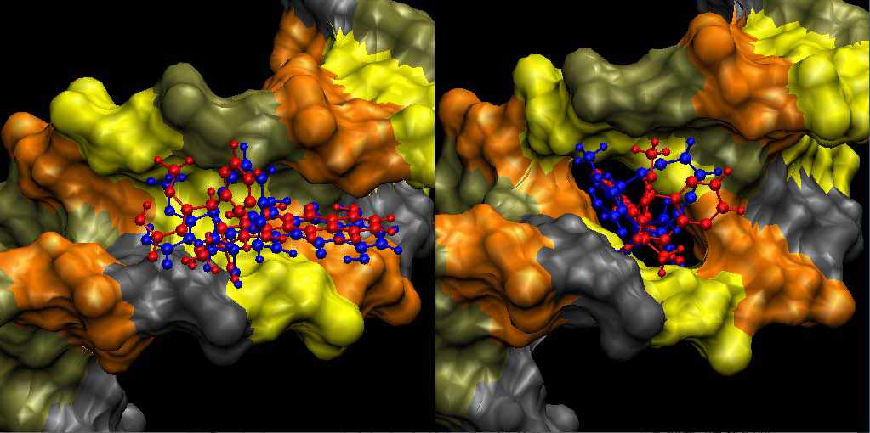
Two different binding modes
Insertion
Intercalation
H atom far away from
radical center
H atom near
radical center

Slide 62
Biological activity of
Dynemicin

Slide 63
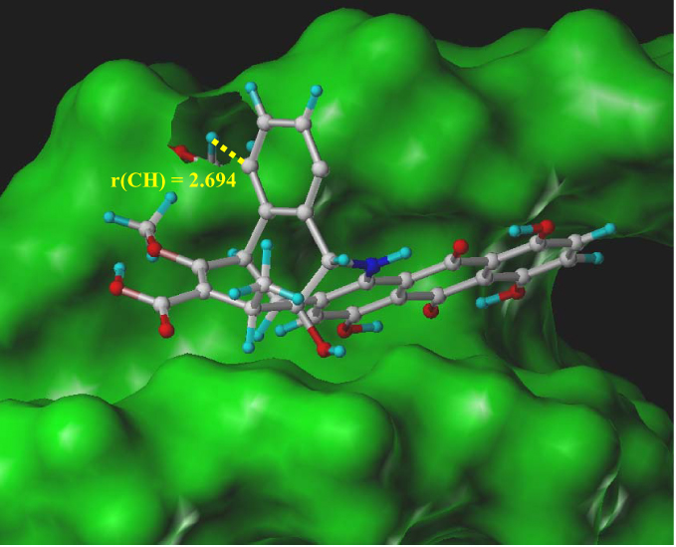

Slide 64
Design of a non toxic
Dynemicin drug candidate

Slide 66
Target: pK_{a} = 5.8

Slide 67
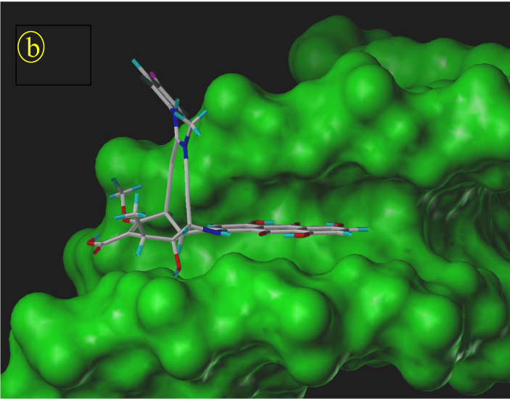
Form (b)
enough space for the new
amidine warhead
Notes:
67

Slide 68
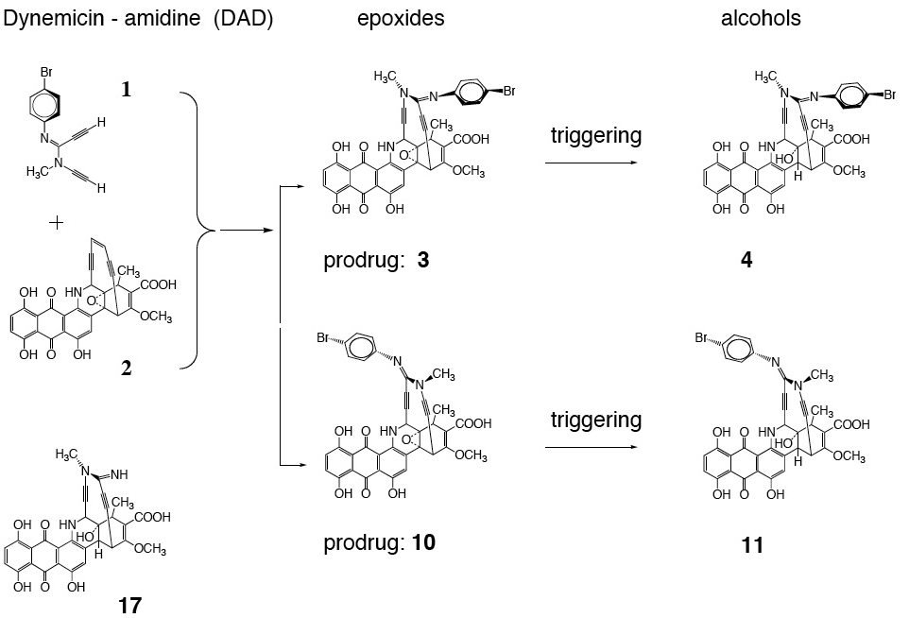
ΔE_{bin} = -7.13
pKa = 5.74
Form (b)
ΔE_{bin} = - 5.18
pKa = 6.07
Form (a)

Slide 69
Form (b)

Slide 70
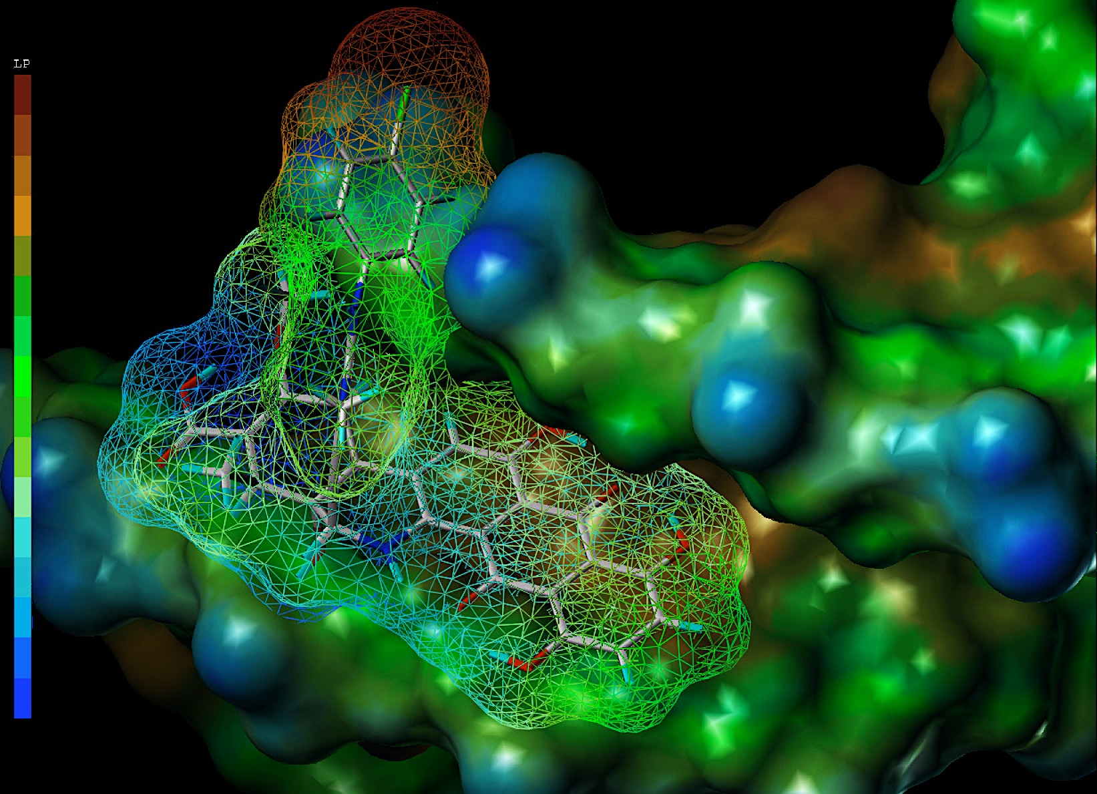

Slide 71
Summary
The toxicity of the enediynes can be significantly
reduced by using an amidine in the enediyne head group.
2) Amidines can be taylored to fulfill certain pK_{a} conditions matching the pH of the tumor cell.
3) The new design concept can be combined with the
natural design concept of dynemicin.

Slide 72
Acknowledgements
National Science Foundation, Grant No. CHE-071883,
SMU High Performance Computer Center

Slide 73

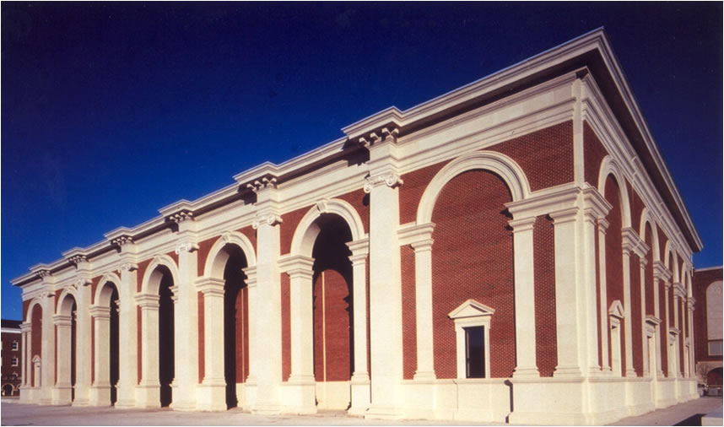


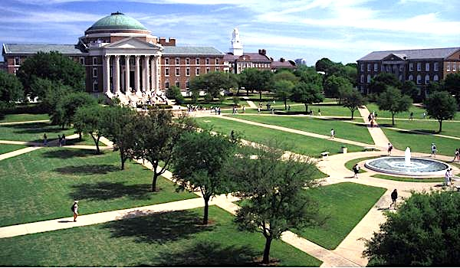
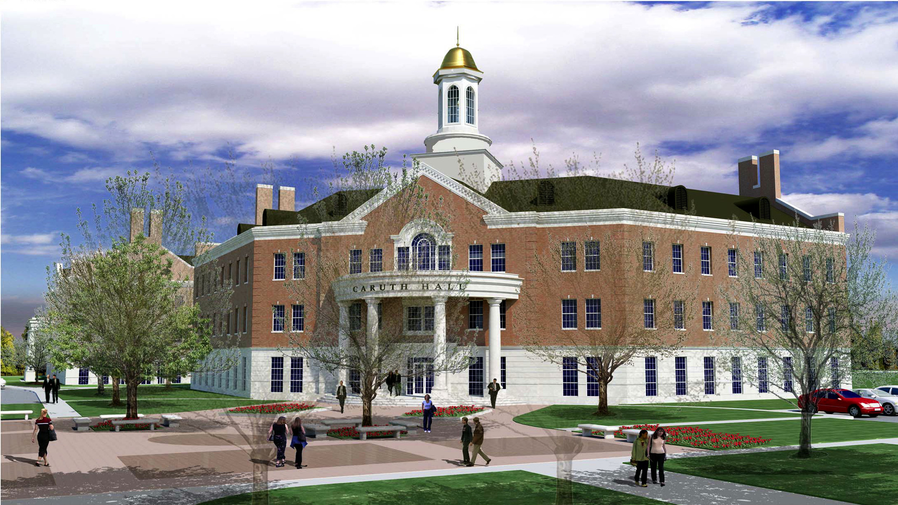
SMU Campus

Slide 74
Two postdoc positions are available
in the CATCO group
1) METHOD DEVELOPMENT project in quantum chemistry, which
requires extensive programming in Fortan and C.
Possible topics: Design and programming of the reaction valley approach
for an implicit or explicit inclusion of solvent effects;
2-­component relativistic methods for the investigation of “relativistic”
systems; new QM/MM methodologies for the description of chemical
reactions in an enzymatic environment.
2) ADVANCED APPLICATIONS including standard quantum
chemical calculations, QM/MM calculations as well as high­-accuracy
calculations with CASPT2, CCSD(T), and MRCC methods including
relativistic effects; working in a HPC environment, scripting.
Possible starting date: September 1st
Please contact Elfi Kraka, ekraka@smu.edu; Dieter Cremer, dcremer@smu.edu

Slide 76
Local vibrational mode analysis as tool for
characterizing H-bonding

Slide 77
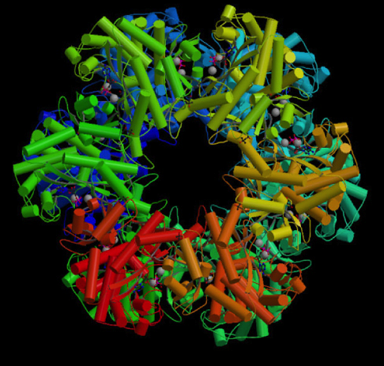
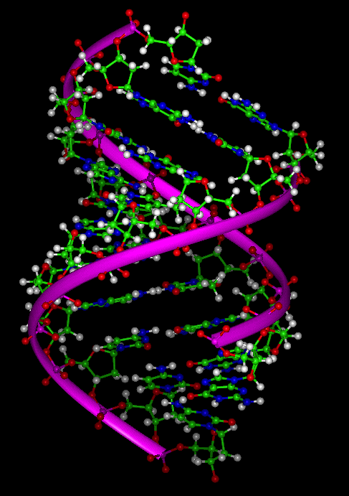
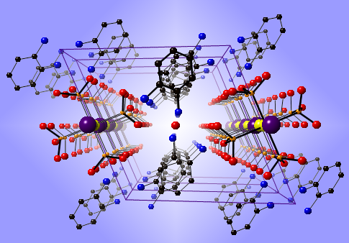
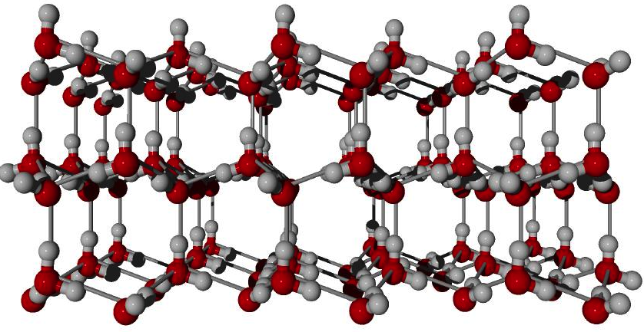
Weak chemical bonds, in particular hydrogen bonds, play an important role in living organisms and for our environment:
  keep complementary strands of DNA together
  participate in enzymatic catalysis
  determine the secondary structure of proteins
  are applied in polymer chemistry, materials
  science, crystal engineering

Slide 78
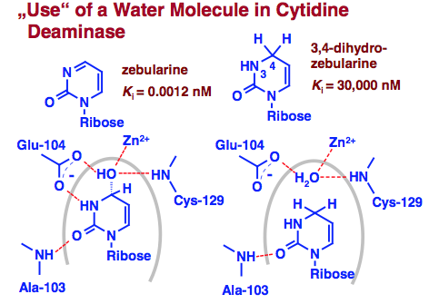
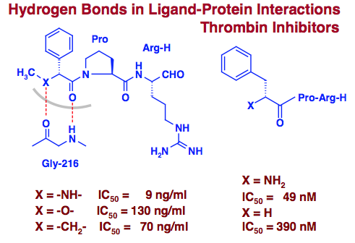
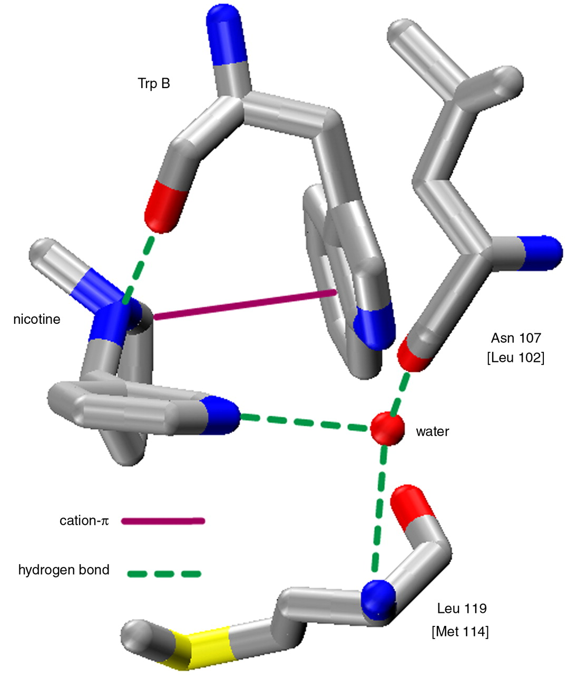
Hydrogen bonds in drug receptor interactions
Lipinski’s rule of five
The molecular weight is less than 500.
The compound's lipophilicity logP is less than 5.
The number of groups in the molecule that can donate hydrogen atoms to hydrogen bonds is less than 5.
The number of groups that can accept hydrogen atoms to form hydrogen bonds is less than 10.
Pharmacophore
Hydrogen bond
Hydrogen bonds strongly influence
the inhibitor constants

Slide 79
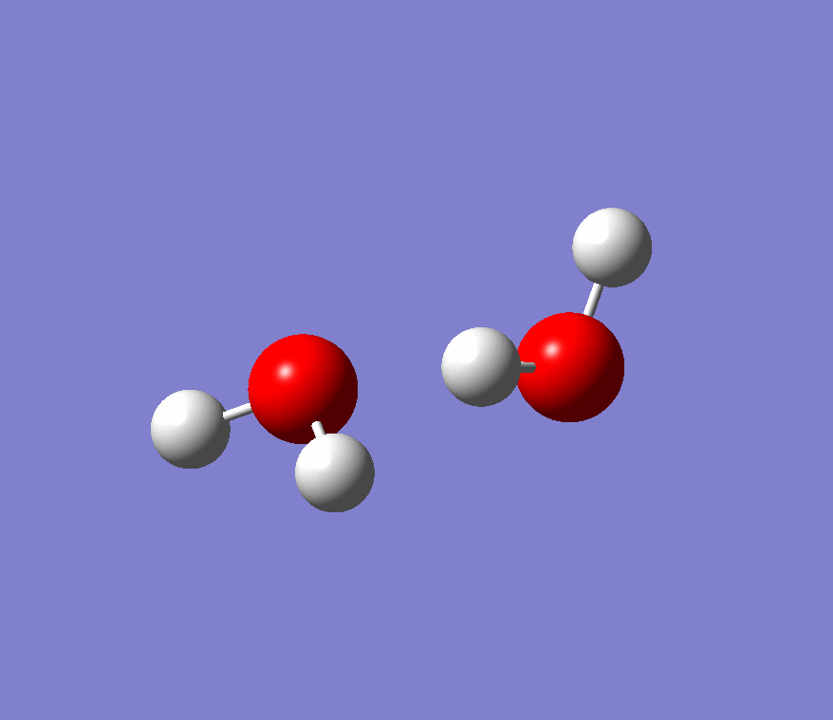
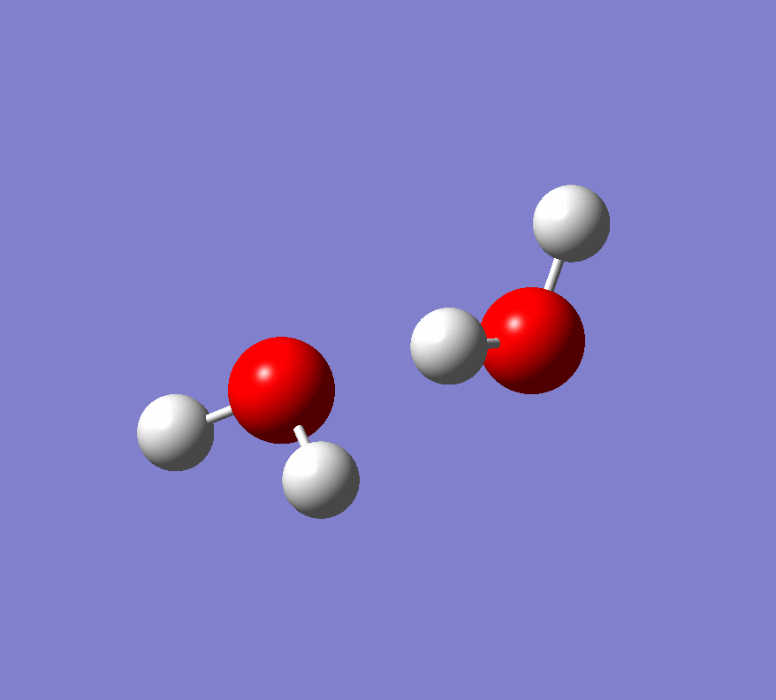


Water dimer
Normal O…H stretching mode
Local O…H stretching mode

Slide 80
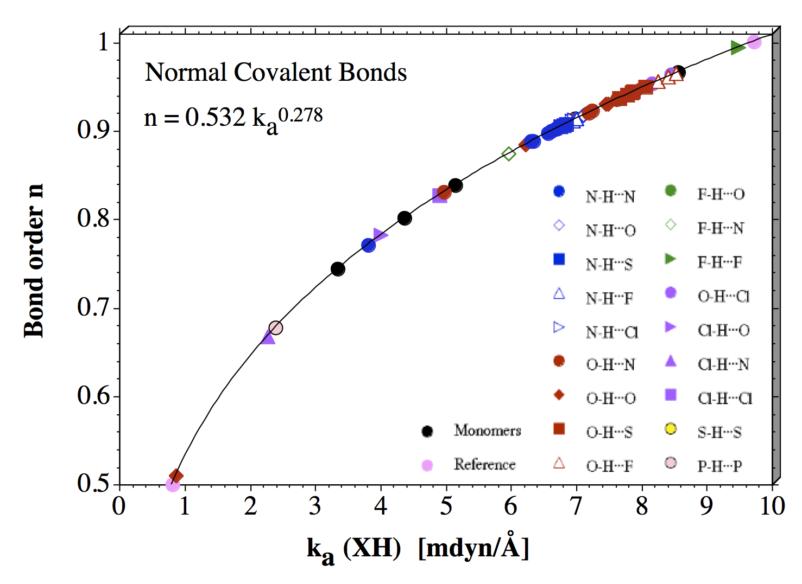
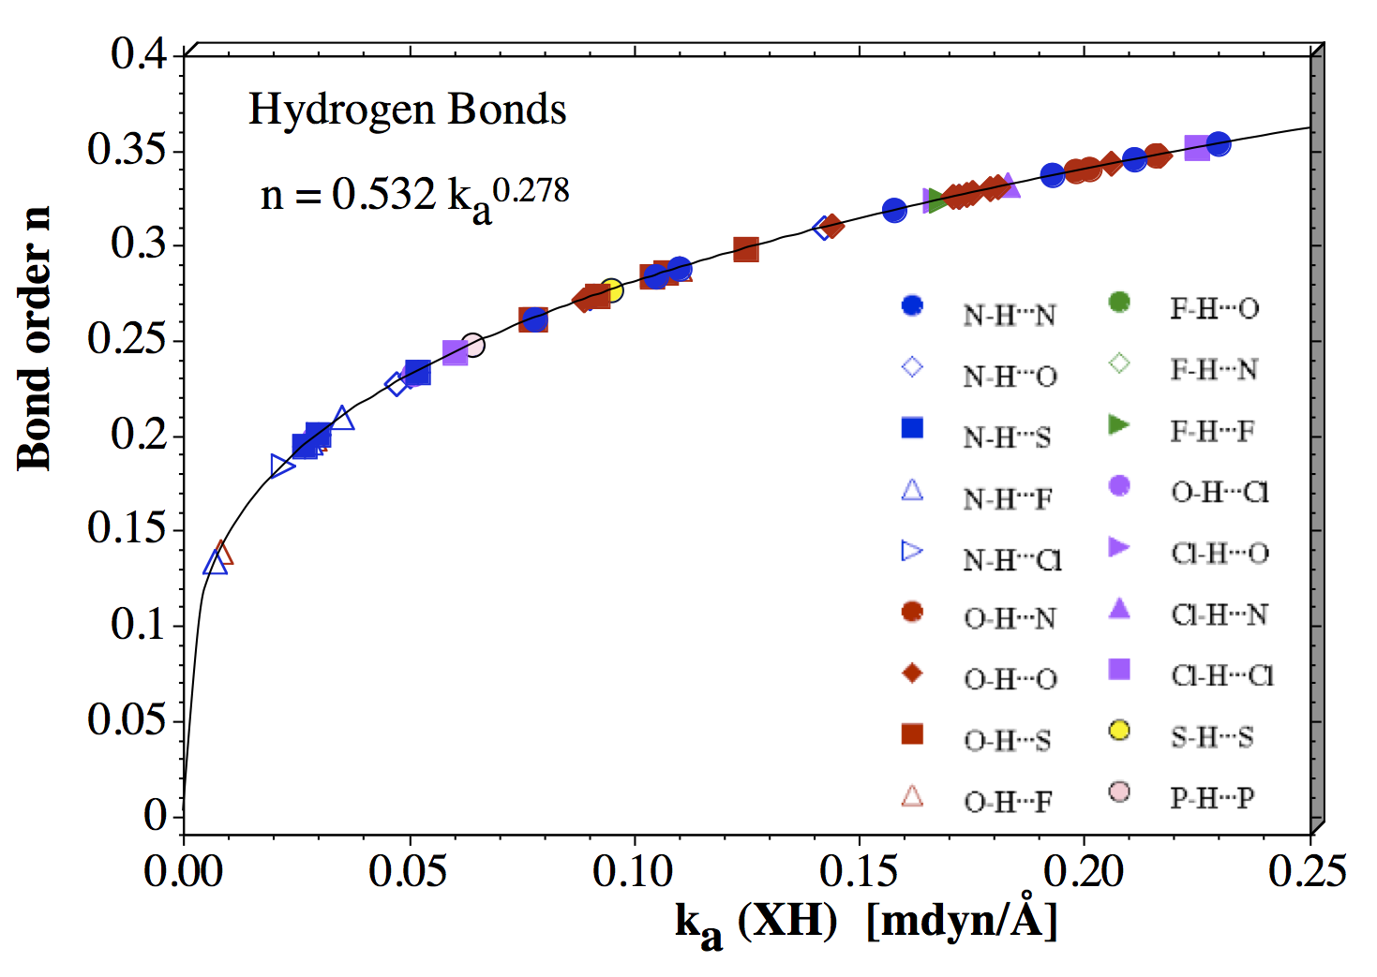
Extension to 70 different D-H bonds and 58 DH…A bonds
(D: hydrogen donor, A: acceptor)
Freindorf, Kraka, Cremer, Int. J. Quant. Chem. 112, 3174-3187 (2012)

Slide 81
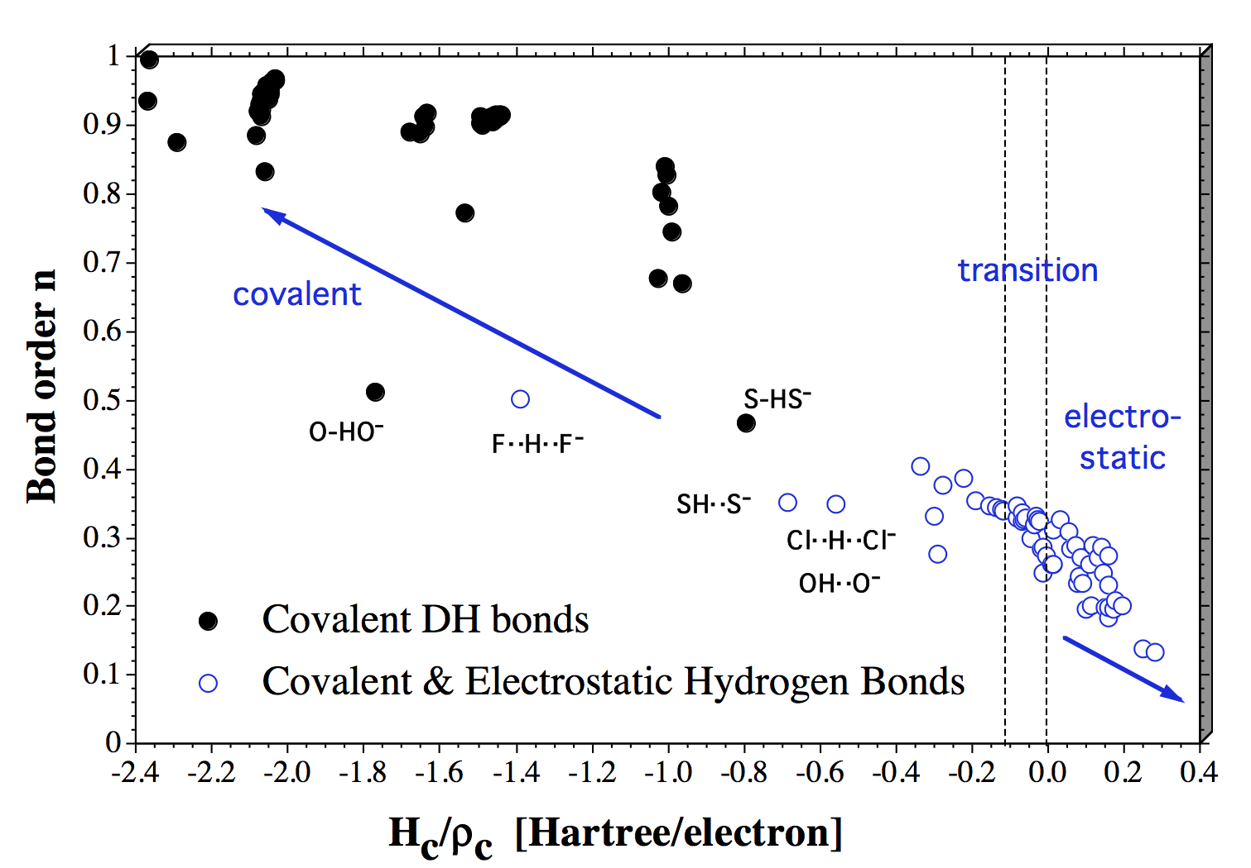
Differentiation between covalent and electrostatic contributions
Cremer-Kraka criterion for covalent bonding: Necessary condition, existence of a bond critical point r_{c}; sufficient condition, energy density H(r_{c}) < 0.
Mini Course VII, …..
Comparison of the bond order n based on local mode stretching force constants
k_{a} with the normalized energy density H(r_{c})/ρ(r_{c})

Slide 82
Local vibrational mode analysis as tool for
chiral distinction

Slide 83

Heterochiral
Homochiral
S,R or R,S
R,R or S,S
A molecule is said to be homochiral if all the molecule's constituent units
are of the same chiral form.

Slide 84
Some facts:
Pharmaceutical agents are usually synthesized from
simple achiral starting materials
chiral drugs are usually obtained as racemate
The human body is chiral
Enantiomers of compounds can react differently in the
body, with desired curing or harmful outcomes

Slide 85

Thalidomide,1960
(Contergan, Kevadon)
(R)
(S)
*
*
Sedative to treat insomnia
as well to reduce nausea
during pregnancy;
synthesized as racemate
Overlooked:
the (R)-enantiomer is the effective desired form
the (S)-enantiomer is teratogenic causing birth defects.

Slide 86
Lock-key models for chiral recognition
in drug design

Slide 88
There are 3 H-bond possibilities in all PO…Gly complexes
HB1: between the oxygen atom of PO and the OH group of Gly (should be the strongest and decisive)
HB2: between the hydrogen atom of the H-CCH₃ group of PO the oxygen of Gly or between one of the methyl hydrogen atoms of PO and the oxygen of Gly
HB3: between one of the CH₂ hydrogen atoms of PO and the oxygen of Gly
PO
Gly

Slide 91
Can CH…π interactions be decisive?
IR-UV double resonance experiments (Zehnacker et al, 2011)
suggest that secondary CH…π interactions may control the molecular recognition
Can our local mode analysis deliver the proof?

Slide 92
There are three interaction possibilities
HB: between the oxygen atom of butanol and the OH group of the chromophore
CH…π: between the π density of ring A of the chromophore and the central HC or one of the central CH₃ hydrogen atoms of butanol
CH…π: between the π density of ring B of the chromophore and one of the terminal CH₃ hydrogen atoms of butanol
(R,S)-trans-2-butanol
Chromophore: (R,S)-2-naphthyl-1-ethanol

Slide 93
Complexes between (R,S)-2-naphthyl-1-ethanol and (R,S)-trans-2-butanol
336
305
275
283
292
157
245
174
decisive CH...π interaction

Slide 94
Not used

Slide 95

Normal vibrational modes of the water dimer: Exp. frequencies
Normal vibrational modes of the water dimer: Exp. frequencies
red: stretches
green: bends
light blue:
torsions
dark blue:
HB stretch
Normal mode vibrations are decomposed into local modes

Slide 96
Bond strength descriptor based on local vibrational modes
Task: Definition of a bond order n based on the local bond stretching
force constants k_{a} associated with local vibrational modes
Strategy
1) The relationship between bond order n and
local mode force constant k_{a} has the form of
a power equation
n = f(k_{a}) = a k_{a}^{b}
2) We need 3 reference points
a) k_{a} = 0 has to lead to n = 0
b) We choose for H-bonding
n = 1 (FH) and n = 0.5 (F…H…F)⁻

Slide 101
SUMMARY
  Weak molecular interactions play a central role in chiral
  recognition
  Exp. detection and identification is best done with
  vibrational spectroscopy; measured (or calculated)
  normal mode frequencies are transformed in local
  mode frequencies
  Local mode frequencies are sensitive to the chiral
  environment; they guide the identification of decisive
  electronic factors for chiral discrimination

Slide 102



The primary molecules of life exist in one specific form even though ordinary chemical reactions produce equal amount of both mirror forms.
Living organisms contain complex enzymes that specifically produce molecules of only one form.
Homochiral biological macromolecules
RNA
DNA
Enzyme

Slide 103
Discrimination of homo- and hetero-chiral systems
Chirodiastaltic energy: ΔE_{chir} = E_{bind}(homo) – E_{bind} (hetero)
Problem: small differences; also ΔE_{chir} is a global
rather than local property
NMR spin-spin coupling constants:
Problem: often not decisive
Vibrational-spectroscopy:
Focus on red (blue) shifts of ν(OH), ν(NH) frequencies
Problem: often not decisive
b) Focus on low frequency modes
Problem: coupling of H-bond stretching mode with other
low frequency modes

