Slide 1
The Intrinsic Strength of the Halogen Bond
Halogen
donor
Halogen
Acceptor
Y-X···A
~180°
Elfi Kraka, Vytor Oliveira, and Dieter Cremer
Computational And Theoretical Chemistry
GrOup (CATCO) http://smu.edu/catco/
Department of Chemistry, SMU, Dallas, USA
Notes:
This is my opening slide. I have to check what else it should conmtain

Slide 2
Outline
Part – 1 Introduction
What is Halogen Bonding (XB)
Relevance
Objectives
Part – 2 Methods
Tools to Access the Nature of XB
Local Modes
Part – 3 Selected Results
XB Mechanism and Nature of the Interaction
Dihalogens and Interhalogens
XB vs Other Non-covalent Interactions
Local Stretching Force Constants and Other Quantities
Part – 4 Conclusion and Overview
Notes:
The presentation was organized in four parts: 1) First I will give a short introduction on halogen bonding, discussing its unique features, applications, point out what was not done yet and how theoretical chemistry can help. 2) In the second part I will explain the computational methods that were used, and why this methods were suitable for the present research 3)In the third part, I will give a brief explanation about the halogen bonding mechanism, and based on this explanation I will show how can we rationalize (predict) the halogen bond strength of several different systems, the halogen bond will be compared to other non-covalent interactions and at the end of this part I will show how proprieties such as bond distances and binding energies correlate with the intrinsic strength of the halogen bond given by the local stretching force constant.

Slide 3
Outline
Part – 1 Introduction
What is Halogen Bonding (XB)
Relevance
Objectives
Part – 2 Methods
Tools to Access the Nature of XB
Local Modes
Part – 3 Selected Results
XB Mechanism and Nature of the Interaction
Dihalogens and Interhalogens
XB vs Other Non-covalent Interactions
Local Stretching Force Constants and Other Quantities
Part – 4 Conclusion and Overview

Slide 4
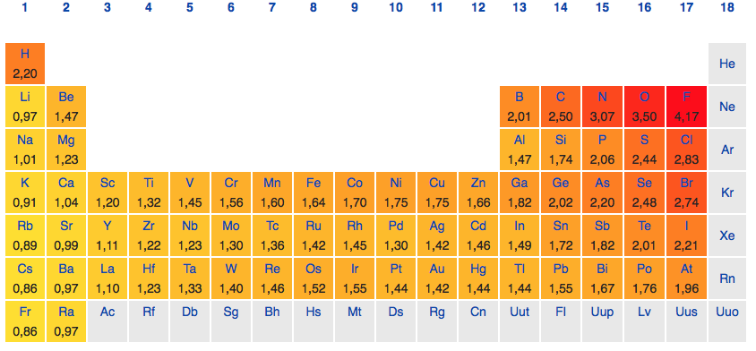
What is Halogen Bonding (XB)
Halogens
Periodic table colored according to Allred-Rochow electronegativity scale
Notes:
The halogens are; fluorine, chlorine, bromine, iodine, astatine and as you can see from this period table colored according to the electronegativity, the halogens are among the most electronegative elements.

Slide 5
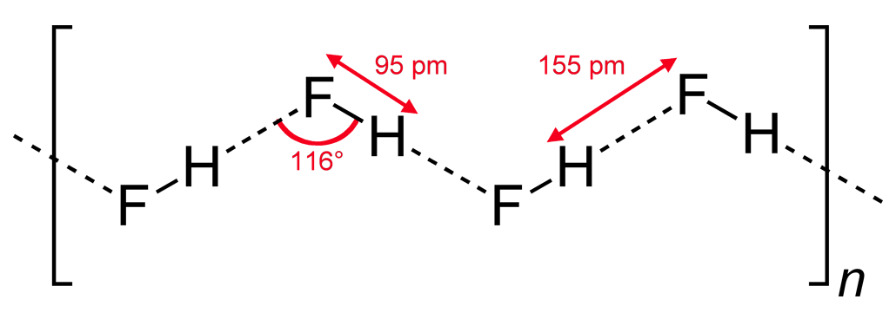
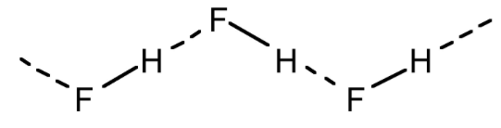
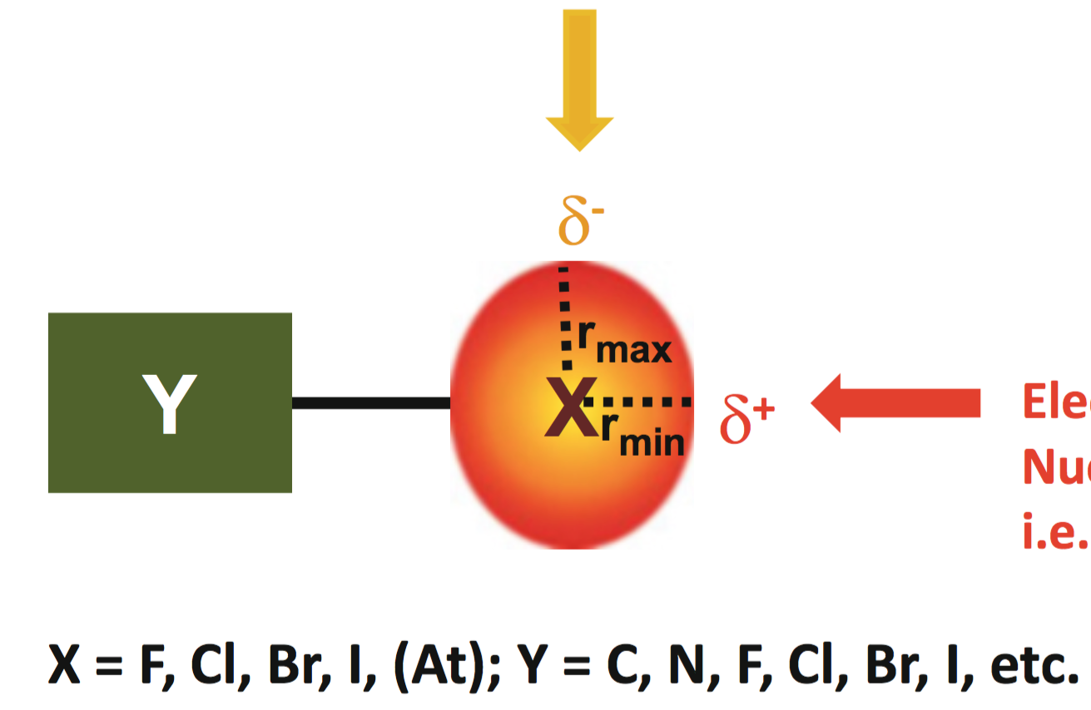
What is Halogen Bonding (XB)
Hydrogen bonding in hydrogen fluoride chain
A singly bonded halogen (Y-X) has an anisotropic electron density distribution:
In the σ direction, the electron density is tightly bonded to the nucleus leading to the formation of a positive electrostatic potential
In the π direction, a belt of negative potential is formed and the halogen can act as a nucleophile
Lewis acid
Halogen bonding
Lewis base
Notes:
In covalently bonded halogen atoms, the effective atomic radius along the extended Y􏰀X bond axis is smaller than in the direction perpendicular to this axis, and a region of positive electrostatic potential is present along the covalent bond, in this direction the halogen act as a electrophile and can interact with a Lewis base, this is what is called halogen bond perpendicular to this YX bond the halogen can act as a nuclephile and make for example Hydrogen bond.
Any halogen can form halogen bonds, however fluorine requires a strong electronegative Y.
When a halogen forms a covalent bond its electron density distribution in the direction of the sigma bond becomes more tight to the nucleous and in the π direction the density increases. This anisotropic electron distribution allows the halogen to interact in the pi direction with a lewis acid, to form for example, a hydrogen bond as shown in this Hydrogen fluoride chain and in the sigma direction the halogen can interact with a Lewis base. It is this later, interaction that is called halogen bonding.
Any halogen can form halogen bonds, however fluorine requires a strong electronegative Y.

Slide 6
What is Halogen Bonding (XB)
Halogen
donor
Halogen
Acceptor
Colin 1814
-First halogen bond
Y-X···A
Guthrie 1863
- Pure form of I₂···NH₃
~180°
Y = Group covalently bound to X
A = Hetero atom, π-systems or anion
Highly directional
Easily tunable
X···A is shorter than the sum of the van der Waals radii
Mulliken 1952
- Electron donor-acceptor model
Hassel noble lecture (1970)
1,4-dioxane and bromine
Notes:
Halogen bond tend to form a linear interaction. As a conventioned by IUPAC in 2013 we call the halogen X the atom or group covalent bond to it as Y and the lewis base or halogen acceptor we denote by A. A can be a heteroatom, pi-system or anion. Halogen bond has several unique properties due to it high directionality, it tunability, the strength of the interaction changes significantly by changing any of it components . Similar to hydrogen bond, the interaction is shorter than the sum of the vdw radii of the atoms involved. The first halogen bonded adduct was described by Collins 200 years ago, 50 years after that Guthrie obtained it in a pure form and proposed the correct structure. 100 later Mulliken did a big step in the understanding of this interaction with his electron donor-acceptor model. Hassel in the 70 enphasided
According to the IUPAC deffinition
Halogen bonding comprise of a halogen donor part where Y can be any atom or molecule covalently bond to the halogen X and a halogen acceptor (A), which can be a hetero atom with avaliable lone pairs, a pi-systems or an anion. Halogen bond has some unique characteristics. For example: it is has strong tendency to form a linear interaction, and tend to be more linear than H-Bond; Easily tunable: halogen bond binding energies are known to vary significantly by changing the halogen, the donor or the acceptor; Hydrophobic; halogens are commonly used in drug to increase their lipophilicity. Halogen bonds are usually shorter than the sum of the van der waals radii of the atoms involved. From this property researchers could scan for halogen bonds on crystallography data bases, such as the PDB and the Cambridge Structural Database, And they found that halogen bond are quite common. Halogen bonding is not something new. 200 years ago Colins, while work on Gay Lusack lab, noticed the formation of a liquid of metalic luster upon reaction of dry iodine and dry gaseous ammonia. 50 years later Guthrie obtained the pure of the compound by adding powdered iodine to liquid ammoniahe was the first to propose I2···NH3 structure. An important step to understand the nature of the interaction was done, 100 years later with the electron donor-acceptor interactions, proposed by Mulliken, Where ammonia would be the electron donor and iodine the electron acceptor. Odd Hassel studied the structure of several halogen bonded crystals.
A halogen bond occurs when there is evidence of a net attractive interaction between an electrophilic region associated with a halogen atom in a molecular entity and a nucleophilic region in another, or the same, molecular entity
A typical halogen bond is denoted by the three dots in R–X Y. R–X is the halogen bond donor, X is any halogen atom with an electrophilic (electron-poor) region, and R is a group (see p. 1118 in ref. [1]) covalently bound to X. In some cases, X may be covalently bound to more than one group (see p. 1118 in ref. [1]). It may also form more than one halogen bond. Y is the halogen bond acceptor and is typically a molecular entity (see p. 1142 in ref. [1]) possessing at least one nucleophilic (electron- rich) region. Some common halogen bond donors and acceptors are itemized below.

Slide 7
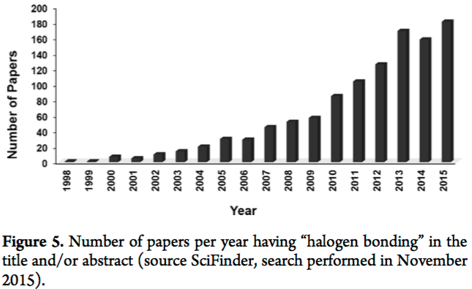


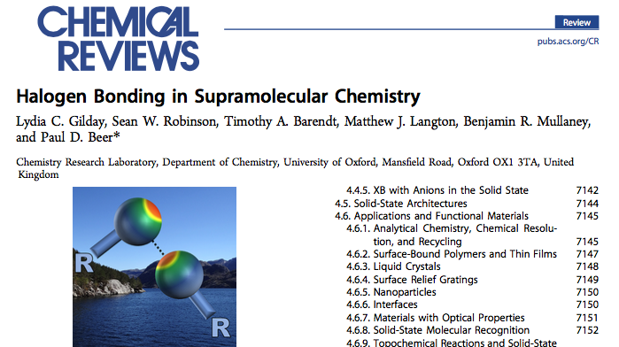

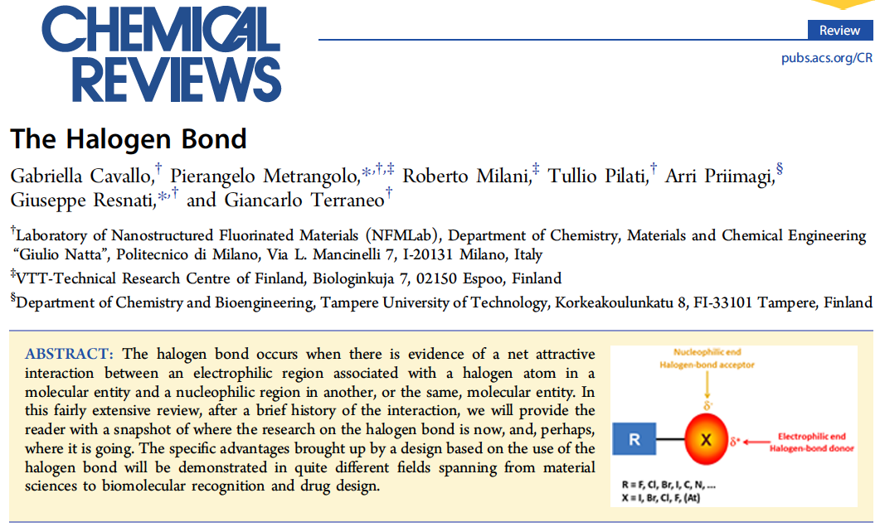

Relevance
2015
2016
Notes:
The term halogen bonding was established in the late 90s. Since then the number of papers about halogen bonding increased in a fast rate. And nowadays it is a hot topic, just last year 2 books and a major chemical review about halogen bonding was published. This year started with another major review. Also this year the second symposium on halogen bonding will take place on Sweden.

Slide 8
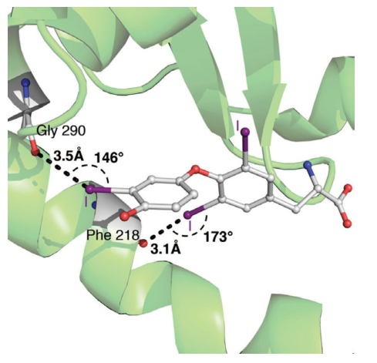
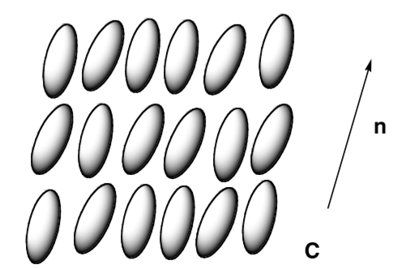
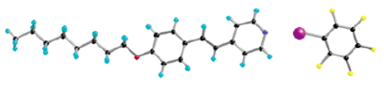
Relevance
Halogen bond can be used to direct self-assembly phenomena
T3 is recognized by the thyroid hormone receptor via halogen bonding.
Notes:
the increasingly interest in halogen bond was triggered by the discovery that halogen bonds can effectively be used as a tools to direct and control molecular assembly phenomena. Halogen bond was also found to be important in biosystems, for example, the recognition of triiodothyronine T3 by its receptor occur via halogen bonding between iodine and carbonyl oxygen.

Slide 9
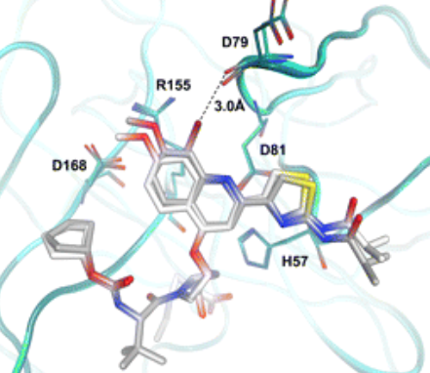
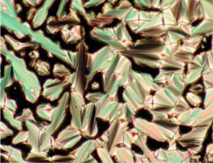
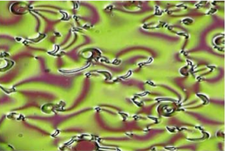
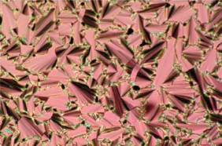
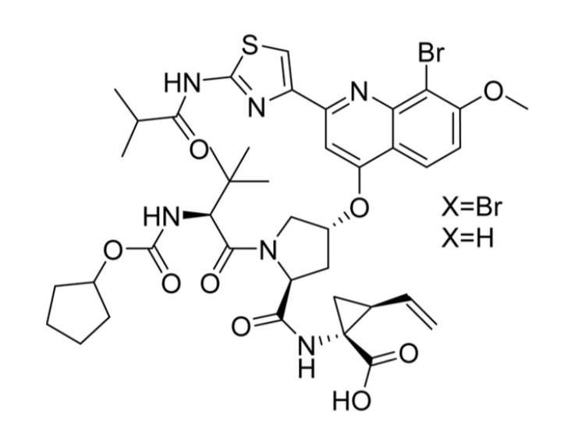
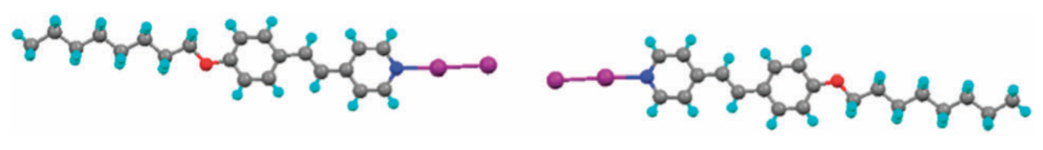
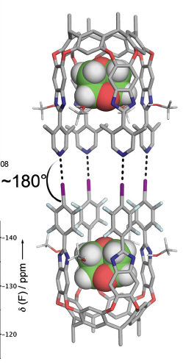
New Materials Based on XB
XB Drugs
XB liquid crystals
Drug based on XB for hepatitis C virus
Crystal Engineering
New building blocks based on XB
Halogen Bonding in Solution
Anion transporters/sensors
Catalysis
First 4 point molecular capsule based on XB
Notes:
Nowadays we have already a drug designed based on halogen bonding for hepaitis C virus in phase 3, we have molecular capsules held by halogen bonds, which can be used for drug delivery, several different liquid crystals phases were developed by Bruce. In crystal engineering we have material with unique physical properties and they are interested in finding new build block that lead to self-assembly, in solution we have anion sensors and transporters and halogen bond also has application in catalysis.
------------------------------------------------------------
There are several other biomolecules where halogen bonding play a key role, and now, drugs are been developed, using halogens not just to increase the lipophilicity of the drug but also to increase the binding affinity of the drug to the receptor. The first drug developed based on halogen bonding is on phase 3 of development. Halogen bonds finds applications in the development of molecular compartment for drug delivery, here is a molecular capsule based on 4 halogen bonds, inside of this capsule 1,4-dioxinane guest molecules. Several different liquid crystal phases were obtained by Bruce and co-workers based on halogen bonding interactions. An active area of research is to find new halogenated molecules that can efficiently lead to self-assembly. There are also many studies of halogen bonding applications for anion sensing and transport and catalysis.
---------------------------------------------
The halogen bonding can be exploited in areas such as supramolecular chemistry, crystal engineering and drug design
Very potent and selective inhibitor of genotype1 NS3
On phase III Clinical trials
Examples of material been developed using halogen bonds are drugs where the halogen has not only a
Halogens in drug design:
Around 50% of molecules applied in high-throughput screening are halogenated
Around 25% of the market-leading drugs by revenue also contain halogens
Until recently halogens were used mostly as lipophilic moieties incorporated in the drugs to enhance membrane permeability
halogenated
molecules represent a large proportion of pharmacological compounds clinically
used or in clinical trials, and incorporated into screening libraries to search for lead
compounds as potential inhibitors against therapeutically important targets
Halogenated molecules represent a large portion of pharmacological compounds
Sma liquid crystal
halogenated
molecules represent a large proportion of pharmacological compounds clinically
used or in clinical trials, and incorporated into screening libraries to search for lead
compounds as potential inhibitors against therapeutically important targets
Halogenated molecules represent a large portion of pharmacological compounds

Slide 10
Motivation
What is missing in the study of XB?
⦁ A Quantitative assessment of the XB strength
⧿ ∆E, r(XA) can provide only a qualitative insight
⦁ A detailed study on the nature of the XB
⧿ How covalent it can be
⦁ An accurate and ample study
⧿ DFT fails to describe dispersion
⧿ MP2 tends to overbind non-covalent complexes
1
2
3
Notes:
Although advanced material have been developed, until now there is no quantitative assessment of the strength of the XB, most quantities used can give only some limited qualitative description which does not reflect the intrinsic strength of the bond. Also there is no consensus in what extent can this bond be considered as electrostatic and when covalent contributions may play an important role. Another problem is that most methods used to describe this interaction may not be accurate enough for example DFT does not describe dispersion well and MP2 is known to tend to overbind non-covalent interactions.
Although advanced material based on halogen bonds have been made recently, there are some gaps on the understanding of the strength and nature of this interactions, which comes from the fact that: No quantitative assessment of the halogen bond intrinsic strength was done yet. Most studies assumes that quantities such as binding energies can describe the strength of a bond. However binding energy is cumulative property and are not ideal bond strength descriptors. The halogen bond nature is still disputable in the sense that some researcher consider its strengthen and directionality to be electrostatically driven interaction while others researcher consider covalent contribution to be the key contribution. Besides of that most computational studies on halogen bonding were done with inaccurate methods, such as DFT and MP2. It is well known that DFT struggles to describe dispersion, even when dispersion corrections are included the problem is only minimized but not solved. MP2 methods tend to overestimate the binding energy of non-covalent bonds.
Some basic studies could help to the rational design of halogen bonded polymers or drugs
Maybe one of the biggest gaps in the theoretical studies of halogen bond is that there is no quantity until now
That could measure the intrinsinc strength of the halogen bond,
By understanding the intrinsinc strength of halogen bonding we could optimize
It would also be possible to understand the cooperativity or competitivity between non-covalent interactions
Another deficiency in the theoretical exploration of halogen bonds the few studies done at high computational level
Are mostly done to bench mark low accuracy methods and
Even for small systems where high accuracy calculations are applicable, most studies were done
At low accuracy level such as MP2 or DFT, these methods can at best give qualitative correct results,
Since halogen bond deals with electronegative atoms and weak dispersive interaction this methods may fail even qualitatively

Slide 11
Objectives
We calculate and analyze for the first time, the intrinsic strength of the halogen bond by combining high accuracy CCSD(T) calculations and vibrational spectroscopy to answer the following questions:
How strong can XB be? Is XB stronger or weaker than other non-covalent interactions?
On what properties does the strength of the halogen bond depend?
In which situations is it dominated by electrostatic and in which do covalent contributions play an essential role in halogen bonding?
How does a negative charge change halogen bonding?
How different XB properties commonly used in the literature reflect the strength of the XB?
Notes:
To fill these gaps we decided to employ, for the first time, high accuracy CCSD(T) calculation to explore the nature of the halogen bond and also to measure its intrinsic strength. Our study focused on the following question: 1) How strong halogen bond can be, and is it stronger or weaker than hydrogen bond, pnicogen bond or chalcogen bond. 2) What properties halogen bond strength depend 3) is halogen bonding essentially electrostatic or covalent and in what occasions one contribution may overcome the other. 4) We looked the strength of anionic and neutral halogen bonded complexes 5) And we compared the intrinsic strength given by the local stretching force constant with other properties, experimentally or theoretically.

Slide 12
Outline
Part – 1 Introduction
What is Halogen Bonding (XB)
Relevance
Objectives
Part – 2 Methods
Tools to Access the Nature of XB
Local Vibrational Modes
Part – 3 Selected Results
XB Mechanism and Nature of the Interaction
Dihalogens and Interhalogens
XB vs Other Non-covalent Interactions
Local Stretching Force Constants and Other Quantities
Part – 4 Conclusion and Overview
Notes:
Now I am going to explain what theoretical tools we used, and why they are suitable to answer those questions:

Slide 13
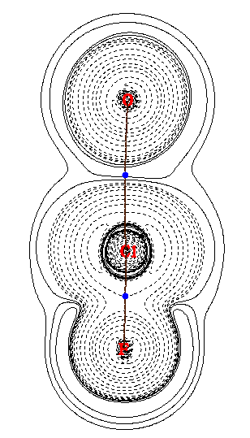
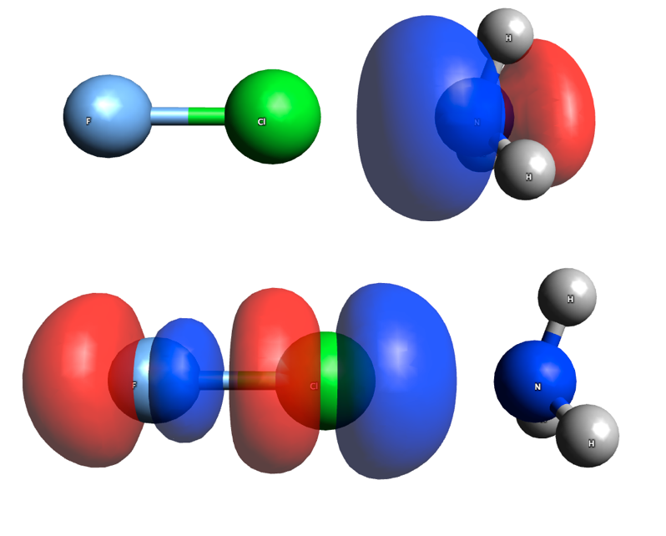
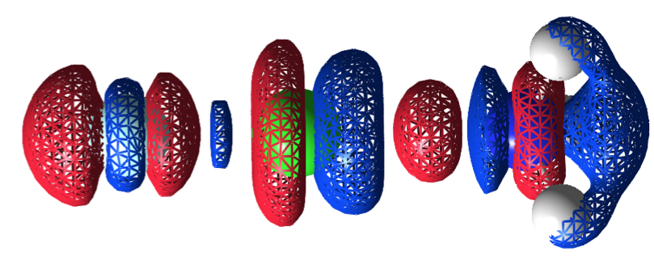
Tools to Access the Nature of XB
Electron Difference
Density Distribution (∆ρ)
Energy density distribution
Natural Bond Orbitals
Lp(N)
F-Cl···OH₂
Critical
point
FCl···NH₃
H(r) = G(r) + V(r)
Cremer-Kraka criteria
(sufficient condition)
H_{b} < 0 covalent
H_{b} > 0 electrostatic
σ*(FCl)
Red – electron
density increase
Blue – electron
density decrease
lp (A) → σ*(RX)
Partial atomic charges
Charge transfer
∆ρ(r) = ρ(Complex, r) − ρ(Monomer1, r) − ρ(Monomer2, r)
Notes:
Electron difference density distribution is given by subtracting the density of the halogen bond complex by the density of its monomers. Blue part show a decrease in electron density upon the formation of the complex, while red part show an increase, by this we can have a qualitative picture of charge transfer and polarization. The nature of the interaction can be accessed from the energy density distribution. This contour plot shows the energy density for the halogen bond between water and Chlorine monofluoride dashed lines show negative, therefore stabilizing energy density and solid lines are positive destabilizing values. According to Cremer-Kraka criteria for covalent bond there most be an electron density path connecting the atoms as we see here and if the energy density at the critical point of this path, is positive we can say that the bond is electrostatic because the local kinetic energy (G) which is positive overcomes the potential (V) which is negative. In a covalent bond here you can see that the energy density in the critical point is negative. From natural bond orbital analysis we can derived localized orbital like lone pairs, bonding and antibonding orbital useful to rationalize electron delocalization effects. We can also obtain atomic charges, from them calculate charge transfer.

Slide 14
XB Strength From Vibrational Spectroscopy
Vibrational spectroscopy provides a way to probe the intrinsic strength of a bond without breaking or even changing it!
Via the force constant of a stretching vibration:
The force constant gives the curvature of the PES
In polyatomic molecules the normal vibrational modes are delocalized, due to vibrational coupling including both the kinetic (T) and potential (V) energy contributions.
PES for a diatomic molecule:
Stronger bond
AB
A----B
weaker bond
A-B
Notes:
To probe the strength of the bond we used vibrational spectroscopy. From the vibrations it is possible to probe the strength of a bond without breaking it. We do this by calculating the force constant of the stretching vibration. The force constant give the curvature of the potential energy surface. For example in a diatomic molecule the
We get a Morse curve, a large force constant would mean a stronger curvature thereby a stronger bond, otherwise a flat surface indicate a weak bond. The problem is that for polyatomic molecules we can no longer speak of a local stretching vibration involving only 2 atoms, normal vibrations are delocalized and involve the entire framework of the molecule. To solve this problem we have to eliminate both potential and kinetic energy contributions that lead to vibrational mode coupling.
-------------------------------------
The intrinsic strength of the halogen bond was obtained from vibrational spectroscopy, more specifically from the stretching force constant of the halogen bonding. You may ask why vibrational modes? And the answer is: We can probe the strength of a bond without breaking it or even changing it electronic structure. How? From the stretching force constant of the halogen bonding. This is not as simple as it seems, you cannot just take of an infra-red spectrum. What we get from an IR spectrum are vibrational modes that involves the entire framework of the molecule. Therefore they are delocalized, To solve this problem and obtain local vibrational modes we, first have to get rid of kinetic and potential coupling among vibrations.
---------------
You may ask, Vytor what do you mean by the strength of the halogen bonding given by the local force constant?
However this is not what we usually get from an IR spectrum, generally we get vibrational modes that involve the entire framework of the molecule and not just
The bond we what to see

Slide 15
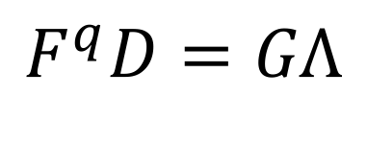

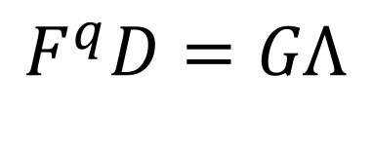

Vibrational Modes Theory
General Vibrational Equation:
Normal vibrational frequencies (cm⁻¹)
Solve the vibrational equation by diagonalization of F^{q} matrix
Potential energy coupling among normal vibrations is eliminated
Kinetic coupling on G matrix remain, therefore these modes are not local!
How can we eliminate kinetic energy coupling among vibrations?
Diagonal matrix of
Eigenvalues (λ_{μ})
Force constant
in Internal coordinates q
Collection of eigenvectors (d_{μ})
Wilson kinetic matrix
$$ω^{2}=\frac{λ_{μ}}{4π^{2}c^{2}}$$
Notes:
Potential coupling is eliminated by solving the general vibrational equation, which is an eingenvalue-eingenvector problem that we solve by diagonalizing the force constant matrix F given in terms of internal coordinates q. The problem is that kinetic coupling remains on the G matrix.

Slide 16
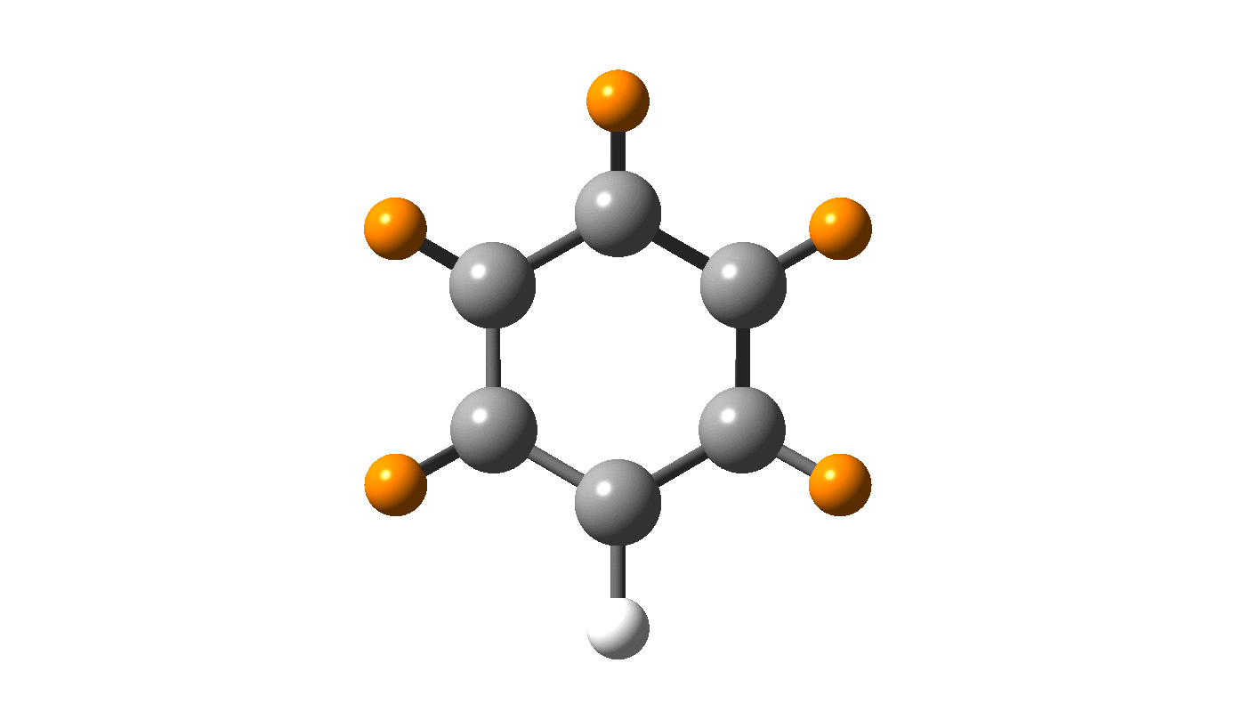
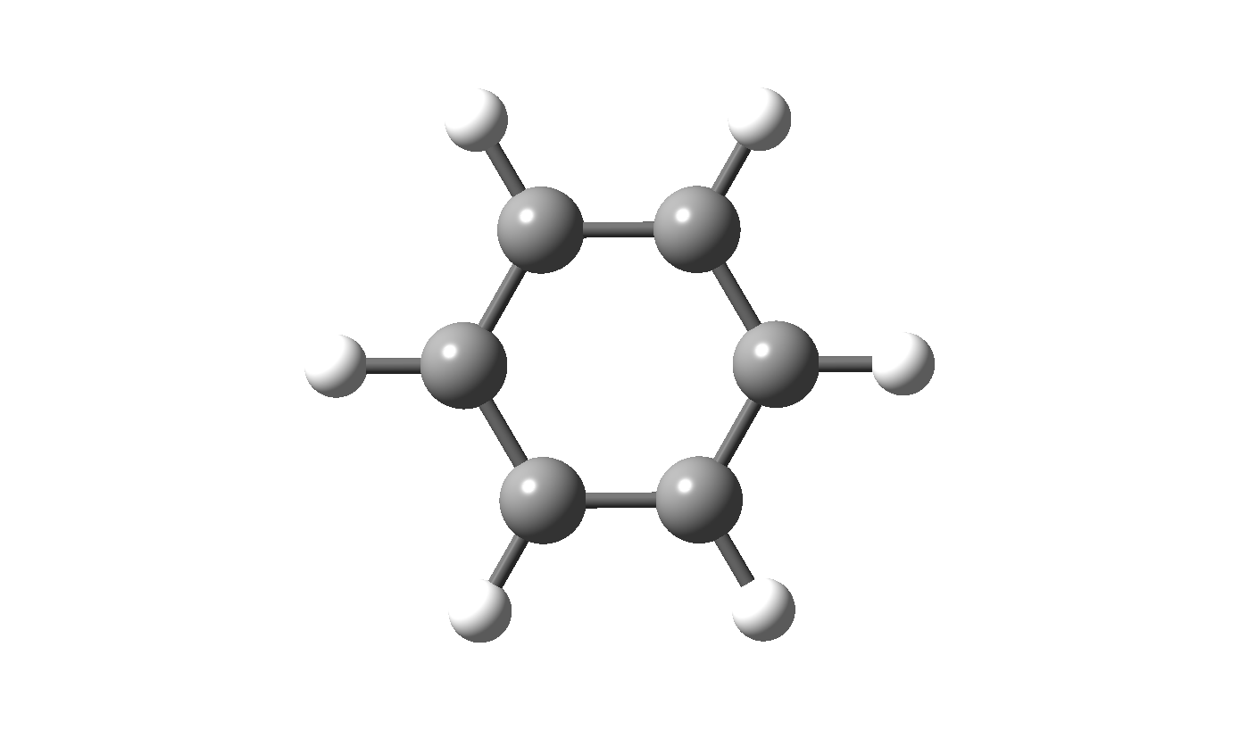
Experimental Localized Vibrations
McKean could obtain close to local C-H stretching vibrations by exploiting the large mass difference between H and D.
Substituting all Hs for Ds but one H
Of limited applicability
Close to local C-H vibration
Notes:
Experimentally McKean could circumvent this problem for the stretching of C-H in hydrocarbons by substituting all hydrogen by deuterium and exploiting the large mass difference between Hs and Deuterium leading to the separation of CH frequencies from CD, the result is close to a localized C-H stretching frequency. However, this is not of general applicability, once the mas ration between the heavy atoms and their isotopomers are not as expressive as in the case of deuterium.

Slide 17
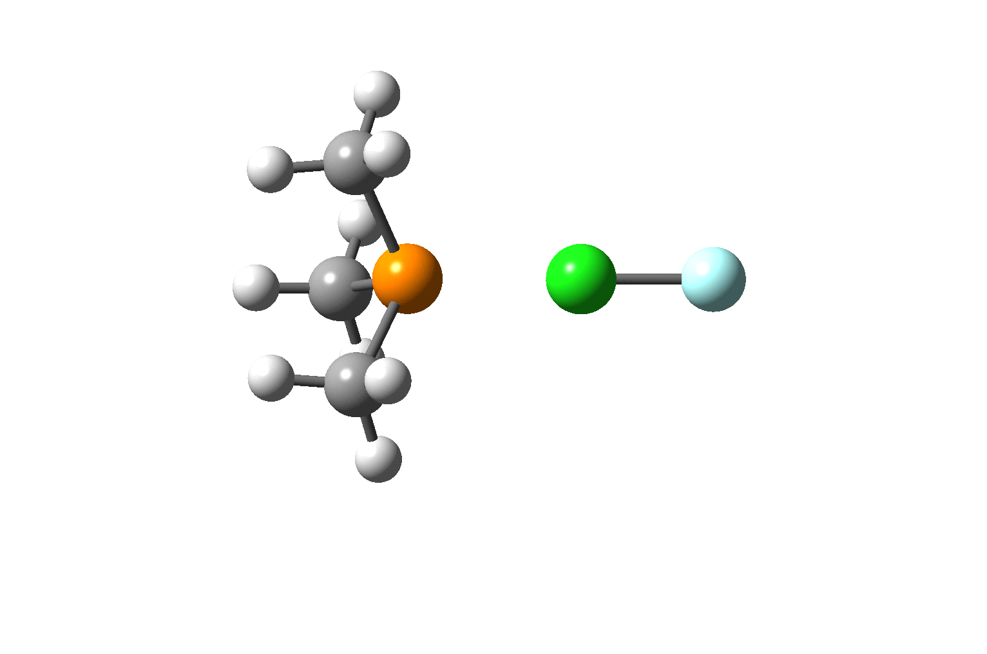
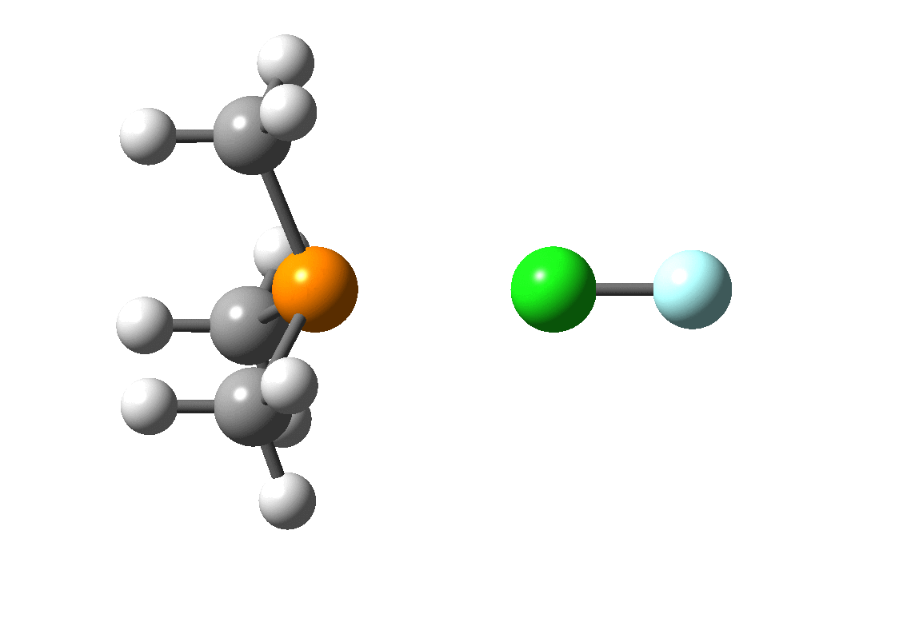
Local Vibrational Modes
Konkoli and Cremer:
NORMAL stretching :
Mass decoupled Euler-Lagrange equations
Mass decoupled vibrational equations
LOCAL stretching :
Local modes and their associated local frequencies (ωª)
local force constant (kª)
Zou and Cremer showed that these local modes are the only local equivalent of the normal modes
Notes:
A general way to obtain local vibrational modes were obtained by Konkoli and Cremer. To get rid of kinetic (or mass) coupling, they step back to the Euler-Lagrange equation used to derive the general vibrational equation and by using mass decoupled Euler-Lagrange equation they obtained mass decoupled vibrational equation which are free from any coupling mechanism. The difference between normal and local stretching mode is illustrated for the halogen bond between chlorine mono fluoride and trimethyl phosphine.
-----------------
Konkoli and Cremer solved the problem theoretically by going back to the Euler-Lagrange

Slide 18
Relative Bond Strength Order
To facilitate the analysis and interpretation of the local mode stretching force constants a power equation can be used to derive a bond strength order (BSO):
Ref. F-F Bond in | n | kª (mdyn/Å)
F₂ | 1.0 | 4.700
F₃⁻ | 0.5 | 1.376
 | 0.0 | 0.000
Strong
BSO n = 0.418(kª)^{0.564}
Weak
a
b
Notes:
According to general Badger rule we can obtain relative bond strength order by taking the force stretching force constant of two bonds of well known bond order and assuming a zero force constant for a zero bond order. In this case we took the single bond in fluorine and the bond of half bond order in the trifluorine ion. The bonds strength order was obtained from this equation. To order the halogen bond according to their strength we plotted the BSO versus the local stretching force constant.
Halogen bond with BSO smaller than 0.2 was considered to be weak and the ones with BSO higher than 0.3 to be strong.
--------------------------------------------------------------------------------------------------------
From the local stretching force constant of the bond of two molecules, in this case fluorine single bond and bond in the triflurine ion which have a half bond order. order and assuming a zero force constant for a zero bond order we can derive a power equation, which allow us to obtain the bond strength order from the force constant. This is useful to order the halogen bonds according to their strength here we can see
From the local stretching force constants we can obtain bond strength orders according to the general Badger rule we can set a power equation and by using the force constant of two molecules of well known bond order: In our case F2 with bond order =1 and trifluoride with bond order of 0.5 and assuming a zero bond order for a zero force constant. We obtain this equation: By plotting the Bond strength vs the stretching force constant for all molecules we obtain this plot Halogen bonds of bond strength order inferior to 0.2 where considered weak bonds, Between 0.2 and 0.3 normal halogen bonds and higher than 0.3 strong halogen bonds.

Slide 19
Is CCSD(T) Necessary ?
% Deviation of the halogen bond distance:
Computational cost:
DFT M³
MP2, DH M⁵
CCSD(T) M⁷
aug-cc-pVTZ:
Each H has 23 b.f
Each C, N, O, F has 46 b.f
FCl···PF₃ has 284 b.f
 | F₃⁻ | FCl···NFH₂ | FCl···NH₃ | FCl···NH₂CH₃
B3LYP | - | 4 | 2 | -1
ωB97XB | 2 | 1 | 1 | -1
M06-2X | 4 | -2 | 0 | 0
MP2 | 1 | 5 | 4 | 4
B2PLYPD | -1 | 5 | 3 | 1
mPW2PLYPD | 0 | 4 | 3 | 1
Reference (Å):
CCSD(T) | 1.739 | 2.400 | 2.320 | 2.193
M = # of basis functions (b.f)
% Deviation of the local force constant:
 | F₃⁻ | FCl···NFH₂ | FCl···NH₃ | FCl···NH₂CH₃
B3LYP | - | -65 | -44 | -13
ωB97XB | 28 | -20 | -4 | 0
M06-2X | 70 | 31 | 23 | 0
MP2 | -45 | -23 | -30 | -41
B2PLYPD | 3 | -71 | -54 | -27
mPW2PLYPD | 2 | -60 | -45 | -21
Reference [mdyn/Å]:
CCSD(T) | 1.376 | 0.197 | 0.311 | 0.497
CCSD(T) allow us to:
Do quantitative Comparisons
Work with a more diversified
set of systems
Notes:
The computational cost of coupled cluster scales to the seventh power of the number of basis functions, which means that any increase in the number of atoms of my system leads to a huge increase in the computational cost. Therefore an important question is do I really need coupled cluster? Here is a comparison of just 4 molecules, geometries are not a big problem all methods did ok. However, the deviations in the force constants are quite high.
CCSD(T) ALLOW US TO HAVE

Slide 20
Summary
Halogen-bonded Complexes Studied
High accurate
CCSD(T)/aug-cc-pVTZ
Was used to compute:
Local stretching force constant (kª)
Energy density
NBO charges
Of 45 complexes
136 other complexes were calculated at DFT level
Notes:
In summary we applied high accuracy coupled cluster calculations to compute local stretching force constant, obtained from these the bond strength orders, we look into the energy densities to see the covalent character and we did an nbo analysis for this 45 complexes.

Slide 21
Outline
Part – 1 Introduction
What is Halogen Bonding (XB)
Relevance
Objectives
Part – 2 Methods
Tools to Access the Nature of XB
Local Modes
Part – 3 Selected Results
XB Mechanism and Nature of the Interaction
Dihalogens and Interhalogens
XB vs Other Non-covalent Interactions
Local Stretching Force Constants and Other Quantities
Part – 4 Conclusion and Overview
Notes:
Now let’s talk about the halogen bonding mechanism, how it can be used to rationalize and predict trends in the strength of the halogen bonds
And them discuss the results

Slide 22
The Nature of the XB
H_{b} > 0 (destabilizing)
Electrostatic nature
H_{b} < 0 (stabilizing)
Covalent nature
Covalent
Halogen bond can vary from:
weak and electrostatic to
strong and covalent
electrostatic
Notes:
On this figure shows the bond strength as a function of the energy density. What we can see is that halogen bond vary from weak electrostatic to strong and covalent
But the correlation is scattered.

Slide 23
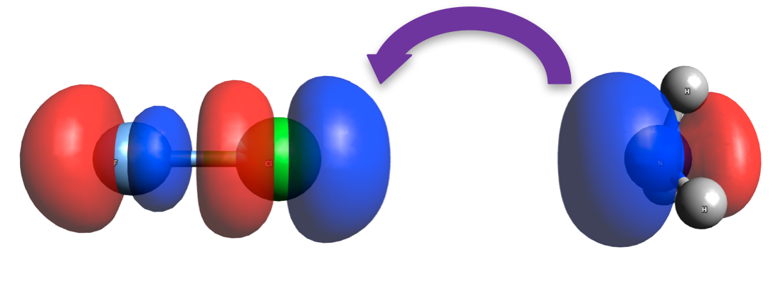
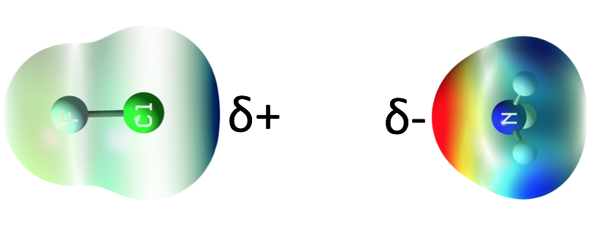
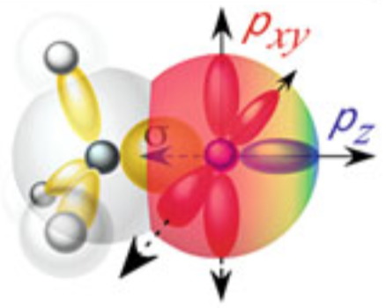
Halogen Bonding Mechanism
Electrostatic
Coulomb Interaction
Polarization
Covalent
Charge transfer
Y-X antibonding orbital
σ*(Y-X)
Acceptor
lone pair orbital
lp(A)
Y-X···A
δ+ increase with:
polarizability of X (F < Cl < Br < I)
Electronegativity of Y
δ- increase with:
A atomic charge
Notes:
Halogen bonding has both an electrostatic and a covalent part: 1) The electrostatic part involves coulomb interaction between a positive electrostatic potential collinear to the sigma bond (this blue part) and a negative electrostatic potential at the lone pairs of a hetero atom and the polarization that occur as the halogen donor approaches the acceptor. The positive potential at the halogen increases with the polarizability of the halogen and with the polarizing power of the donor group (Y) the covalent part of the interaction involves the charge transfer of the lone pairs of the acceptor to the σ* antibond orbital of the halogen donor.

Slide 24
Molecular Orbital Diagram
Charge transfer (CT) involves a 2e-stabilization and a 4e destabilization
2e Stabilization of XB:
Proportional to:
Lp and σ* orbital overlap
Inversely proportional to:
σ* and lp(A) orbital
energy gap ∆ε
σ*
Δε
lp
Leads to an elongation of YX bond due to:
4e Destabilization (weakening X-A bond)
Proportional to:
lp and σ orbital overlap
Inversely proportional to:
σ and lp(A) orbital
energy gap
Notes:
We can rationalize the charge transfer using this simplified MO scheme where we can distinguish two effects: First, a 2e electrons stabilization due to delocalization of the lone pairs of the acceptor into the σ*(YX) orbital of the donor. This stabilization is proportional to the orbital overlap and is inversely proportional to the orbital energy difference the 2 electron stabilization is always accompanied by a 4-e destabilization, since we partially occupied an orbital that has an anti bonding character with regard to the YX bond, the later is weakened, This weakening also depend on orbital overlap (sigma and lone pair) the orbital energy difference.

Slide 25
Molecular Orbital Diagram
Halogen bond can be strengthened:
Decreasing σ*(RX) energy
Increasing the Lp(A) energy
Increasing the σ*(RX) - Lp(A) overlap (Cl > Br > I)
Decreasing the 4e destabilization
σ*(YX) is higher in energy compared to lp(A)
CT increases by:
Decreasing σ* energy
Increasing lp energy
Increasing lp – σ* overlap
Increasing the electronegativity of Y (from Cl-Cl to F-Cl):
Higher X coefficient at σ *(YX)
Smaller lp(A) - σ(YX) interaction
Larger lp(A) - σ *(YX) interaction
Halogen bond can be strengthened:
Decreasing σ*(RX) energy
Increasing the Lp(A) energy
Increasing the σ*(RX) - Lp(A) overlap (Cl > Br > I)
Decreasing the 4e destabilization
Better overlap with lp(A)
Smaller energy gap
Increasing the polarizability of X:
Higher X coefficient at σ *(YX)
↑lp(A)- σ *(YX)
More Diffuse σ *(YX)
↓ lp(A)- σ *(YX)
Higher σ *(YX)
↑ ∆ε(2), ↓ ∆ε(4)
σ*(Y-X)
∆ε
Lp(A)
σ(Y-X)
Notes:
To improve the charge transfer and make the covalent part of stronger, we need to lower σ* orbital energy, increase the lone pair energy, or improve the overlap between this two orbital. We can do that by having a more electronegative Y for example here, by substituting the Chlorine by a fluorine. The fluorine would adopt a larger coefficient at σ and due to orbital orthogonality the halogen would have a larger coefficient on σ* and the overlap with the lone pair would increase. And a second effect that an electronegative atom bring down both σ and σ* orbital and the orbital energy difference becomes smaller
-------------------------------------------
would lower both σ and σ* orbital and increase their splitting leading to a larger 2 electron stabilization and a smaller 4e destabilization
And second effect is that Y would adopt a larger coefficient at σ and due to orbital orthogonality the halogen would have a larger coefficient on σ*. Hence the orbital overlap with lp(N) would increase in the later case
And decrease for the former.
We can also increase the lone pair of the acceptor by for example going from N to P,
However by doing this we end up with two opposing effects, phosphine has a lone pair of higher energy therefore smaller orbital energy different but the orbital overlap decrease because the lone pair of phosphine is more diffuse than the lone pair of the nitrogen.

Slide 26
Molecular Orbital Diagram
Increasing the polarizability of A (from N to P):
Smaller energy difference
More diffuse lp(A)
Smaller lp(A)-σ*(ΥΧ) overlap
More diffuse means it the reach further into space and can overlap with sigma(YX),
If we contract lp(P) with F atoms lp(P)-σ*(YX) increases but lp(P)-σ(YX) may decrease,
resulting in an increase of ∆ka(YX).
Opposite effects!

Slide 27
Dihalogens and Interhalogens
Notes:
Now, let apply what we learn to explain the halogen bonding in dihalogen (fluorine and chlorine) and interhalogen chlorine monofluoride with 4 different acceptors: water, Hydrogen Sulfide, ammonia, phosphine.

Slide 28
Dihalogens and Interhalogens
Y-X: (FCl > Cl₂ > F₂)
Electrostatic:
F₂ is less polarizable than Cl₂, FCl has a dipole of 0.93 Debye
Covalent:
F₂ has a too compact σ*(F-F),
Cl₂ diffuse orbital σ*(Cl-Cl)
FCl has the best lp(A) - σ⋆(FCl) overlap
Electronegativity:
χ(F) = 4.17
χ(Cl) = 2.83
Notes:
Here is the Bond strength order as a function of the local force constant, this is the same curve derived previously but omitting the other complexes, here the halogen bonding involving F2 are the weakest, followed by Cl2 and than by FCl. F2 is the least polarizable followed by Cl2, FCl has a large dipole moment there fore it make a stronger interaction, the covalent part follows the same trend, F2 has a too sigma* orbital chlorine has a larger but diffuse orbital and FCl can make the best orbital overlap.
-----------------------------------------------------------------------------
According to the position of the halogen bonds in the curve that we defined previously we can easily see what halogen bonds are weaker and what are stronger and we see that halogen bonds with F2 are the weakest, in red, followed by Cl2 and the interhalogen FCl form the strongest interaction. Although F2 has slightly lower σ* orbital, this orbital is too compact, hence the overlap with the the lone pair of the acceptor is poor, also F is less polarizable and form a weak electrostatic interaction. Cl2 is more easily polarizable and form a stronger electrostatic bond than F2. FCl form both the strongest electrostatic interaction due to the high polarizing power of the fluorine, the charge transfer is also improved, F has a large coefficient on σ and Cl has a larger coefficient on σ*, therefore a better orbital overlap with lp(A).

Slide 29
Dihalogens and Interhalogens
A = NH₃ > OH₂ > SH₂ > PH₃
Electrostatic:
Charge at the heteroatom:
N > O >> S > P
Covalent:
Ionization potential:
SH₂ ~ PH₃ << NH₃ < OH₂
NBO:
Electronegativity:
χ(O) = 3.50, χ(N) = 3.07
χ(S) = 2.44, χ(P) = 2.06
Minimum electrostatic potential (e.V):
NH₃ has the best compromise between electrostatic and covalent contributions
-1.62
-1.40
-0.71
-0.68
Notes:
With regard to the different acceptors we can see that the strength order is the same for F2, Cl2 and FCl, ammonia is the strongest acceptor, followed by water, hydrogen sulfide and phosphine. From the electrostatic point of view oxygen and nitrogen have higher electronegativity and can polarize better the halogen donor making a stronger interaction. Looking the covalent part we see an opposite trend the lone pair of the oxygen is too low in energy only a small charge transfer take place. Ammonia has the best compromise between both parts and form an stronger interaction.

Slide 30
Dihalogens and Interhalogens
A more covalent halogen bond is not necessarily stronger:
FCl···NH₃
FCl···PH₃
Bond strength order (BSO) n = 0.216 0.127
Charge transfer = 14.5 me 36.1 me
In FCl···PH₃ the charge transfer stabilization is counter balanced
by the weaker electrostatic contribution.
Notes:
Comparing the halogen bonds formed between chlorine monofluoride ammonia and phosphine, we see that the later for a weak bond but a more covalent one, with the double of the charge transfer, therefore a more covalent halogen bond is not necessarily stronger. In this case the bond is weak due to weak electrostatic contribution for phosphine as we can see from the partial charges.

Slide 31
Influence of the Halogen Acceptor
FCl···NR₃ BSO range from 0.10 to 0.28
FCl···PR₃ BSO range from 0.09 to 0.40
Notes:
So we decided to see what happen with the halogen bond strength if we substitute the Hs by several different groups, the substituted phosphine are able to form stronger bonds than the substituted ammines, to understand lets take a closer look first in the ammines complexes.

Slide 32
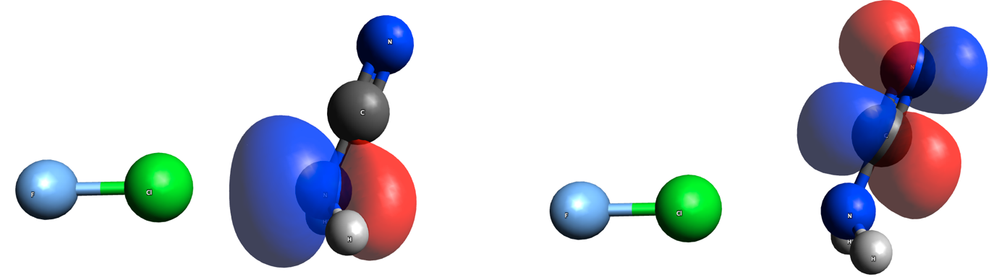
Influence of the Halogen Acceptor
Considering the strength of the XB in FCl···NR₃
FCl ··· NF₃ < NF₂ < NFH₂
F substituents withdraw electron density from the N
FCl···NH₂CN:
lp(N) delocalization via:
Lp(N)
π*(CN)
Electronegativity:
χ(F) = 4.17
χ(O) = 3.50
χ(Cl) = 2.83
χ(H) = 2.20
Notes:
In this case the strength order given in this plot is quite straightforward and can be explained using electrostatic arguments with a few exception: F atoms withdraw electron density from the N, the partial charge becomes less negative and even positive, and the bond becomes weaker. The CN group weakened the Halogen bond because of its electronegativity effects and also due the delocalization of the nitrogen lone pair into a π* orbital of the ciano group which also lower the charge at the N. Cl substituent also weaken the interaction but less effectively due to its smaller electronegativity compared to fluorine.
the nitrogen lone pair delocalize into a
and

Slide 33
Influence of the Halogen Acceptor
Considering the strength of the XB in FCl···NR₃
FCl···NH₂OH
H-Bond:
kª(H···Cl) = 0.095
BSO n (H···Cl) = 0.111
BSO n (Cl···N) = 0.242
No H-bond
BSO n (Cl···N) = 0.175
FCl··· NH₂CH₃
F, CN, Cl substituents weaken the XB
Hyperconjugation increases lp(N) energy,
lowering ∆ε.
OH and CH₃ strengthen the XB
Notes:
The strengthening of the halogen bonding brought by OH was a surprise at first sight since oxygen is more electronegative than Cl, and we found out that the reason for the strengthening was due to a secondary hydrogen bonding with Cl when we shifted the Hydrogen to an anti conformation the complex became much weaker.

Slide 34
Influence of the Halogen Acceptor
Considering the strength of the XB in FCl···PR₃
Electronegative substituents in PR₃:
Decreases lp(A) energy
Increase ∆ε
Contracts lp(A)
Improves lp(A)-σ* overlap
FCl ··· PF₃ < PH3 << PFH₂ < PHF₂
Electronegativity:
χ(N) = 3.07
χ(C) = 2.50
χ(P) = 2.06
Strong XBs
Notes:
Then we investigated the strength trends between FCl and the substituted phosphine. The strength order obtained was completely different, with the partially fluorinate phosphines being able to form strong halogen bonds, as we can see here, why is that? Phosphines a lone pair high in energy, close to σ*(FCl) but its lone pair orbital is too diffuse, electronegative substituents increase the orbital energy difference but effectively contract the lone pairs, we we put the third fluorine atoms the contraction of the lone pair does not pay anymore the increase in the energy gap and de bond becomes weak. Methyl group is also more electronegative than phosphine and can contract its lone pair. Interesting to notice is that for this strong halogen bonds the F atom here becomes quite negative.
therefore the electrostatic contribution of this interaction is small and close in energy to σ*(FCl) Phophine PH3 makes a weak interaction because its lone pair orbital is too difusse, by using electronegative substituents, the charge at the phosphorous becomes more positive, the energy gap becomes higher, but the lone pair orbital is effectively contracted and the orbital overlap with σ* is largely improved. For PF3 the lone pairs becomes too contracted and does not pay off the increase in phosphine positive charge and the higher energy gap between lone pair and σ* . Interesting to notice is that for this strong halogen bonds the F atom here becomes quite negative.
The other substituents can be rationalized in similar terms however we have to consider that in this case C is more electronegative than P and also contract
The P lone pairs.

Slide 35
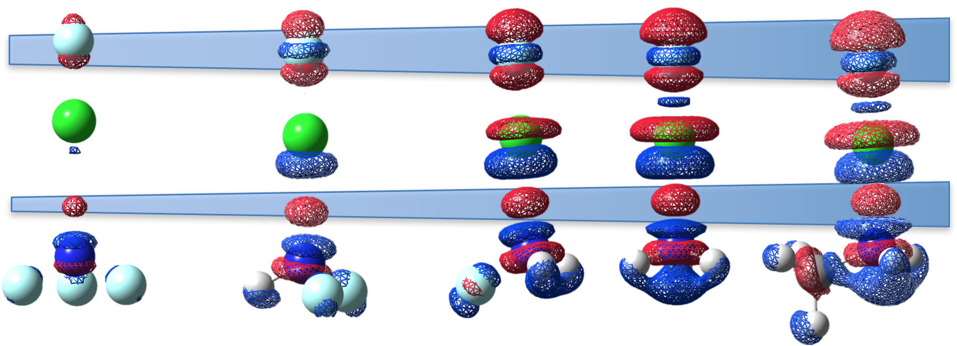
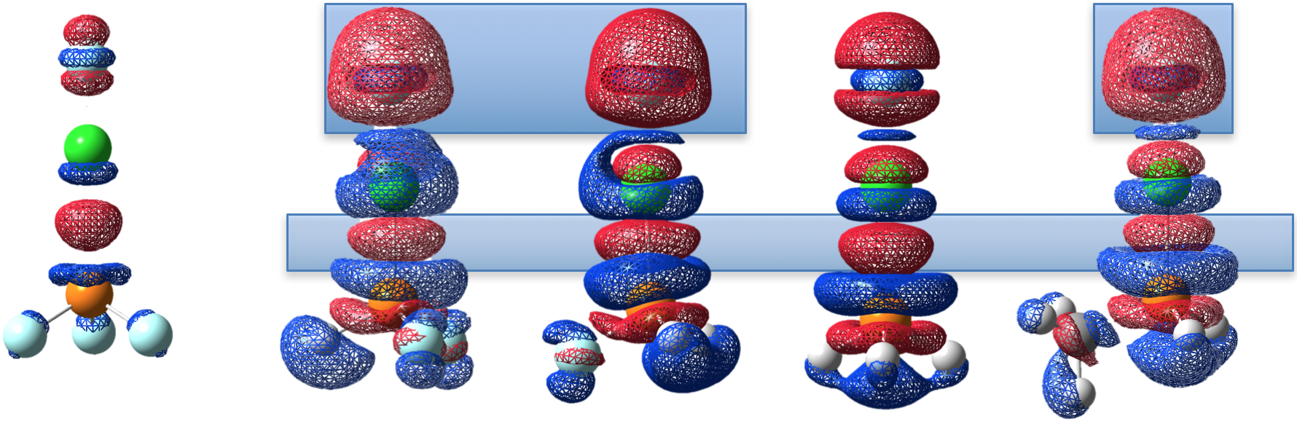
Electron Difference Density ∆ρ(r)
∆ρ(r) = ρ(FCl···NR₃) − ρ(FCl) − ρ(NR₃)
F-Cl···PHF₂
F-Cl···PH₂F
F-Cl···PHCH₃
Close to an ion pair
formation?
F⁻···Cl-PR₃⁺
or
F···Cl···PR₃
FCl··· NF₃
NHF₂
NH₂F
NH₃
NH₂CH₃
FCl··· PF₃
PHF₂
PH₂F
PH₃
PH₂CH₃
Notes:
Comparing the electron difference density of several ammines and phosphines. We see that in the ammines the strengthening of the halogen bond is accompanied by an increase of the electron density in the intermonomer region, here in red, Due to the 2e stabilization a depletion of electron density at the FCl bond (in blue) due to 4e-destabilization with accumulation of electron density at the fluorine. For the phosphine both mechanism are much more accentuated. Alkorta and co-workers suggested that some of this would be a result of the superposition of an ion pair structure.
We took another rote a we tried to analyze it in terms of a 4e-3c bond

Slide 36
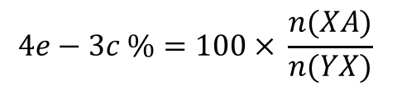
Quantifying the 4e-3c Character
4e-3c Bond
Y···X···A
A simple formula for evaluating the
4e-3c bond character is given by:
Maximum 2-e delocalization
Minimum 4-e repulsion
Notes:
In a 4e-3c bond such as the one we get for the trifluoride ion, 2 electrons are delocalized in the three atoms, and the other two electrons would be in an non-bonding orbital, from this we would get the maximum 2e stabilization and no 4e destabilization. We quantified the 4e3c- character by dividing the bond strength order of the halogen bond by the halogen donor bond. In the best case they would be equal and we would get a complete 4e-3c bond.

Slide 37
Quantifying the 4e-3c Character
Comparison of 4e-3c % character between phosphine and ammine complexes
Notes:
Here, in red is the percent value of the 4e3c character of the halogen bonds in the ammine complexes and in green are the values for the phosphine complexes. What we got is that while the halogen bonds in ammines riches at most 40% the halogen bonds in phosphines can go up to 90%.

Slide 38
Summary – part 1
Nature and strength:
Halogen bond varies from weak electrostatic to strong covalent character.
Dihalogens and interhalogens:
Halogen bond strength does not necessarily relate to charge transfer
Charge transfer is larger for 3rd row acceptors, but even in this cases electrostatic contributions are relevant
Electronegative substituents can have opposing effects on the acceptor
Phosphines can make strong halogen bonds with high 4e-3c character
Notes:
Let’s summarize our conclusions up to now: 1) we saw that halogen bonds tend to vary from weak electrostatic to covalent and strong 2) Than we saw that even for weaker bonds charge transfer may change the strength order as was the case of ammonia been able to form stronger bonds than water for the dihalogen 3)When we compared ammonia with phosphine we saw that a more covalent bond is not necessarily stronger 4) We could satisfactorily explain bond in the halogen bond with the different ammines mostly by electrostatic arguments whereas the phosphines are better explained by analyzing the covalent part. We also so that phosphine forms halogen bonds with strong 4e-3c character

Slide 39
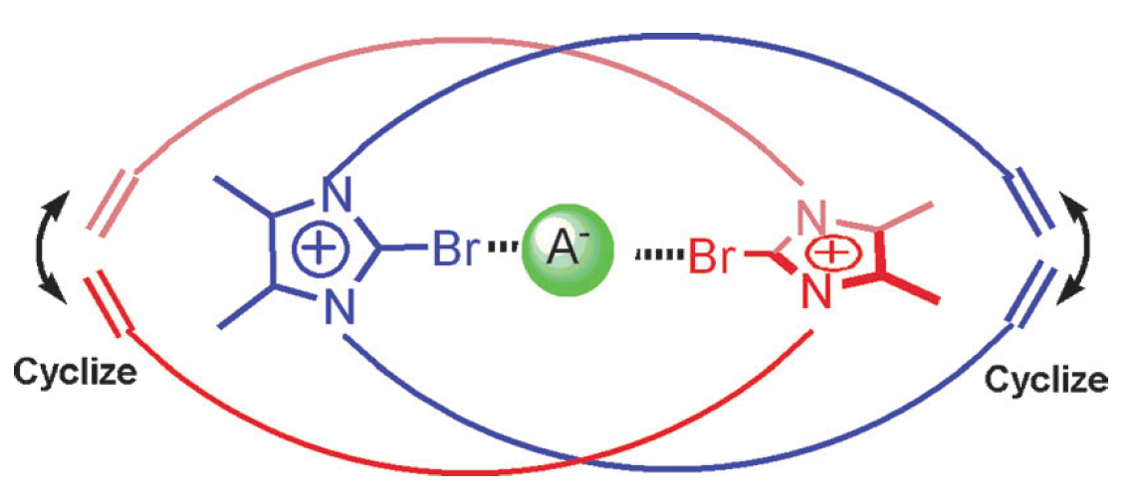
Anionic Complexes
Symmetric 4e-3c
This type of interaction is found in anion
sensors based on halogen bond
halogen bonded complexes
Hydrogen, pnicogen and chalcogen bonded complexes
Notes:
In a subsequent study we decided to take a closer look into some ionic systems such as trihalides ions the hydrogen bifluoride which is considered to form the strongest hydrogen bond. We also tested other systems beside dihalogens using Chloride as the halogen acceptor. And we compared the halogen bonds with the hydrogen bond, pnicogen bond and chalcogen bond.

Slide 40
Anionic Complexes
4e-3c Bonds
Symmetric 4e-3c bonds form the
strongest interactions:
[F···Cl···F]⁻ has a better charge separation
Among the strongest:
Cl₃⁻ and Br₃⁻ form weaker interactions, due to the more diffuse orbitals
Notes:
Going back to our bonds strength order versus halogen bond force constant curve, we can se that our strongest systems between the symmetric 4e-3c bonds were the [F···Cl···F]- since the fluorines are much more electronegative, electron density is higher in the fluorine Chlorine becomes partially positive and can form a stronger bond, with less lone pair repulsion. Among the strongest bond is the one in this difluorodihydrogen phosphate which is isoelectronic to the tetrafluoro sulfurane, this molecule maybe be suitable as a metal ligand. Trichloride and tribromide ions form weaker bonds since this molecules have a more diffuse orbitals
Sulfur tetrafluoride

Slide 41
Anionic Complexes
Halogen bonds
Strength range: n = 0.15 to 0.38
Strength increases with the:
Electronegativity of Y and its polarizing power
HCC-Cl < NC-Cl < O₂N-Cl < FCl
Notes:
With regard to the halogen bonded systems tested we see that the strength of the halogen bond depend on the electronegativity of the donor Y and on its polarizing power

Slide 42
Anionic Complexes
XBs vs Other non-covalent bonds
XB is stronger than the other non-covalent bonds
Cl has a smaller covalent radius
Cl higher electronegativity
σ*(F-P)
σ*(F-S)
∆ε(2)
σ*(F-Cl)
Lp(Cl⁻)
and has a smaller covalent radius than S and P
χ(P) = 2.06
χ(S) = 2.44
χ(Cl) = 2.87
Notes:
If we look comparable systems we see that halogen bond is stronger than chalcogen or pnicogen, for example, in the 4e-3c case the difluorochlorate makes a stronger bond than the difluorodihydrogenphosphate and Chlorine monofluoride is much stronger than the chalcogen bond, hydrogen bond and pnicogen bond.

Slide 43
Neutral Complexes
Halogen bonded complexes
Hydrogen, pnicogen and chalcogen bonded complexes:
Notes:
Considering the same halogen bond donors by switching the acceptor from Chloride to ammonia

Slide 44
Neutral Complexes
NH₃ forms weaker than Cl⁻
Halogen bonds
A similar strength order is found
HCC-Cl < NC-Cl < O₂N-Cl < Cl₂ < FCl
Strength range: n = 0.09 to 0.22
χ(C) = 2.50
χ(N) = 3.07
χ(Cl) = 2.87
Notes:
NH3 tend to form weaker bonds, however it did not changed the strength order qualitatively for the halogen bonds, the same strength order is found.

Slide 45
Neutral Complexes
XBs vs Other non-covalent bonds
3rd row (P, S, Cl) – 2nd row (N) interactions:
F-Cl form a head on interaction
Cl is more electronegative and has a smaller covalent radius than S and P
FH···NH₃ lacks lp(A)-lp(X) exchange repulsion and is stronger than FCl···NH₃
FBr···NH₃ is stronger than FH···NH₃
Notes:
For a consistent comparison between halogen bonds and other non-covalent interactions we consider atoms of the row of the periodic table and a similar donor and we see that halogen bond form the strong interaction, the reason is that chloride monofluoride has lower σ and σ* orbital, therefore a larger 2e stabilization and also due to the linear, head on conformation adopted, which minimize exchange repulsion and maximize both electrostatic and covalent part, the other phosphine monofluoride and Sulfide monofluoride interacts with a ammonia in a less optimal skewed fashion. Halogen bond is less comparable to hydrogen bond, since we have to compare the interaction of atom of different periods. Nevertheless, going from chlorine monofluoride to Bromine monofluoride we can get a halogen bond stronger than the hydrogen bond.

Slide 46
Summary – part 2
4e-3c form strong and highly covalent bonds
[F···Cl···F]⁻ forms the strongest XB bond
The strength of the halogen bond depend on the polarizing power of Y and its electronegativity
Cl⁻ is a stronger halogen acceptor than NH₃
The acceptor did not changed the strength order of halogen bonded complexes
Halogen bonding is stronger than pnicogen, chalcogen and hydrogen bonding in neutral and charged complexes of a similar composition
Notes:
Lets summarize our conclusion for this part: The strongest bond are found for the 4e-3c complexes. The strongest halogen bond is the one in the difluoridemonochloride ion due to better charge separation
halogen bond strength depend on the polari
Cl- can donate electron density more effectively and form stronger and more covalent interactions,
The strength other among halogens, however when we consider the other non-covalent interaction the decrease in the strength of the halogen bonds is larger than other non-covalent interactions
Suggesting than halogen bond depend more on the covalent part than other non-covalent interactions.

Slide 47
How well does the intrinsic strength of the halogen bond given by the BSO value or kª when correlating the latter with :
Centrifugal Distortion Force Constant k_{σ}
Halogen bond length r(X···A)
Binding energy ∆E
V_{max} at the σ-hole
Notes:
In this last study we tested the correlation between the intrinsic strength of the halogen bonding given by the BSO or ka with several other properties used in the literature to describe the strength of the halogen bond

Slide 48
Correlation Between kª and k_{σ}
The intermolecular stretching force constant k_{σ} can be experimentally derived from the centrifugal distortion constants
Measurements are done in gas phase
Monomers YX and A are considered to be rigid
A qualitative correlation is found
k_{σ} is not local
Linear relationship between kª and the centrifugal distorsion k_{σ} obtained from the rotational spectra [3]
Notes:
Here we compare our local stretching force constant to the experimental intermolecular force constants obtained by Legon from the centrifugal distortion constant, qualitatively we get similar results, a little large deviation is found for the FCl···OH2, the OH2 is a floppy molecule is more difficult to get an accurate experimental value. Nevertheless the good agreement we get here might be limited to small complexes since k_{σ} is not local and one of the approximation need to obtain it is to consider than the donor and the acceptor do not distort only the halogen bond.

Slide 49
Correlation Between BSO and r(X···A)
Its is commonly assumed that the shorter the bond the stronger it is
Only interactions between 3rd row halogens (X) and 2nd row acceptors (A) were considered
Badger rule is only qualitatively fulfilled
Halogen bond distance is not a reliable parameter
R² = 0.919
Notes:
Secondly we compare halogen bond strength with the halogen bond distances, If we consider only halogen bonds involving acceptor of the second row and the halogen from the 3 row we see an scattered exponential relationship which is in line with Badger rule however the correlation is qualitative and limited.

Slide 50
Correlation Between BSO and ∆E
Binding energy (∆E):
∆E = E(YX···A) - E(YX) - E(A)
∆E is a cumulative quantity
and accounts for:
Geometry relaxation
Electronic relaxation
Secondary interactions
Notes:
Here we test the correlation between binding energies and the strength of the halogen bond the scattering is due to the fact that binding energies are cumulative properties

Slide 51
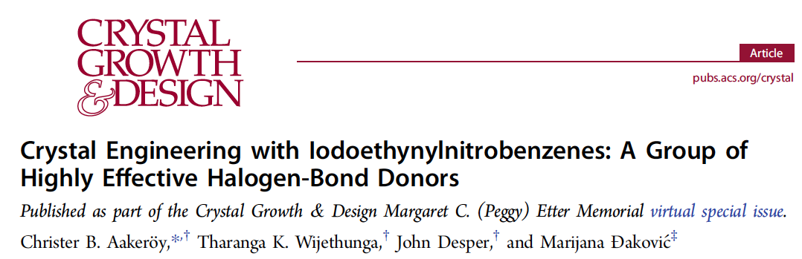
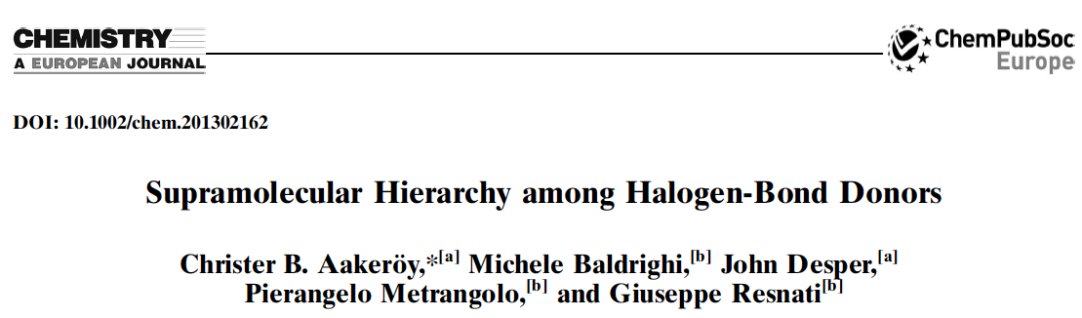
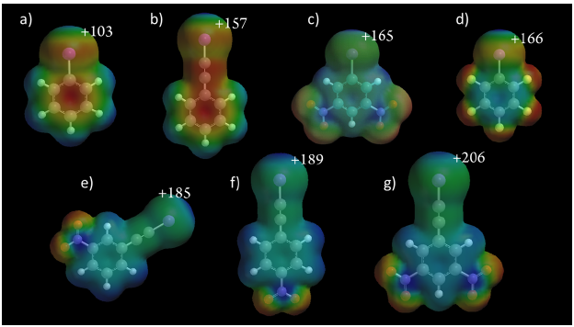
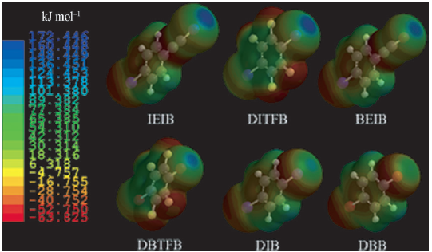
Ranking Halogen Donors
Several studies rank halogen donors according to the maximum potential V_{max} at the σ-hole region:
Notes:
Another strength parameter used to rank halogen donors are the maximum electrostatic potential in the sigma hole region of the halogen

Slide 52
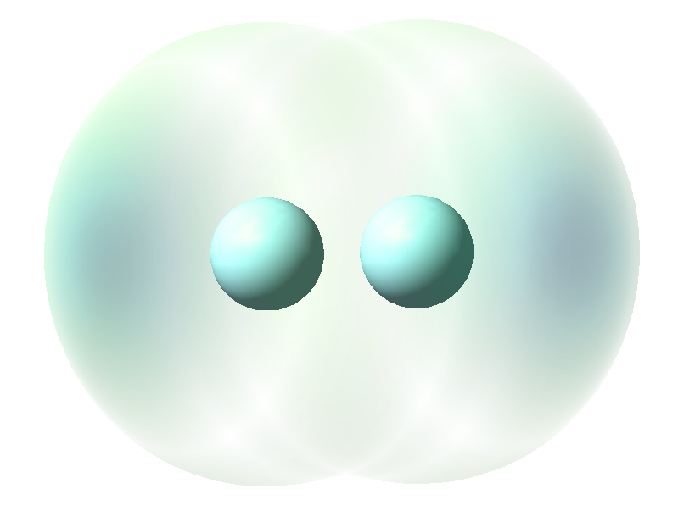
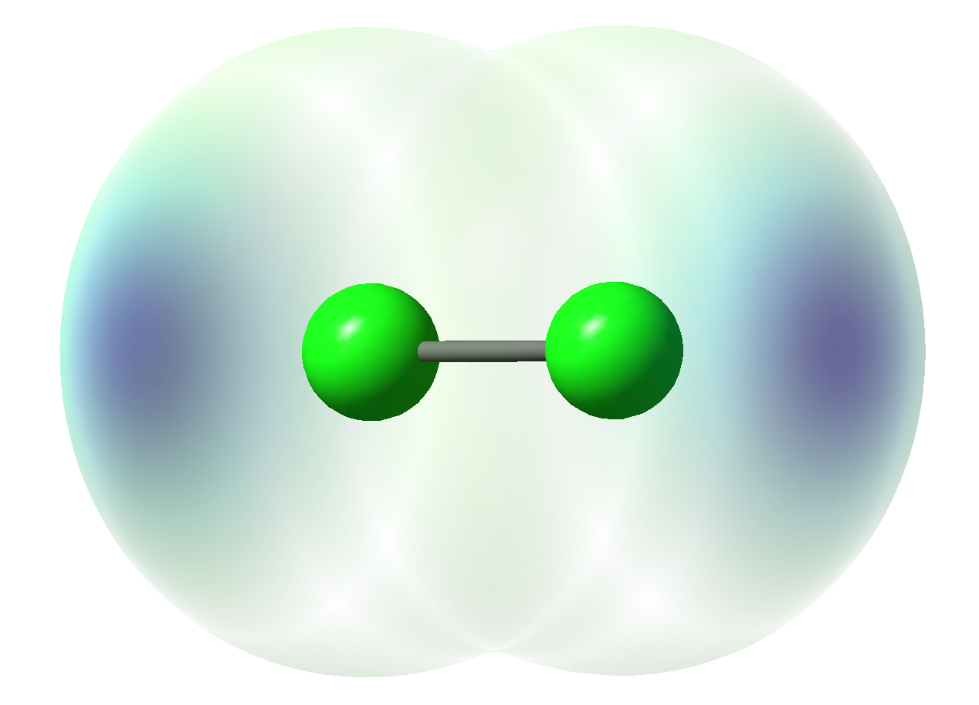
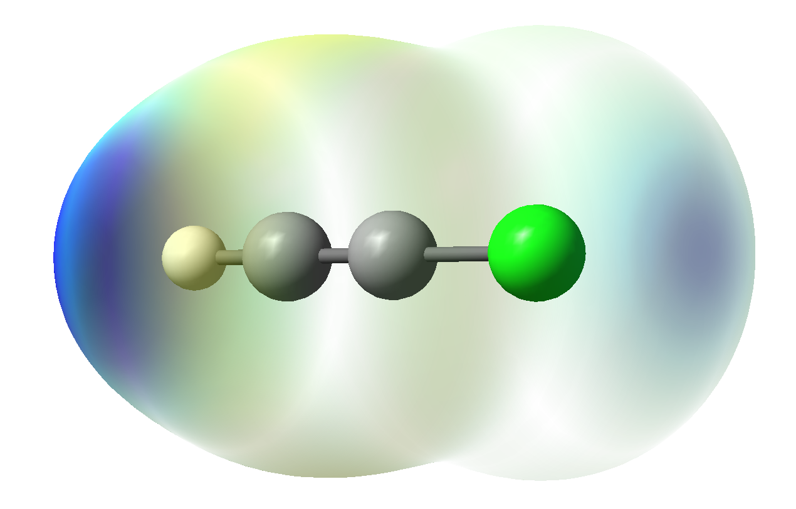
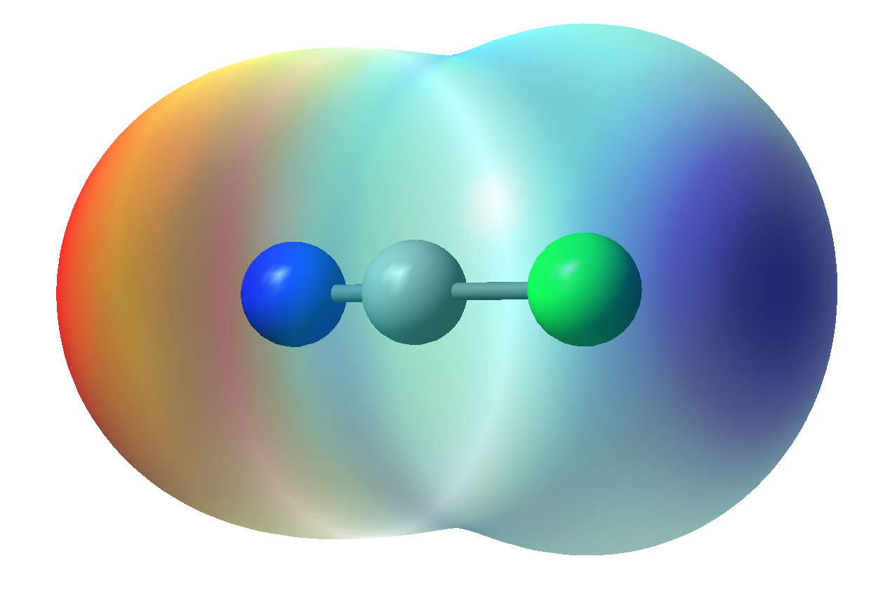
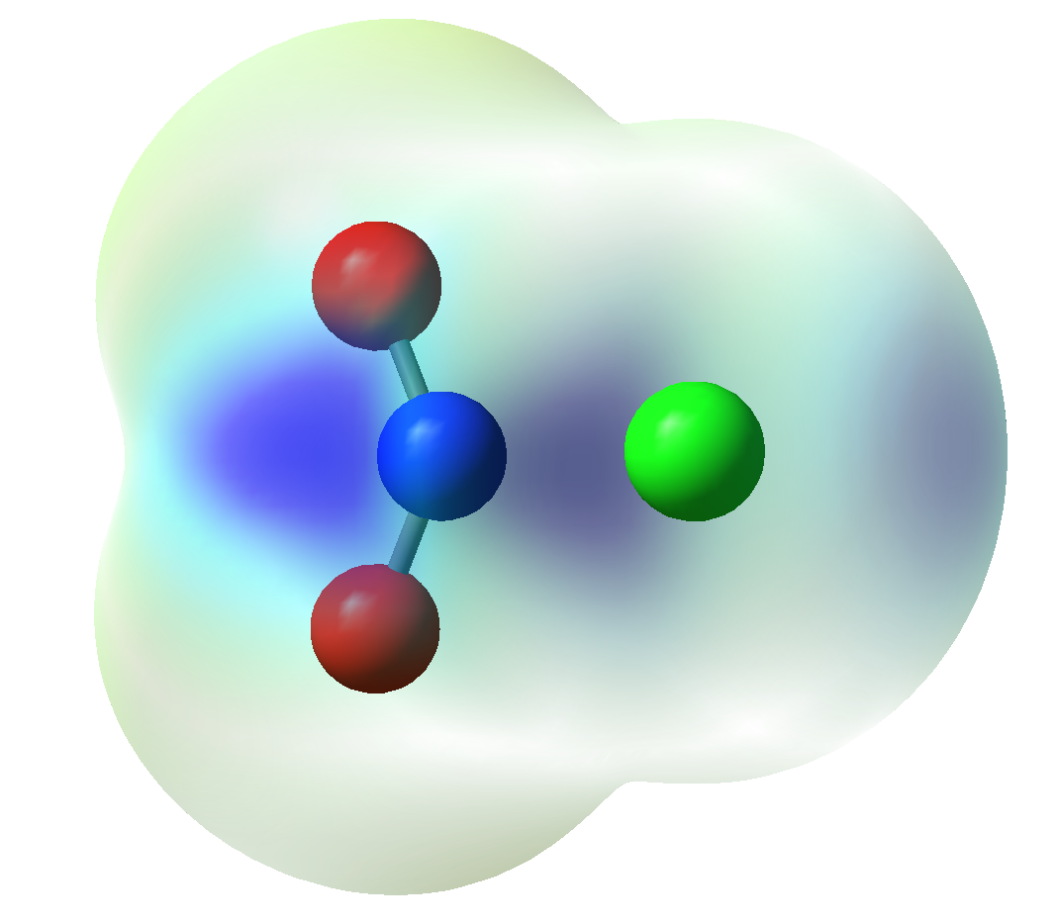
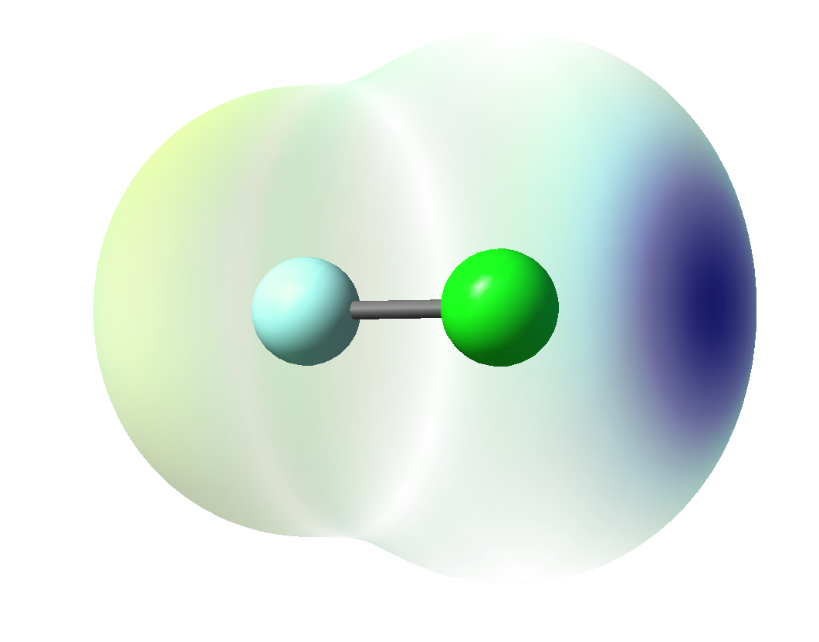
Correlation Between BSO and V_{max}
V_{max} of six halogen donors
Considering only YX···NH₃
16.5 kcal/mol
25.4 kcal/mol
21.8 kcal/mol
36.8 kcal/mol
V_{max} is not a reliable strength descriptor!
21.9 kcal/mol
40.4 kcal/mol
Notes:
So we mapped the electrostatic potential in the 0.01 iso electron density surface and we checked the maximum positive potential at the sigma-hole of the halogen then we ploted the maximum potential versus the halogen bond strength, having ammonia as the halogen acceptor, we did this for only 6 complexes, and we could notice a large scattering.

Slide 53
Summary – part 3
Short coming
k_{σ}
Its not local; floppy molecules and
bigger complexes will have larger deviations
∆E
Cumulative quantity
Depend on the effective radii of the atoms involved
r(X···A)
V_{max}
Purely electrostatic; does not contain kinetic
energy contributions
Notes:
In summary the experimentaly derived intermolecular force constant from microwave spectroscopy gave qualitative similar results for a small set of 10 complexes,the ksigma since to be less reliable for floppy molecules like H2O, and since it is not a local it will probably be less accurate for larger complexes

Slide 54
Outline
Part – 1 Introduction
What is Halogen Bonding (XB)
Relevance
Objectives
Part – 2 Methods
Tools to Access the Nature of XB
Local Modes
Part – 3 Selected Results
XB Mechanism and Nature of the Interaction
Dihalogens and Interhalogens
XB vs Other Non-covalent Interactions
Local Stretching Force Constants and Other Quantities
Part – 4 Conclusion and Overview

Slide 55
Conclusions
Halogen bonding can be:
weak electrostatic 0.05 < n < 0.2
normal halogen bond 0.2 < n < 0.3
strong and covalent halogen bond n > 0.3
2) Halogen bond mechanism:
Covalent part: involve a 2e-stabilization/4e-destabilization
Electrostatic part increases with:
i) polarizing power of A
ii) polarity of YX
iii) polarizability of X
Halogen bond acceptor:
Electronegative substituents:
reduce the strength of XB for amines
increase the strength of phosphines
Some complexes have partial 4e-3c character quantified with the BSO
Notes:
We could separate halogen bonds in 3 different groups
Weak and electrostic, normal halogen bonds and strong and covalent halogen bonds
We could rationalize the strength of the halogen bonding considering two major contributions:
The covalent contribution was rationalized in term of 2e stabilization 4e destabilization
The electrostatic part was rationalized in terms of

Slide 56
Conclusions
4) Secondary interaction (lp(Cl)···H-O on FCl···NH₂OH and FCl···PH₂OH) can strengthen
XB considerably
Strength of 4e-3c bonds depends on its increasing covalent character and better charge distribution
Halogen bonding is stronger than other non-covalent interactions in neutral and charged systems
The intrinsic strength of the halogen bond given by the BSO values are not reflected by ∆E, r(XA), V_{max} or H_{b}. These quantities are useful to describe special electronic effects, but in general they do not correlate with the intrinsic strength of the halogen bond.

Slide 57
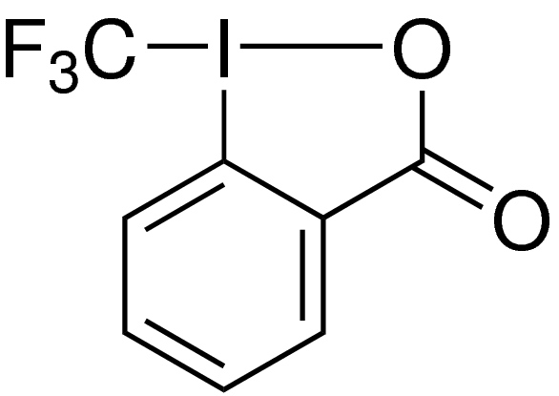
Ongoing Projects
Qualitative study
136 systems were calculated at DFT level, where larger systems and relativistic element such as Br, I were considered.
Binding energy calculations done at CCSD(T)/aug-cc-VTZ using DFT geometries
15 Hypervalent iodine complexes have been calculated at mPW2PLYPD level
Togni II

Slide 58
Ongoing Projects
Investigate larger systems
Investigate the σ-hole model
Bonding implies changes in potential and kinetic energy contributions
Cooperative effects
How halogen bonding is strengthened in polymer chains
Notes:
What we are going to look in the future is
How relativistic effects present on Br and considerably larger for I and Astatine affect the halogen bond
We are going to

Slide 59
Overview
What was done?
Applicability
In this presentation we discussed the strength and nature a set of 45 complexes using:
The detailed description given here for small systems can be used to predict:
New building blocks for crystal enginnering
Effective drug-receptor XB interactions
Tune XB strength in an efficient way
High accuracy CCSD(T)/aug-cc-pVTZ calculations of :
Geometries,
∆E,
NBO charges,
Electron and energy density distributions,
Analytical harmonic frequencies,
local stretching force constants
Where we considered:
dihalogens/interhalogens
Ammines and phosphines acceptors
Neutral and anionic complexes
HB, PB, CB
Notes:
We studied 45 complexes using CCSD(T)/aug-cc-pVTZ where we calculated analytical geometries, harmonic frequencies, NBO charges, energy density, electron density. We evaluated the nature of the interaction using Cremer-Kraka criteria for a covalent bond. Then we ordered all complexes according to their strength bond order, we separated the molecules in comparable groups, rationalized the strength of the halogen bond considering both covalent and electrostatic contributions, halogen bonds involving dihalogen, interhalogens and several other system were computed and compared to other non-covalent interactions

Slide 60
Acknowledgements
National Science Foundation, Grant No. CHE-1152357,
and Grant No. CHE-1464906.
SMU High Performance Computer Center

Slide 61

























Computational And Theoretical Chemistry Group, CATCO:http://smu.edu/catco/

Slide 62
Two postdoc positions are available
in the CATCO group
1) METHOD DEVELOPMENT project in quantum chemistry, which
requires extensive programming in Fortan and C.
Possible topics: Design and programming of the reaction valley approach
for an implicit or explicit inclusion of solvent effects;
2-­component relativistic methods for the investigation of “relativistic”
systems; new QM/MM methodologies for the description of chemical
reactions in an enzymatic environment.
2) ADVANCED APPLICATIONS including standard quantum
chemical calculations, QM/MM calculations as well as high­-accuracy
calculations with CASPT2, CCSD(T), and MRCC methods including
relativistic effects; working in a HPC environment, scripting.
Possible starting date: September 1st
Please contact Elfi Kraka, ekraka@smu.edu; Dieter Cremer, dcremer@smu.edu

Slide 64



High-Performance Computing @ SMU
SMU’s latest addition to the computer computer facilities: ManeFrame
(ranked among the top 500 fastest supercomputers in the world)
Total Capacity in 2015: 10,900 cores, 120 teraflops, 1.5 PB storage
25,000-square-foot facility
housing both the high-
performance and general-
purpose computing equipment

Slide 65






SMU Campus

Slide 66
Thank you

Slide 70
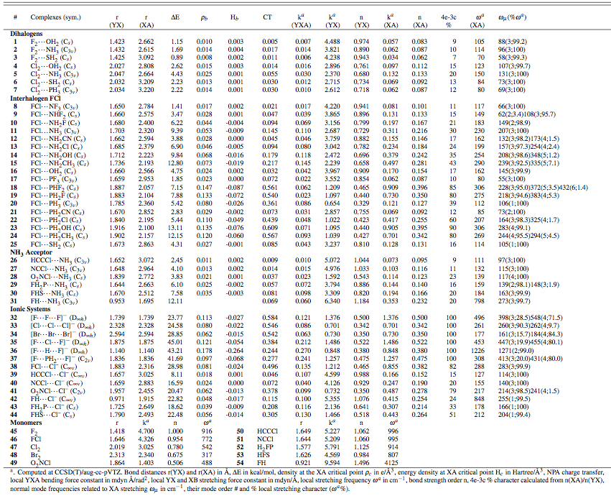

Slide 72
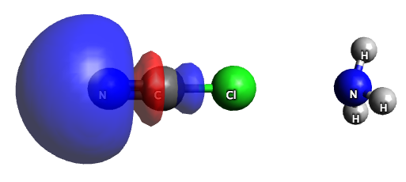
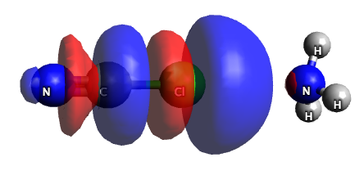
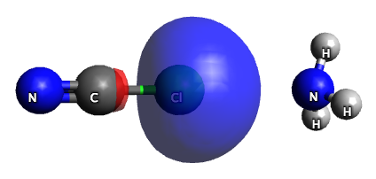
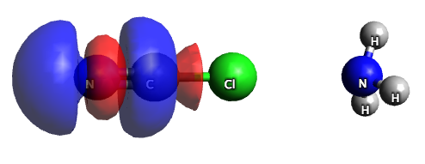




x
σ* is partially occupied
z
y
1)
to
within NCCl |  | CT [kcalmol]
LP spz ( 1) N 1 | σ*( 1) C 2-Cl 3 | 16.4
LP pz ( 1)Cl 3 | σ*( 1) N 1- C 2 | 16.4
LP px ( 2)Cl 3 | π*( 2) N 1- C 2 | 33.9
LP py ( 3)Cl 3 | π*( 3) N 1- C 2 | 33.9
From NH3 to NCCl
LP pz ( 1) N 4 | σ*( 1) C 2-Cl 3 | 3.72
Lp(Cl pz) -> σ*(CN) strong σ-hole
2)
to
3)
to
HOMO
LUMO
4)
Lp(py)->π*
Less negative in the py-direction
Same in px direction
HOMO -3
LUMO +2
Notes:
Why NCCl has a strong σ-hole but makes an interaction weaker than Cl2
there is a doation from lp(N) of the cyano to σ*(C-Cl). This partially occupation of σ*(C-Cl) decreases the donation of lp(N) from NH3 to σ*(C-Cl) #4
The donation of lp(Cl) pz to σ*(CN) increases the σ-hole (mechanism 2)
Mechains 3 decrease the charge at py and px direction

Slide 73


x
z
y
Lp(O)
σ*(N-Cl)
41kcal/mol
Notes:
Why O2NCl make a halogen bond weaker than Cl2?
Partially occupied σ*(C-Cl) due to lp(O) -> σ*(C-Cl)
Also resposible for the N-C blue shift upon formation of the halogen bond with NH3
Interesting is that with the stronger Cl- there was no blueshift

Slide 74
Influence of the Halogen Acceptor
Considering the strength of the XB in FCl···NR₃
Ranking the halogen acceptors based on their vertical ionization energy:
Without the two outliers
R² = 0.928
Notes:
At last, we try to order the acceptors with regard to their vertical ionization energies By plotting the strength ionization energies versus the local force constant of the halogen bond. We see that there is only a loose linear correlation with 2 outliers.

Slide 75
Anionic Complexes
Halogen bonds
Increases in strength with the:
Increase in Y-X polarity
Polarizing power and electronegativity of Y
HCC-Cl < NC-Cl < O₂N-Cl < Cl₂ < FCl
[Cl···Cl···Cl]⁻
χ(C) = 2.50
χ(N) = 3.07
χ(Cl) = 2.87
Cl₃⁻
O₂NCl···Cl⁻
CT: 0.546 me 0.378 me
Notes:
With regard to the halogen bonded systems tested we see that
The strength of the halogen bond depend on the electronegativity of the donor Y and on its polarizing power.
If we look comparable systems we see that halogen bond is stronger than chalcogen or pnicogen,
For example in the 4e-3c case the difluorochlorate makes a stronger bond than the difluorodihydrogenphosphate and
Chlorine monofluoride is much stronger than the chalcogen bond, hydrogen bond and pnicogen bond.

Slide 76
Neutral Complexes
NH₃ forms weaker bonds than Cl⁻
Halogen bonds
A similar strength order is found
HCC-Cl < NC-Cl < O₂N-Cl < Cl₂ < FCl
Similar strength
Cl₂···NH₃
O₂NCl···NH₃
NCCl···NH₃
CT: 0.055 me 0.037 me 0.014me
χ(C) = 2.50
χ(N) = 3.07
Χ(Cl) = 2.87
Notes:
NH3 tend to form weaker bonds, lower bond strength order,
If we consider only the halogen bond complexes we get the same bond strength order,
And the question is why chlorine is make a stronger halogen bond than

