Slide 1
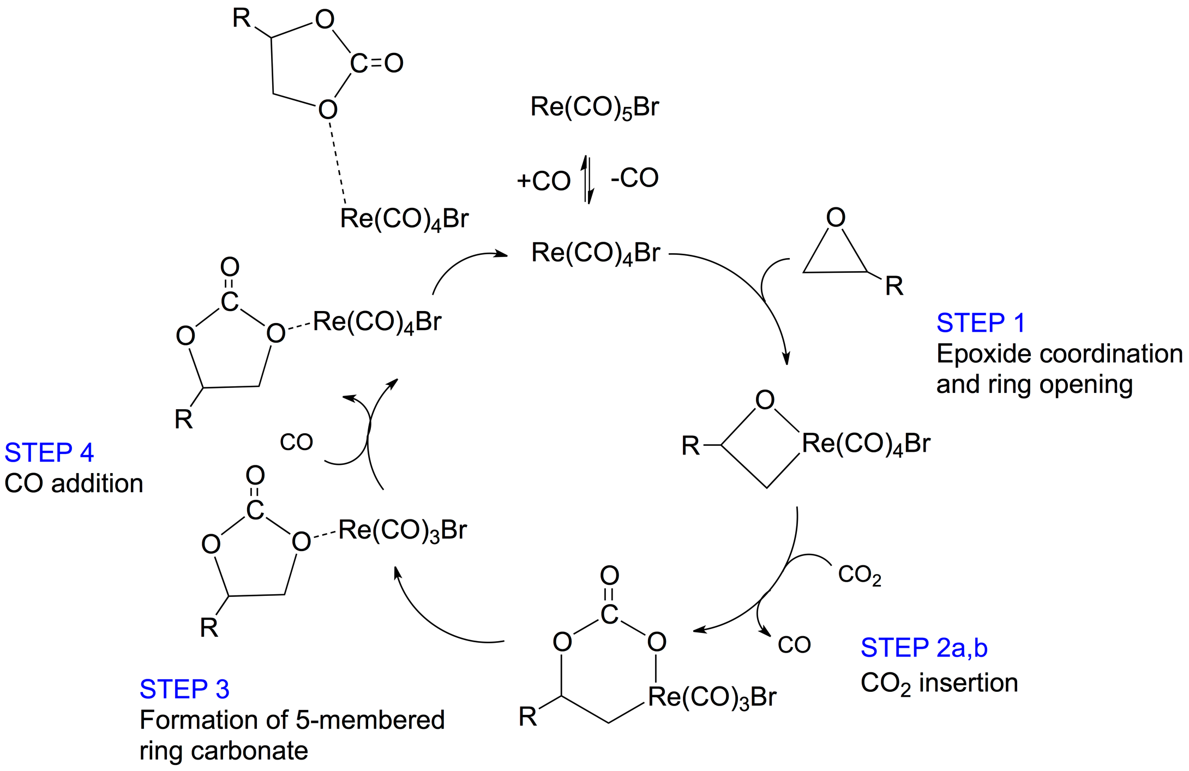
Criteria For An
Active Catalysis
Elfi Kraka, Marek Freindorf, Wenli Zou, Dieter Cremer
Computational And Theoretical Chemistry
GrOup (CATCO) http://smu.edu/catco/
Department of Chemistry, SMU, Dallas, USA
Notes:
This is my opening slide. I have to check what else it should conmtain

Slide 2
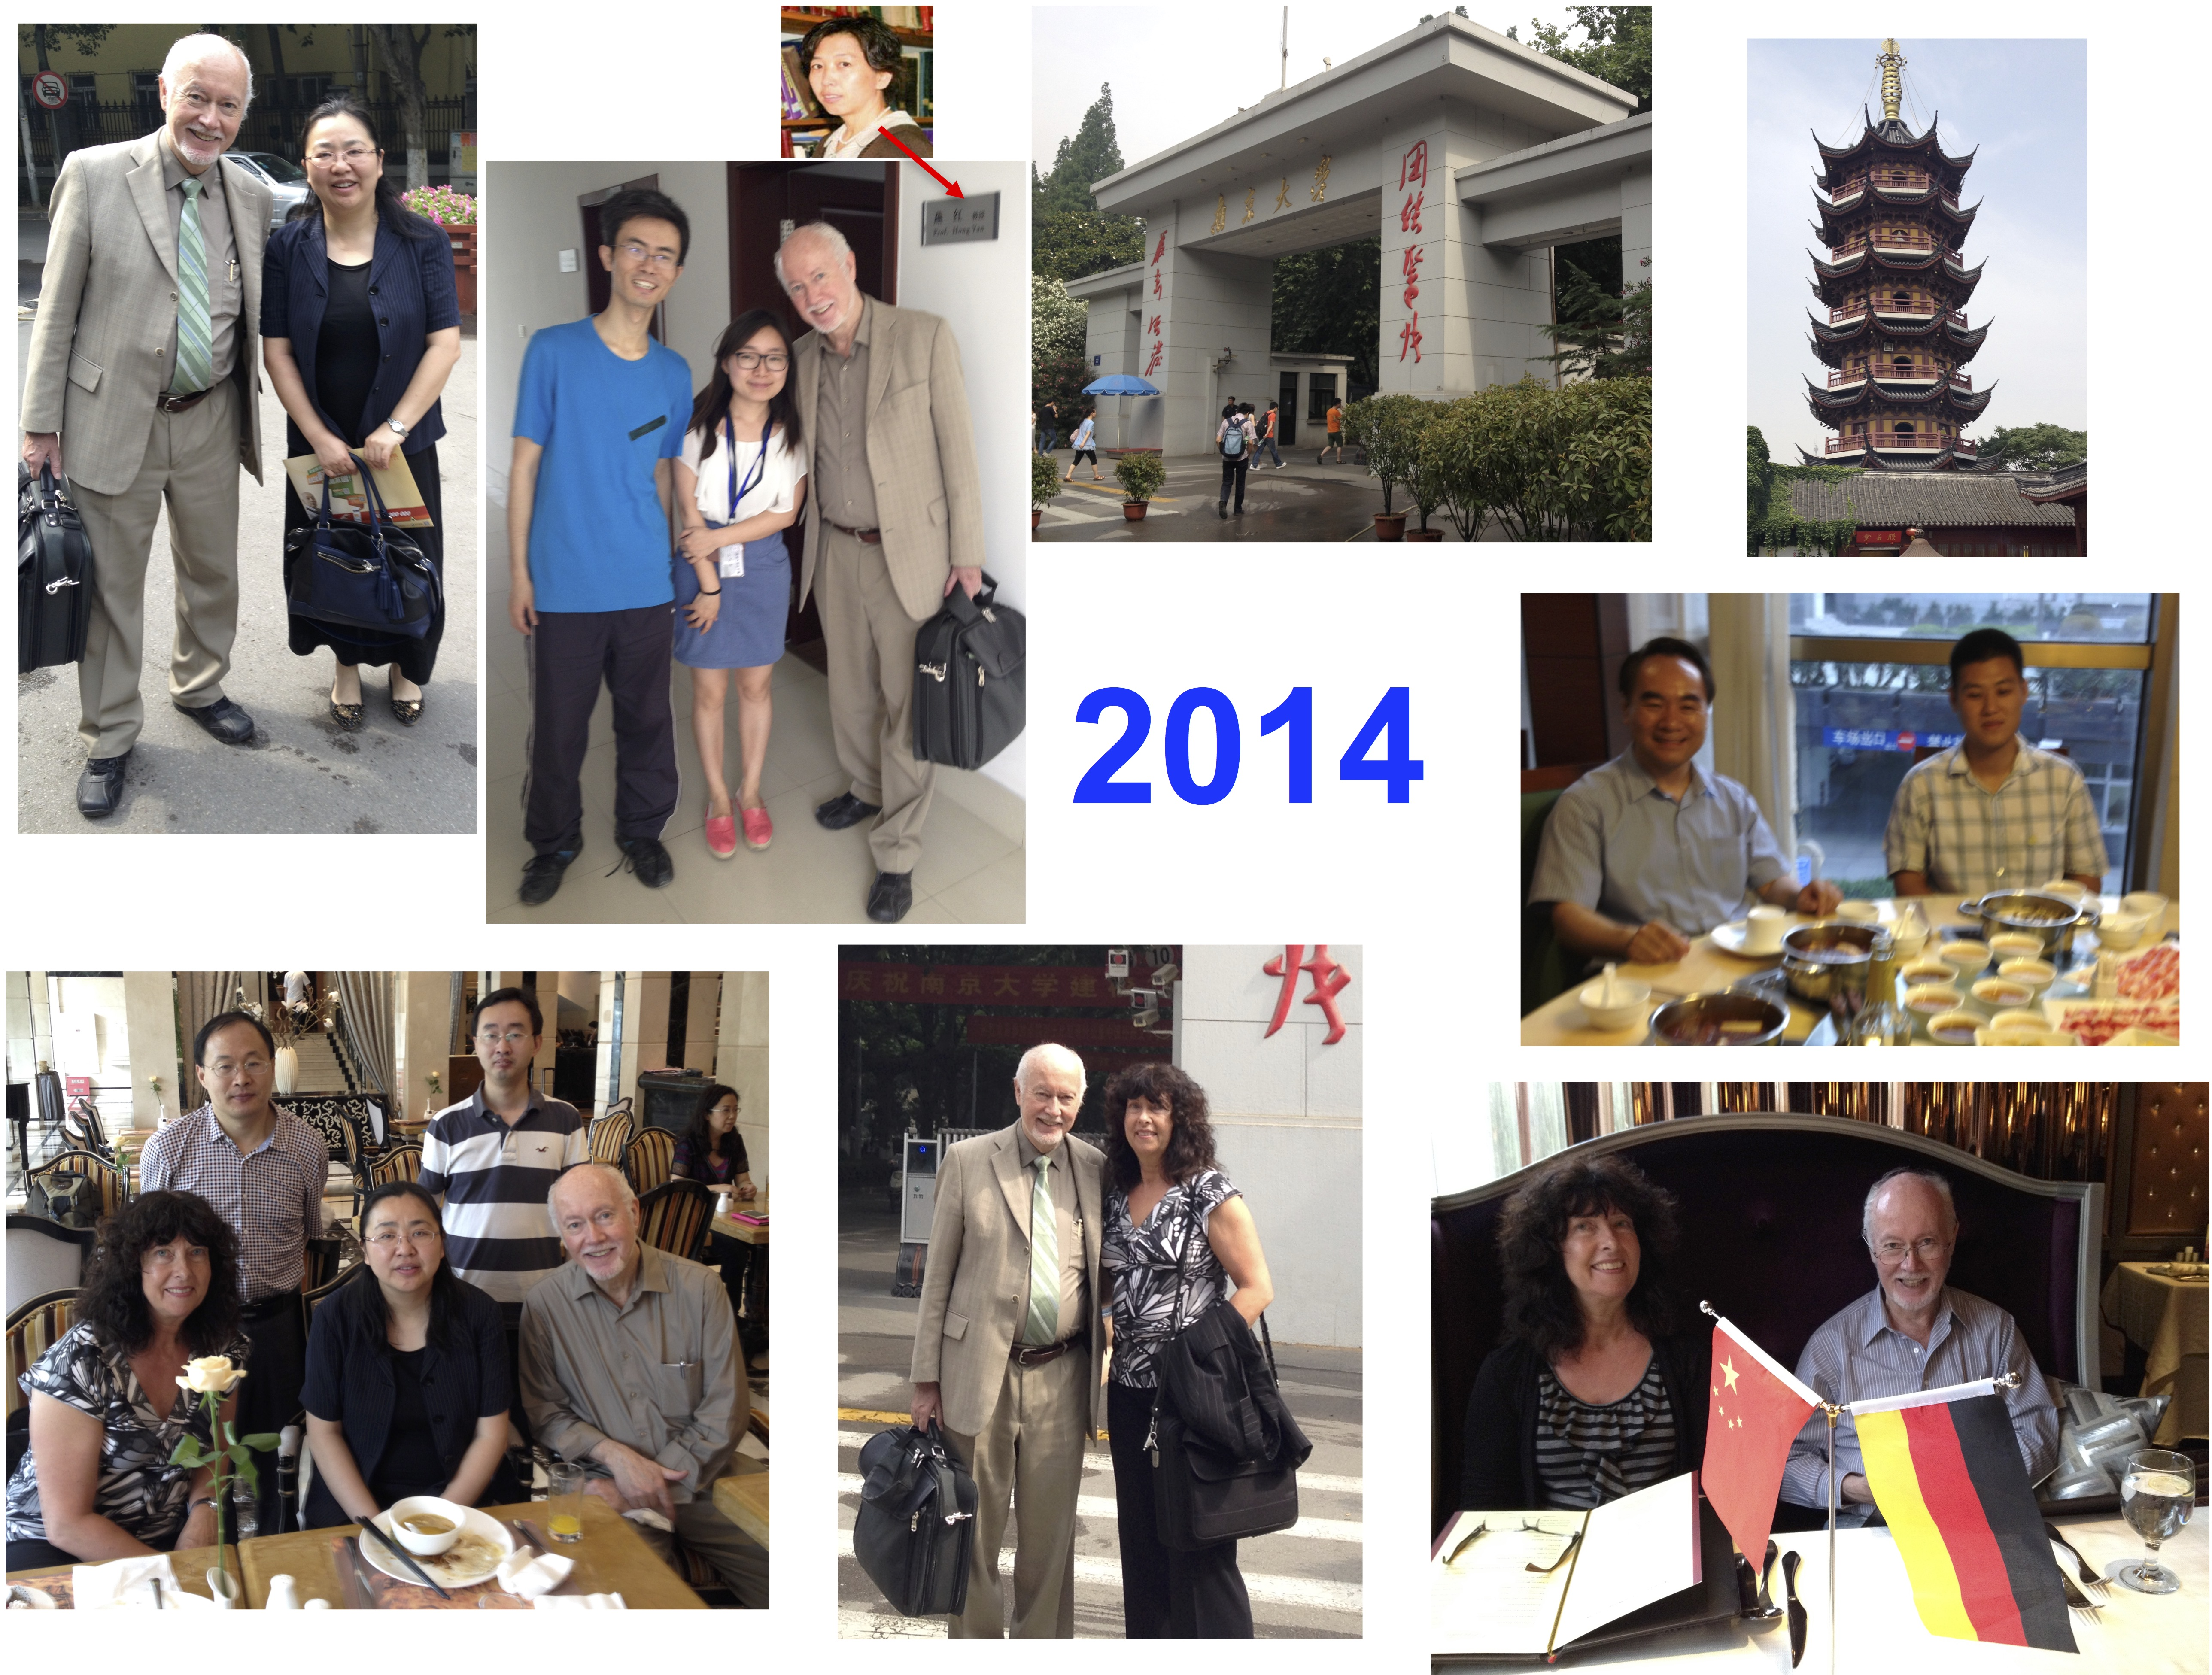

Slide 3
催化剂的重要性
市场上超过90%的化合物都是通过催化剂催化而合成的
2015年，化工行业以及医药行业借助催化剂生产了价值15万亿美元的产品
一直到2050年，催化剂能够降低工业生产中的能耗约20-40%

Slide 4
先决条件
用于详细、准确以及有意义的描述催化剂催化的化学键断裂及化学键生成过程的方法学

Slide 5
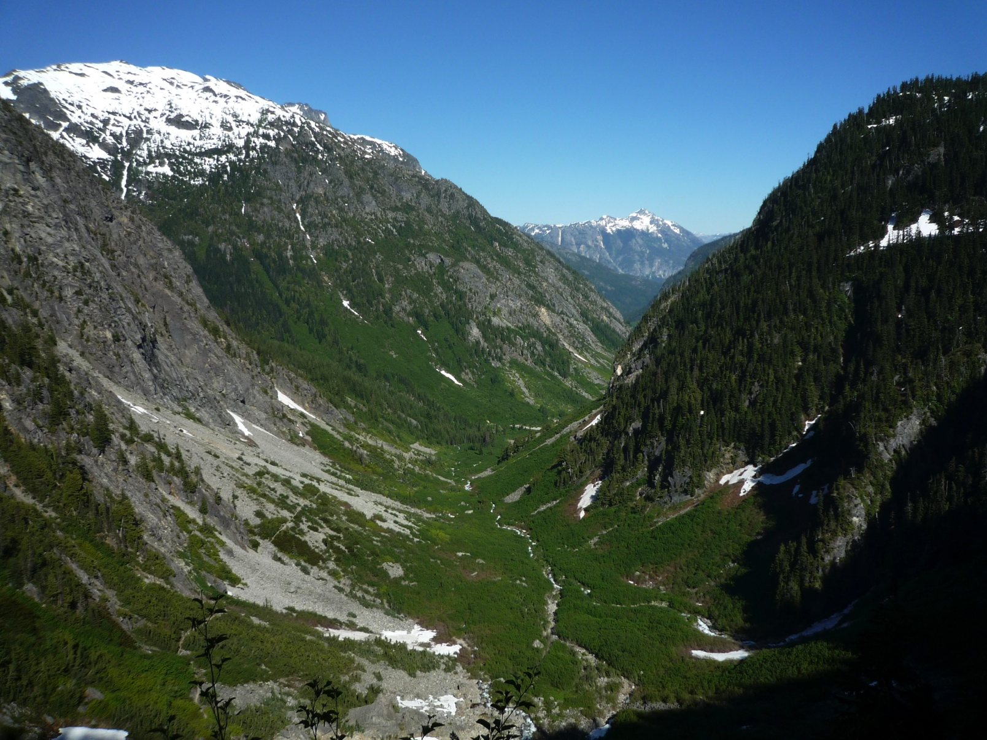

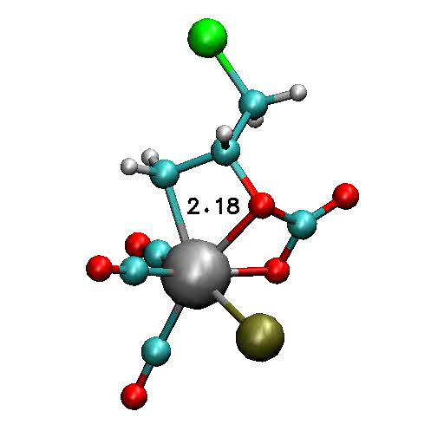
Unified Reaction Valley Approach (URVA)
TS
Based on the features of the quantum chemically determined potential energy surface

Slide 7
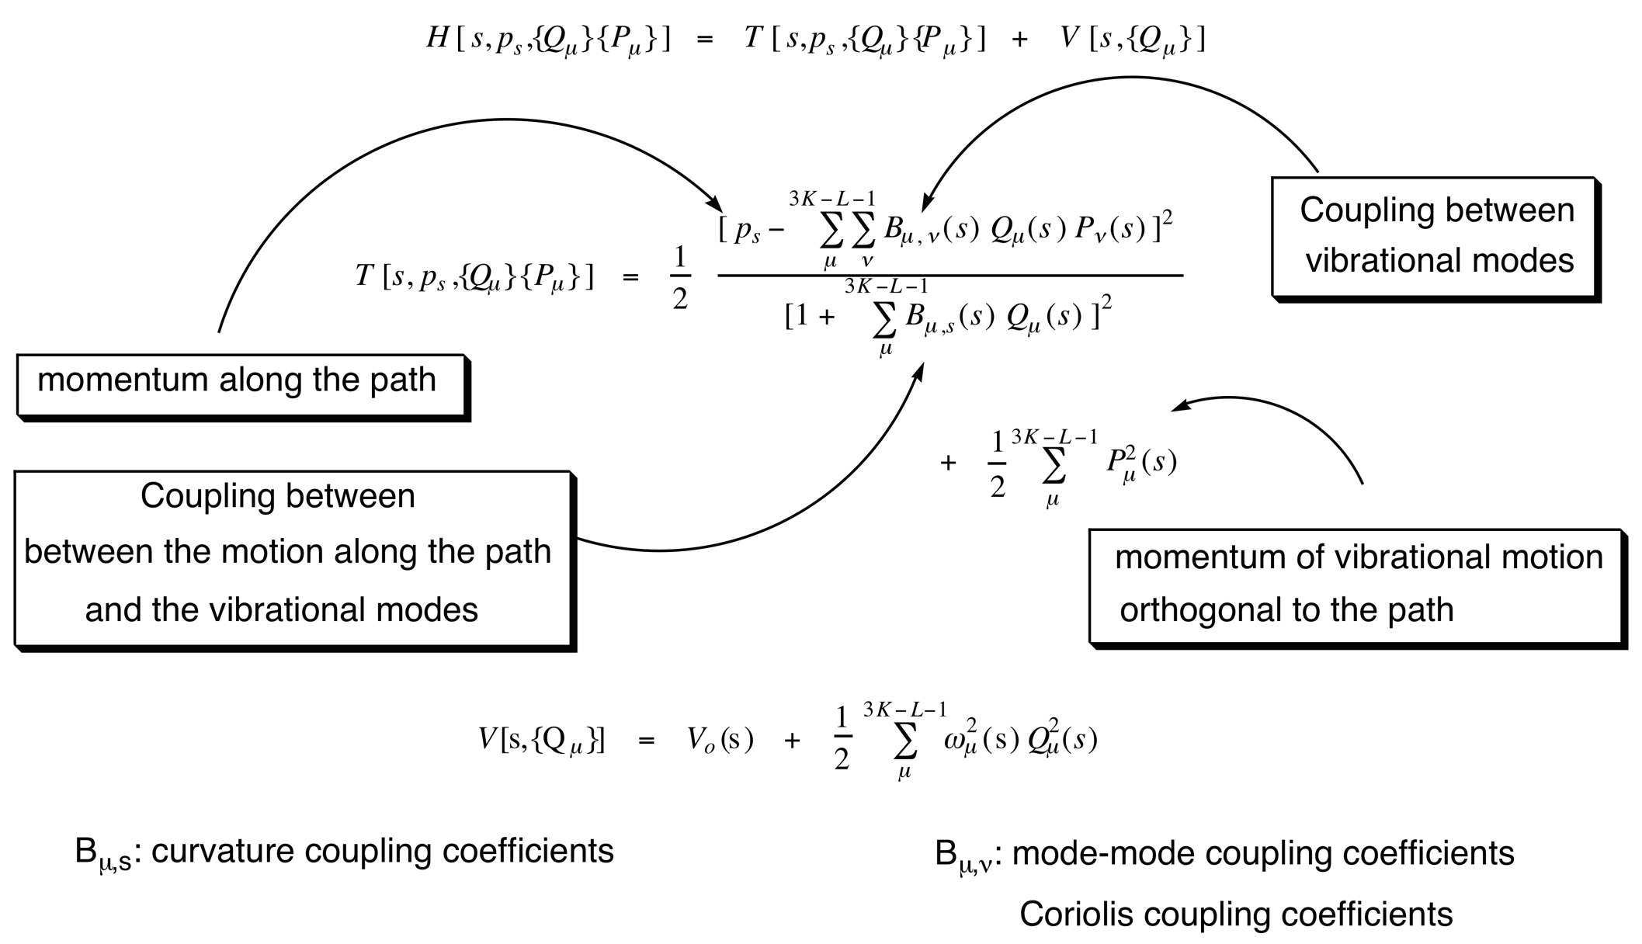
Reaction Path Hamiltonian
Miller, Handy, Adams, 1980

Slide 8
Definition of the arc length s
Definition of the path direction
Definition of the curvature

Slide 9
Connection Reaction Path Curvature and
Curvature Coupling Coefficients
Reaction path direction η(s) (tangent)
Normal mode l_{μ}(s)
Reaction path curvature vector κ(s)
Reaction path x_{s}(s), a curve in (3N-6) dimensional space!

Slide 10
Advanced path following
Notes:
10
This is my opening slide. I have to check what else it should conmtain

Slide 11
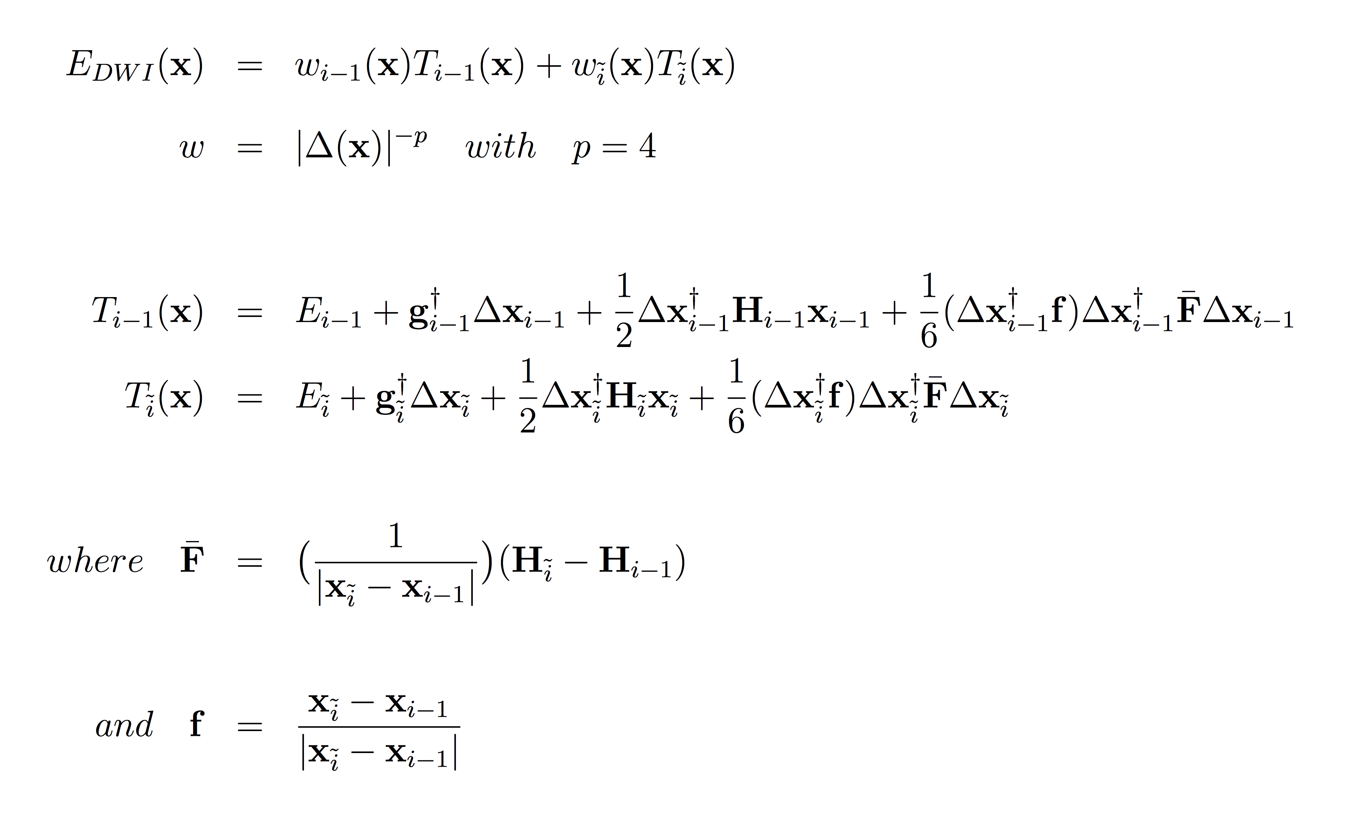
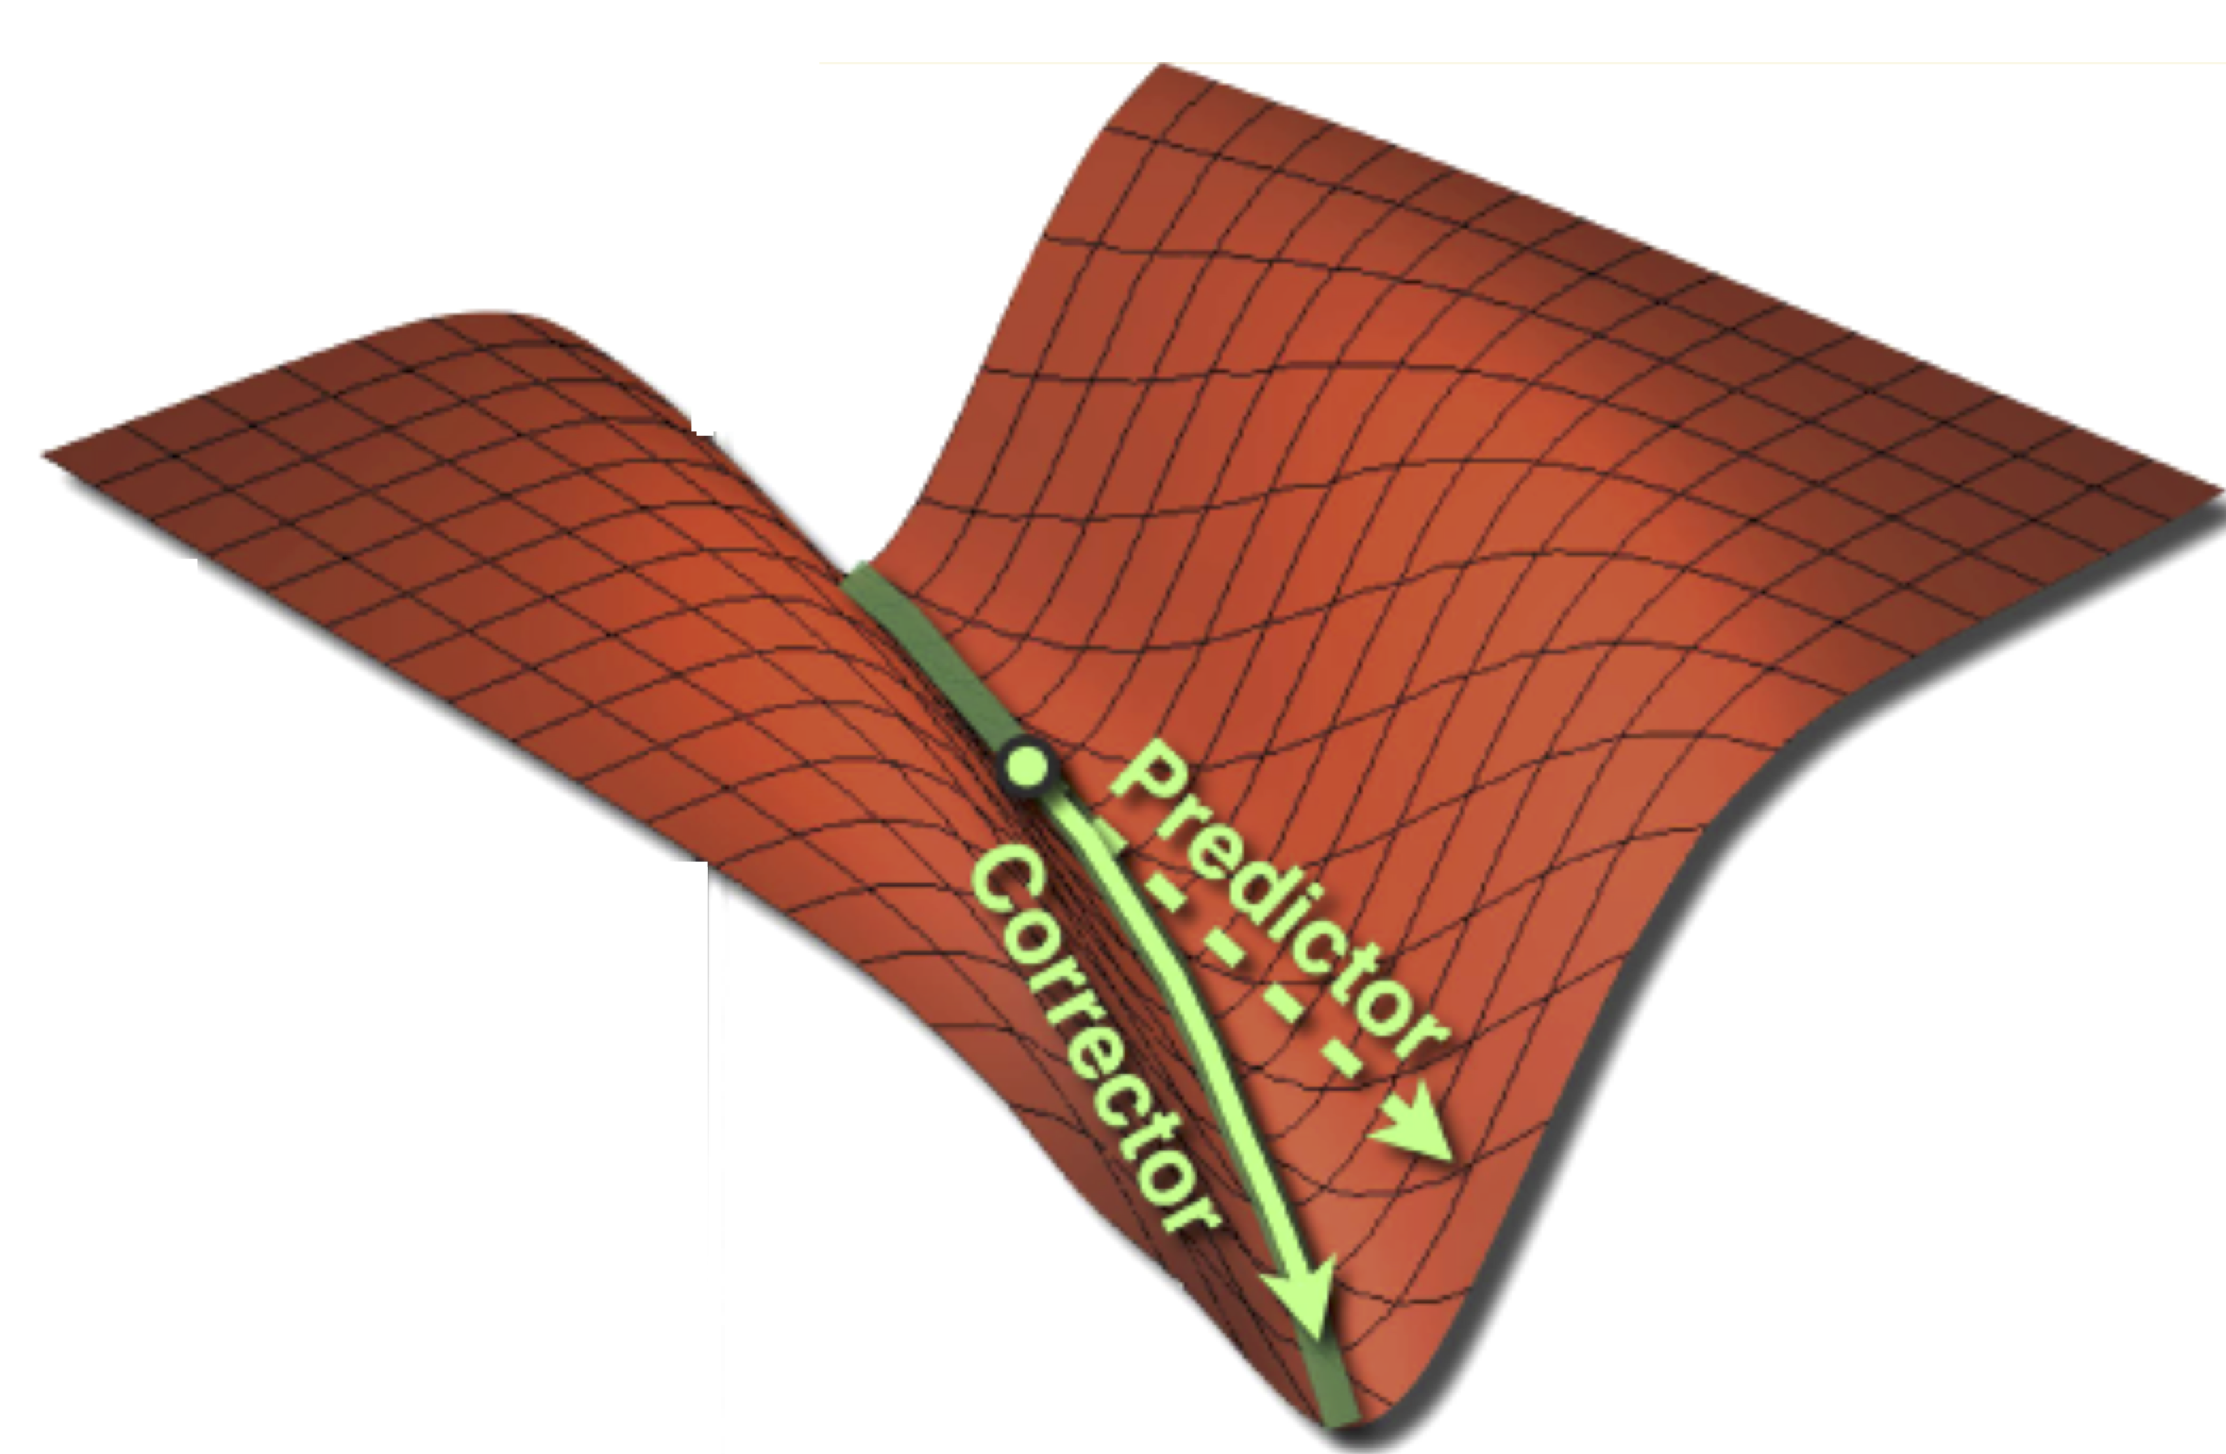
Improvement of the local surface fitting procedure of the predictor-corrector reaction path following integrators
(1)
improved weighting function w
(2)
inclusion of approximate 3rd derivatives
Hrant, Kraka, J. Chem. Theory Comput. 2013, 9, 1481-1488

Slide 12
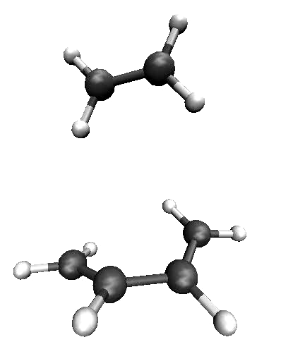
Diels Alder Reaction
Extended Entrance Channel
Path Length with
Standard programs
Extended Exit Channel
(kcal/mol) | B3LYP | CCSD(T)
ΔEª | 23.4 | 22.4
ΔE_{rxn} | -41.2 | -44.9

Slide 13
Analysis of the Reaction
Path Curvature
Notes:
13
This is my opening slide. I have to check what else it should conmtain

Slide 14
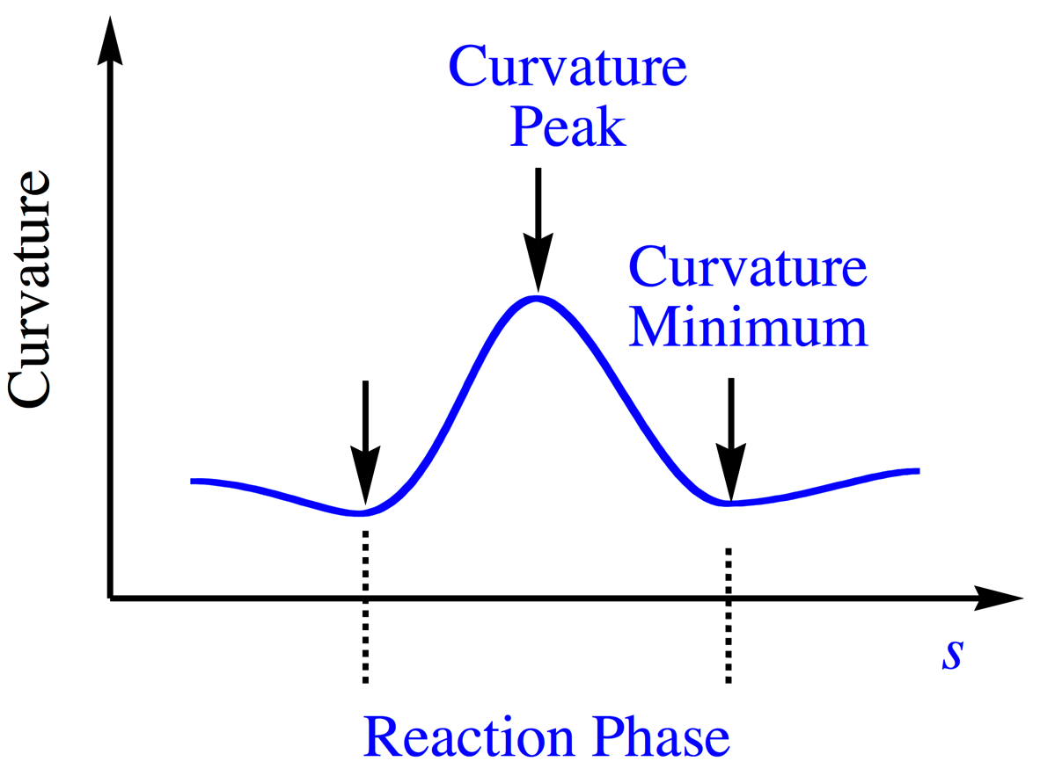
A reaction phase is defined by a curvature peak and
the RP range given by the flanking curvature minima
Scalar curvature κ(s) = |k(s)|
Notes:
14

Slide 15
Reaction Path Curvature
Smaller peaks show preparatory events
Large peak indicates bonding
Reaction Parameter s [amu^{1/2} Bohr]
Reactants
TS (s=0)
Product
Notes:
Curvature peaks denote important chemical changes, so as the formation of the two new CC bond, shown here.

Slide 16
Reaction Path Curvature
Symmetry Allowed reaction
No curvature peak near TS
Small changes in chemical phases
Bond formation after TS
Only energy costs before TS matter
Reaction Parameter s [amu^{1/2} Bohr]
Reactants
TS (s=0)
Product
Notes:
Because the Diels- Alder is a symmetry allowed reaction, there are only small changes in the chemical phases, and no particular curvature peak near the TS.
In fact, the TS does not stand out at all on the curvature plot: The aromatization point, where bond lengths are equalized, is beyond the TS in the exit channel.
A large curvature peak in the exit channel signals the simultaneous formation of both C-C bonds.
The energy cost for this reaction is for the original approach, orientation, and charge transfer which occur in the entrance channel.
Because bond formation occurs well after the TS, it doesn’t cost energy.

Slide 17
Decomposition of the reaction
path curvature
Notes:
17
This is my opening slide. I have to check what else it should conmtain

Slide 18
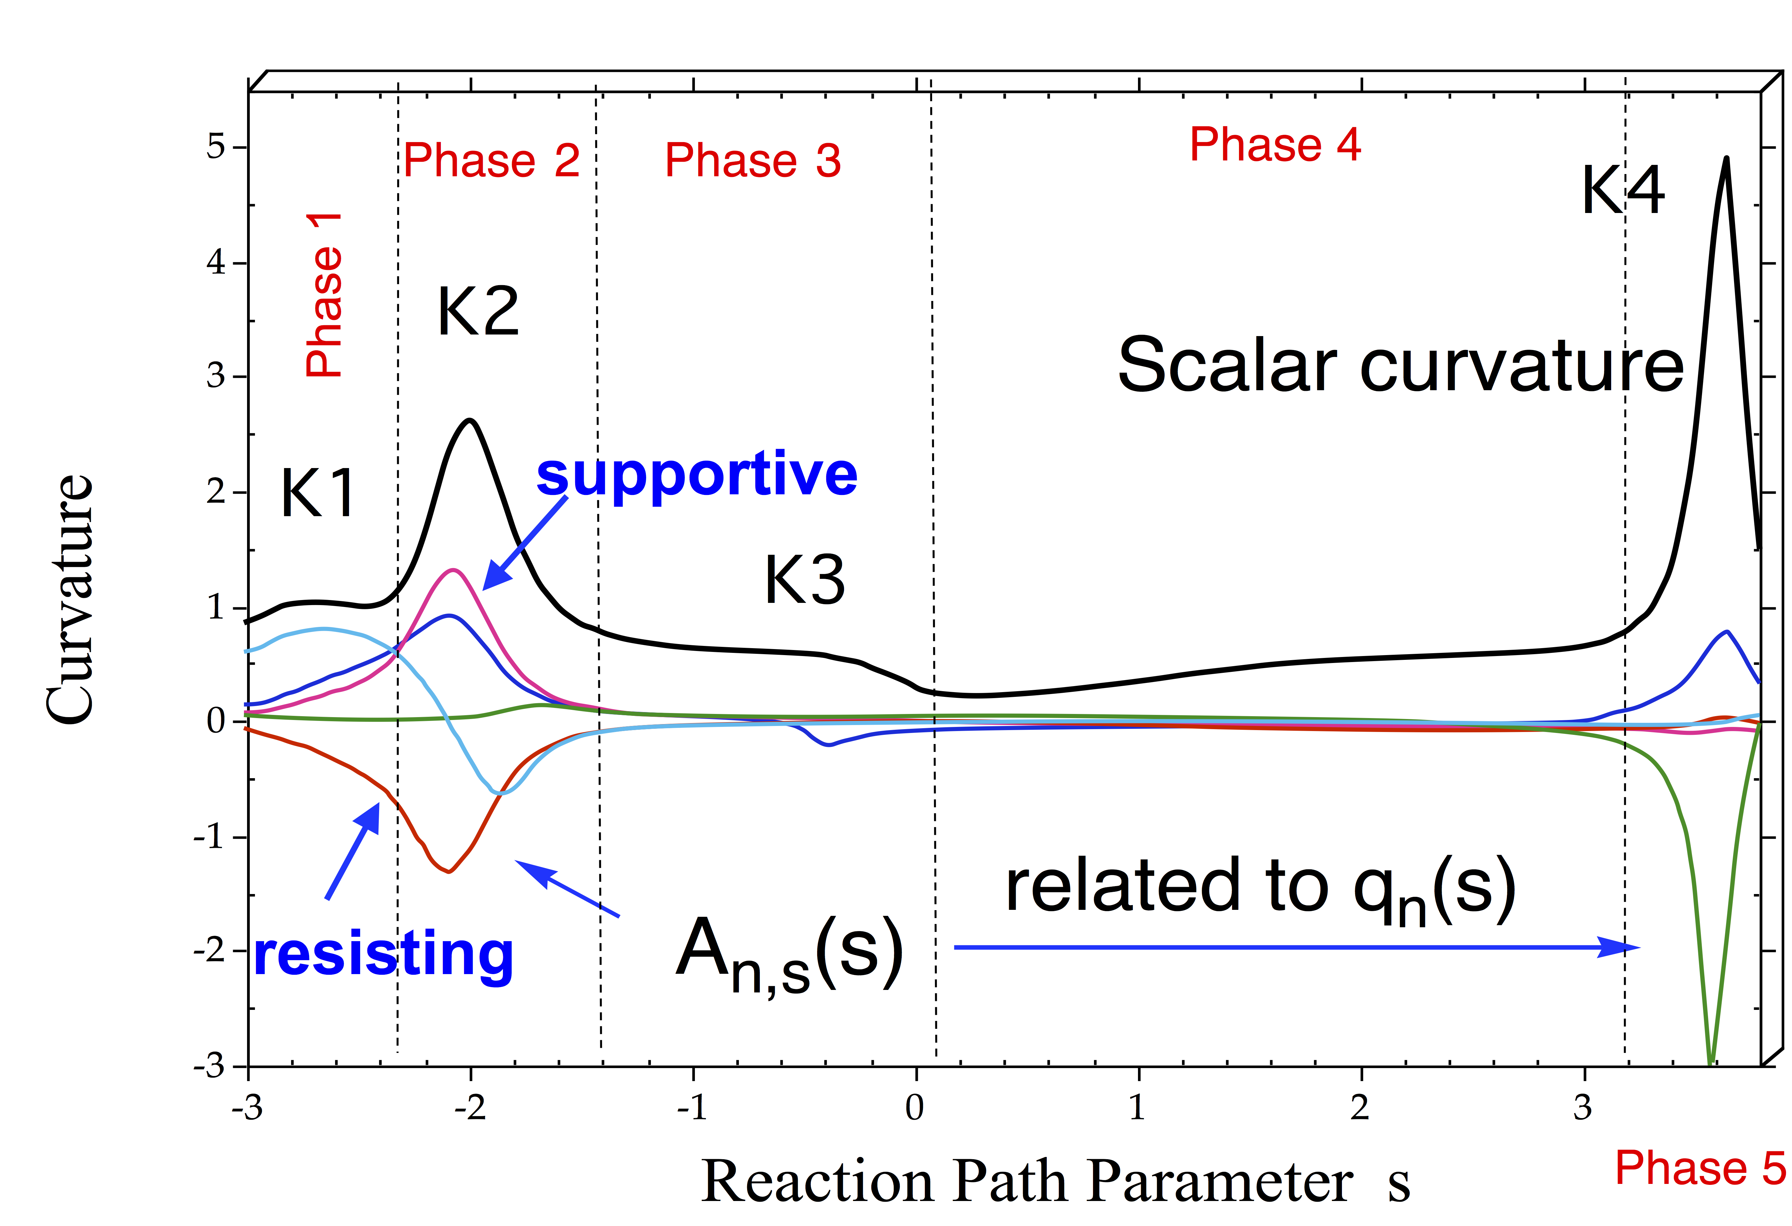
Curvature decomposition into local mode contributions A_{n,s}(s)
Notes:
18

Slide 19
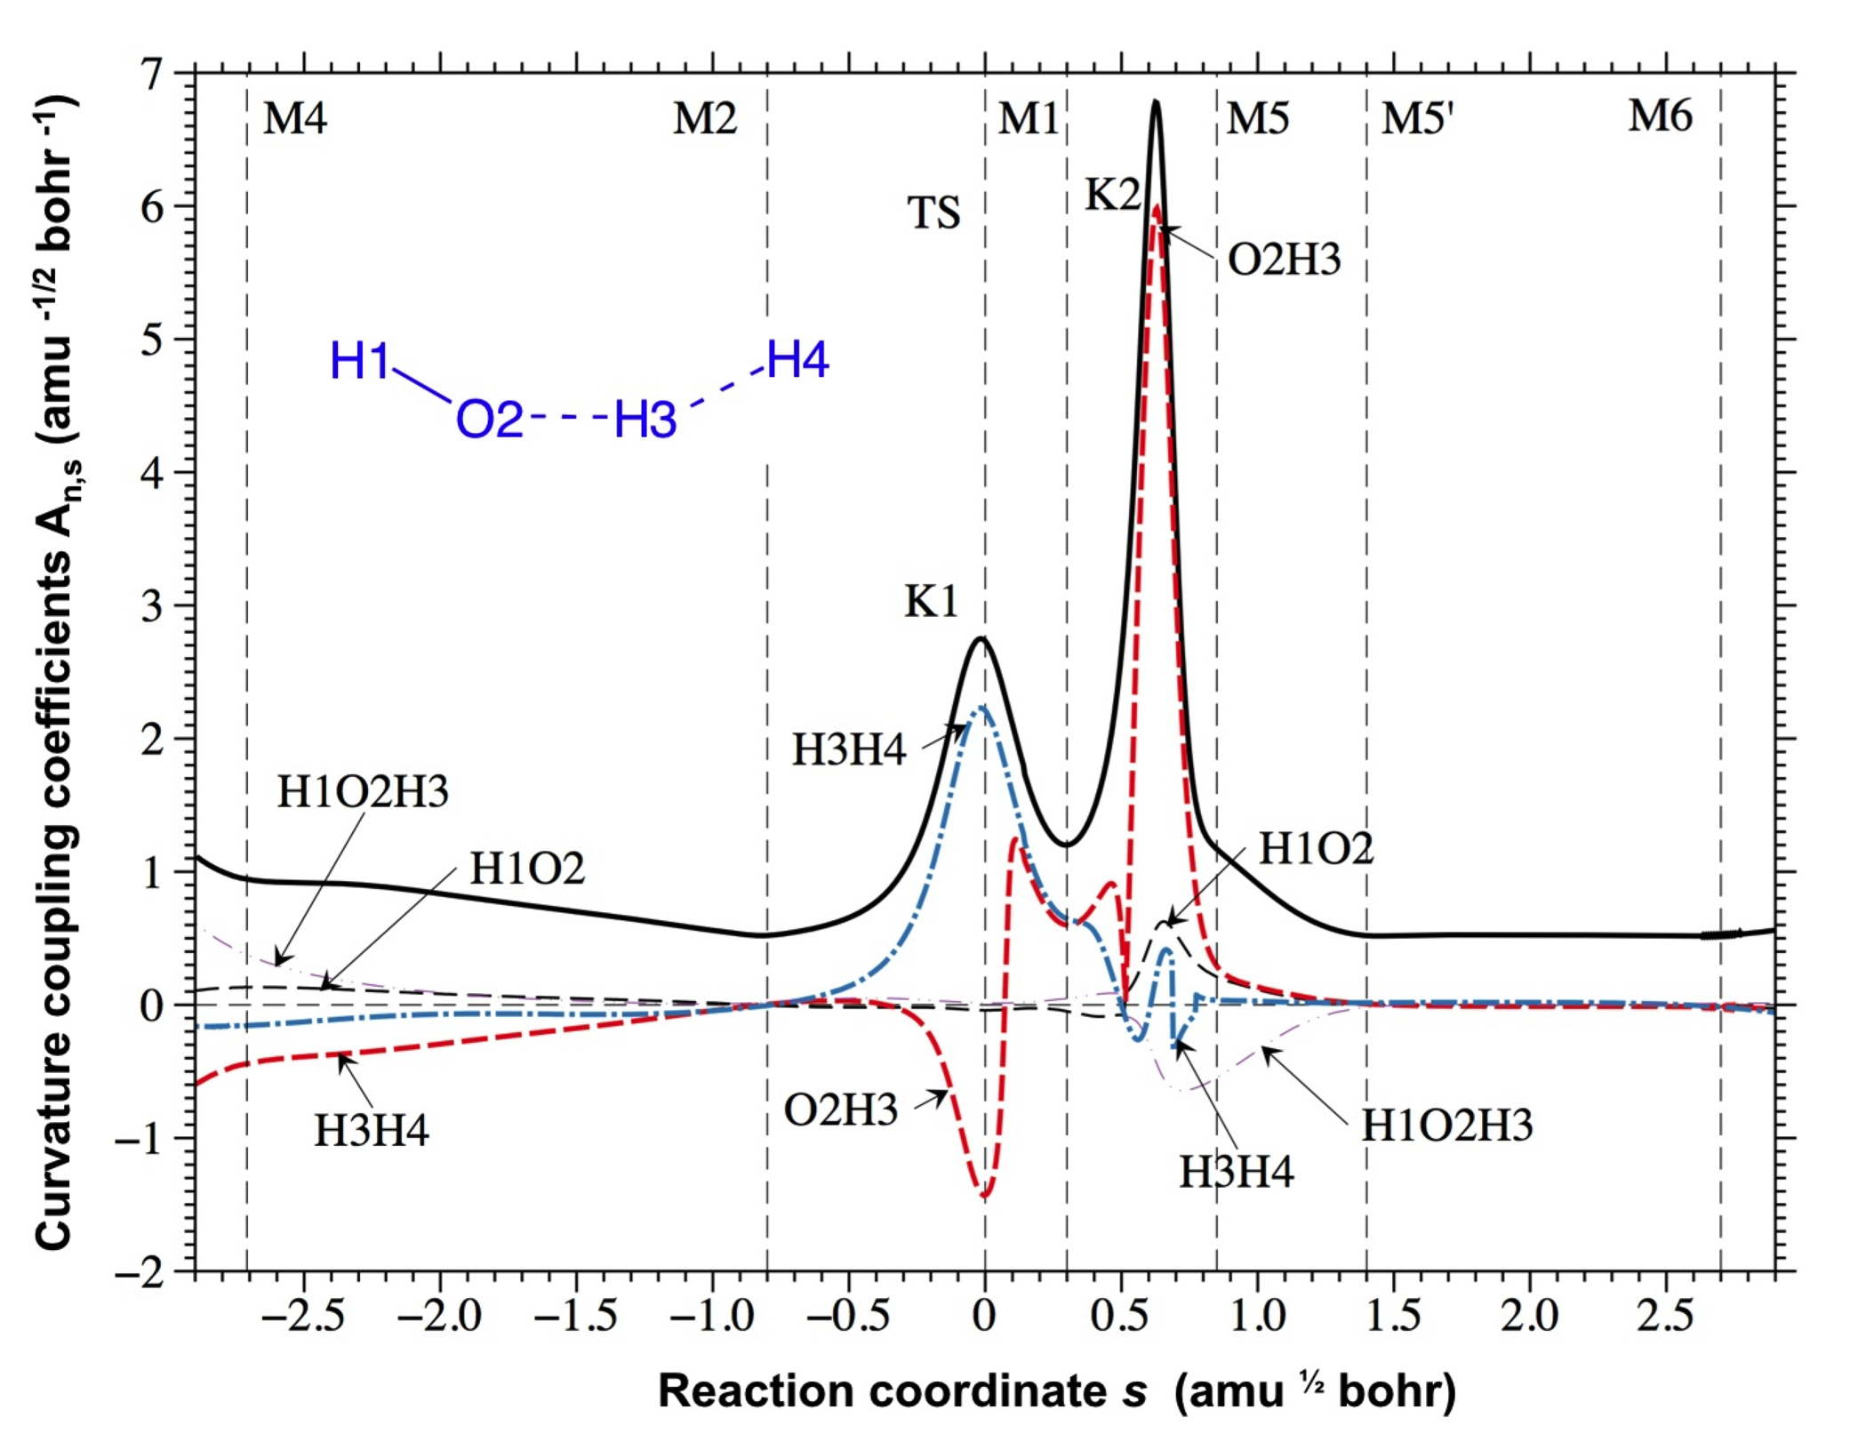
OH formation
orientation
polarization of charge
charge transfer
HH cleavage
rehybridization
product adjustment
Phase 1
Phase 2
Phase 3
Phase 4

Slide 20
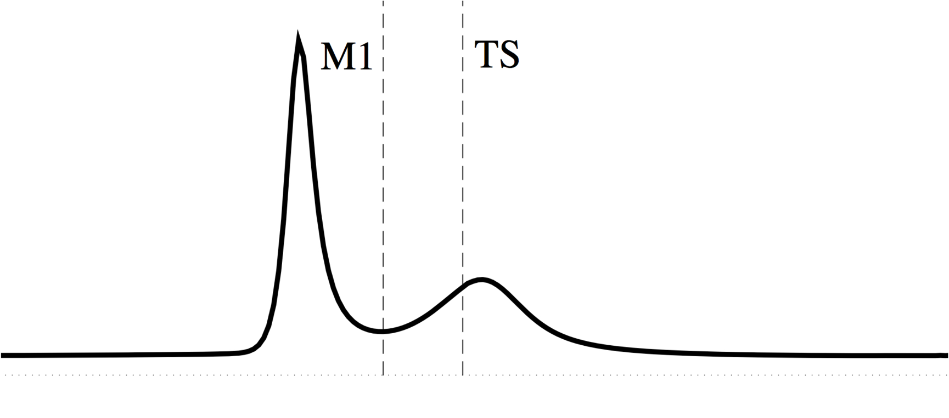
References: Shift Δs of the position of M1 with regard to TS
Δs = s(M1) – s(TS)
K1
endothermic reaction
M1
K2
s(M1)
0
s
Δs = s(M1) < 0 endothermic reaction (late TS)
> 0 exothermic (early TS)

Slide 21
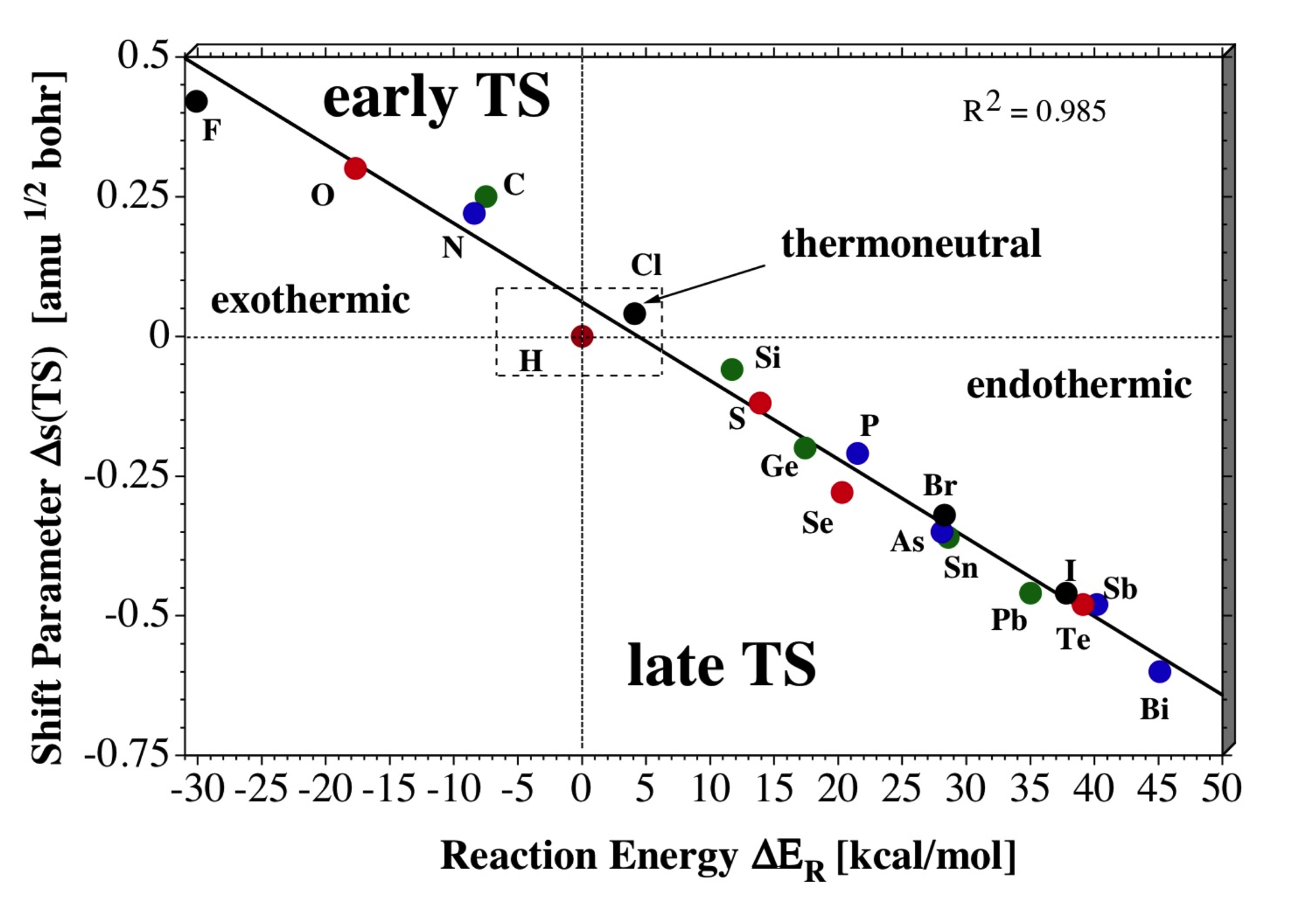
Quantification of the Hammond-Leffler Postulate
XH_{n} + H₂ XH_{n+1} + H

Slide 22
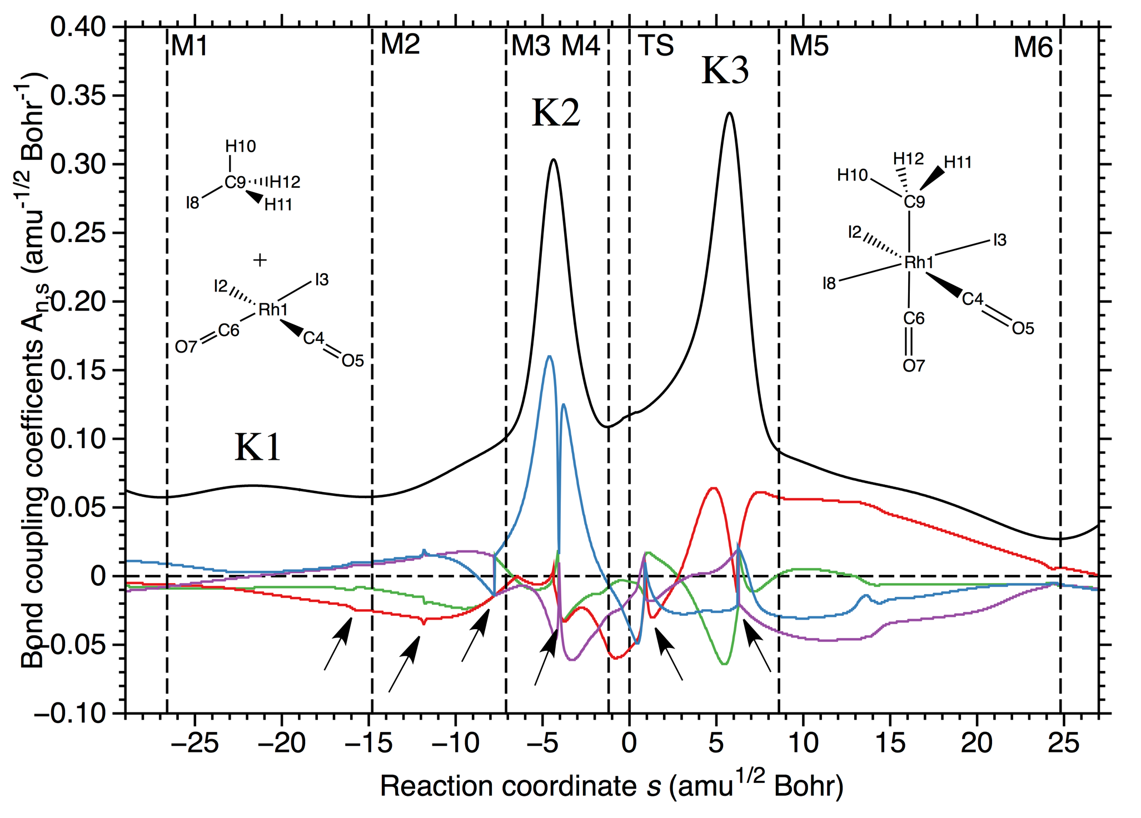
The generalized local vibrational modes depend on the generalized normal vibrational
modes and inherit any problem indicated by the latter.
Path instabilities indicated by imaginary frequencies
Curvature decomposition into local modes
fail!
?
Rhodium catalyzed
methanol carbonylation
?

Slide 23
New curvature decomposition
Notes:
23
This is my opening slide. I have to check what else it should conmtain

Slide 24
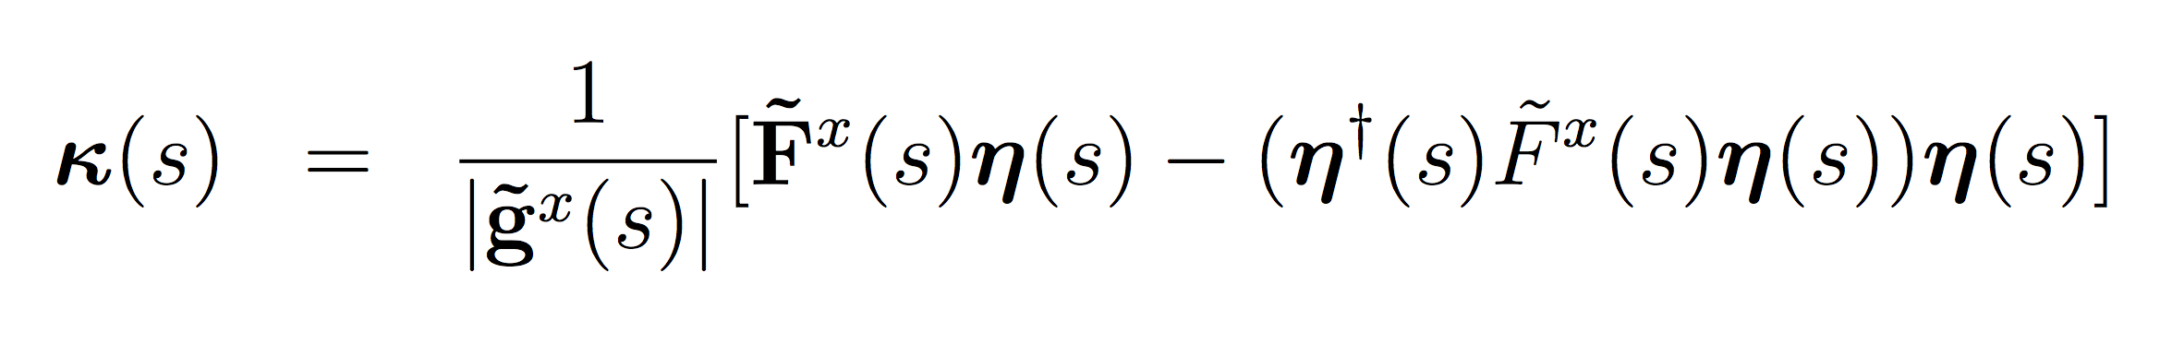
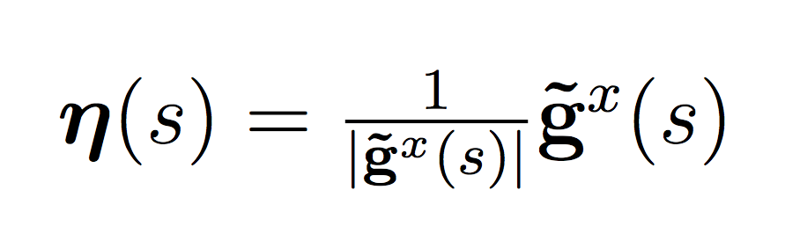
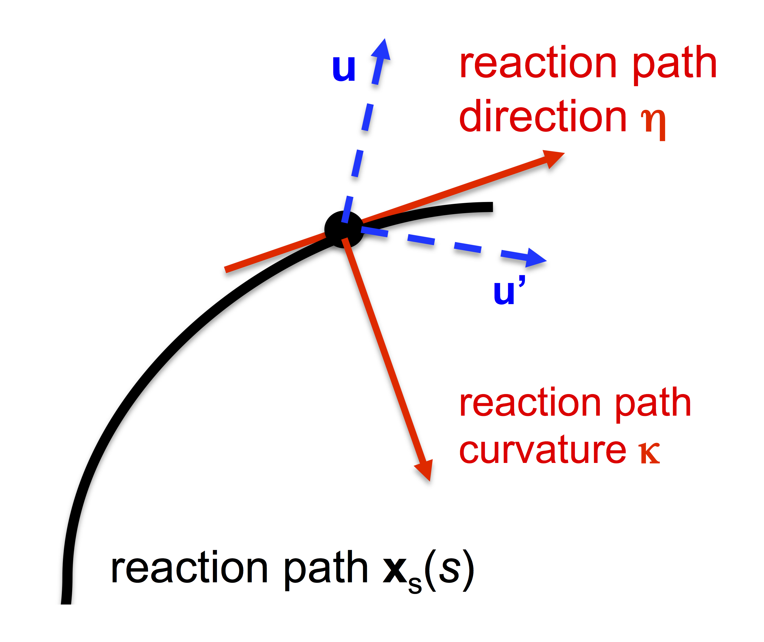
Analysis of the reaction path curvature
in terms of internal coordinate components
g^{x} energy gradient in Cartesian Coordinates (tilde: mass-weighting)
F^{x} Force constant matrix in Cartesian Coordinates
η reaction path direction
reaction path curvature vector
q_{n} nth internal coordinate
M mass matrix
G Wilson G-matrix
B Wilson B-matrix
u_{n} local translational mode contribution of q_{n} to path direction

Slide 25
Curvature Decomposition into internal coordinate components
Rhodium catalyzed
methanol carbonylation

Slide 26
均相催化
对40个催化循环中大约200个均相催化反应
(Fe, Ni, Cu, Ru,
Rh, Pd, Pt, 以及Au配合物参与)
的URVA研究对催化反应的机理给出了崭新并且详细的解释

Slide 27
Sharpless Epoxidation
Of Allylic Alcohols

Slide 28
Open channel
for ROOH

Slide 29
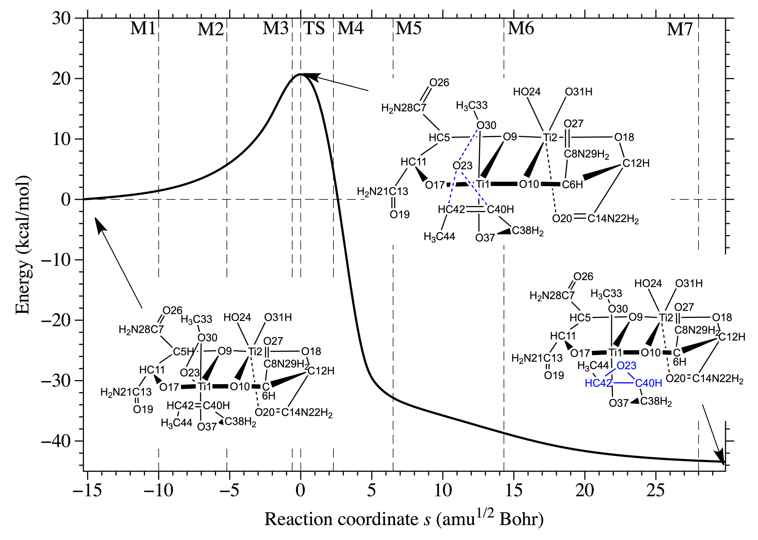
5
6
7
8
Phase
1
2
3
4
Barrier for OO cleavage without catalyst is more than 40 kcal/mol!

Slide 30
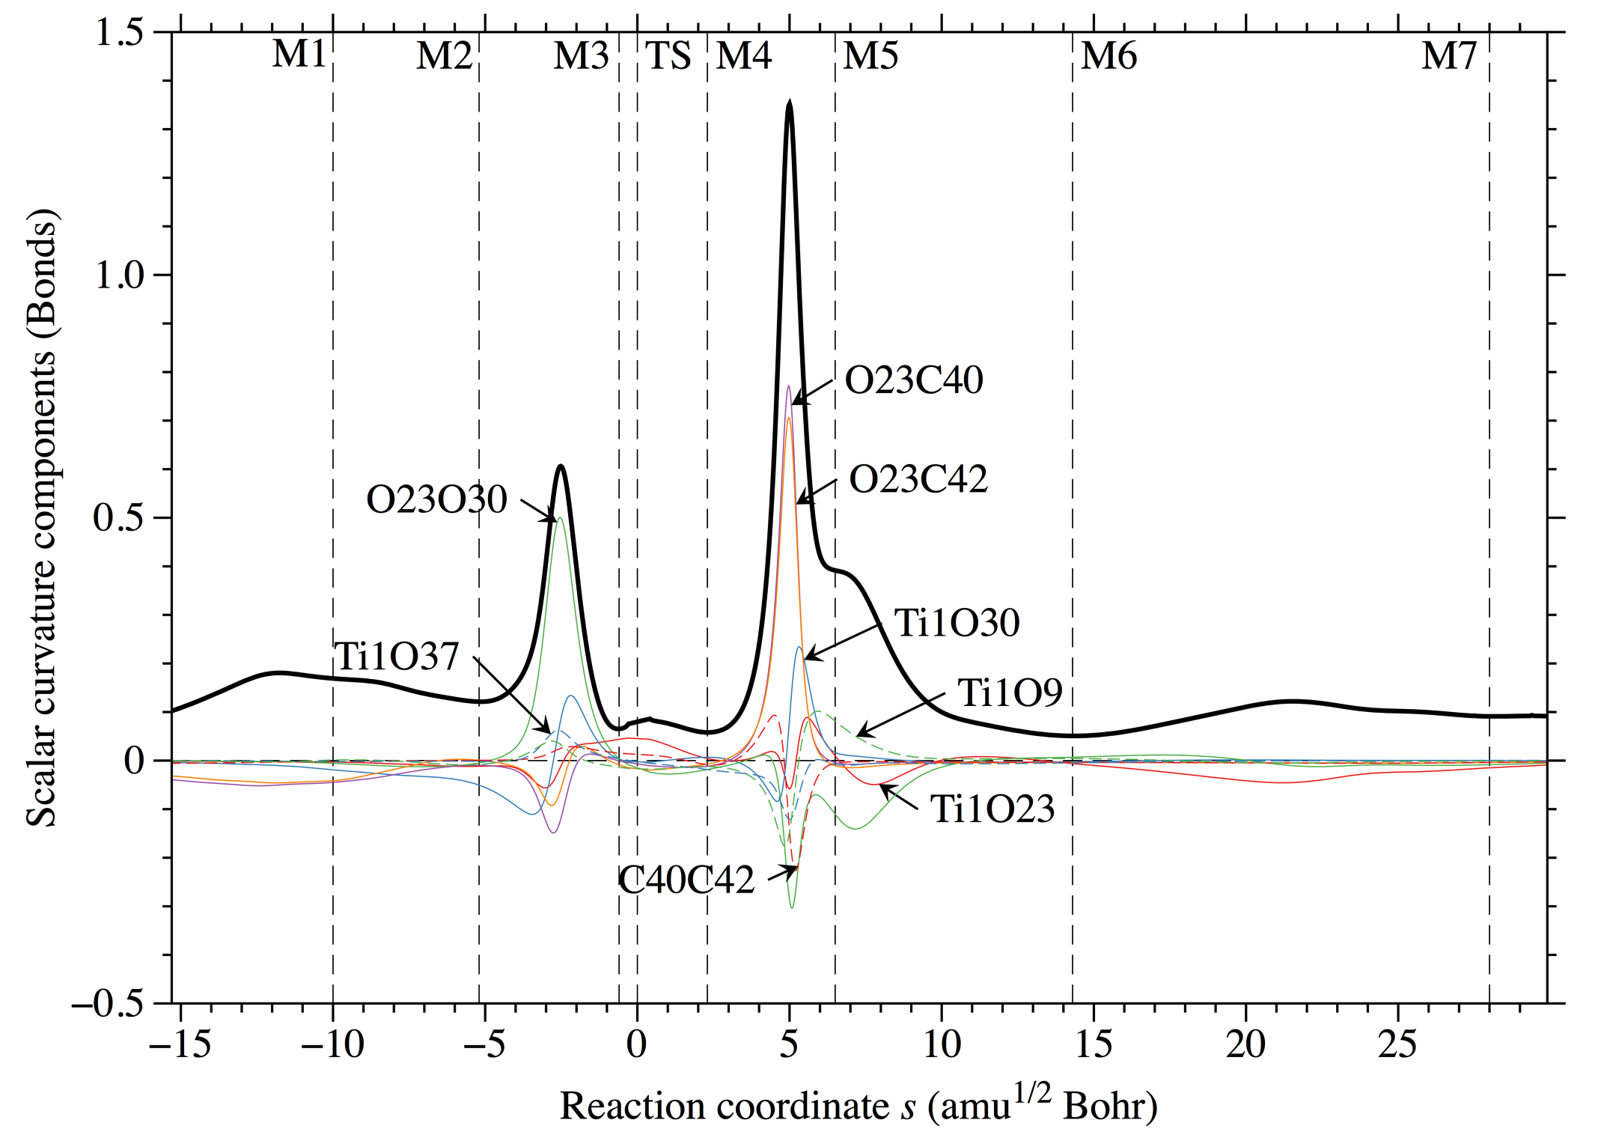
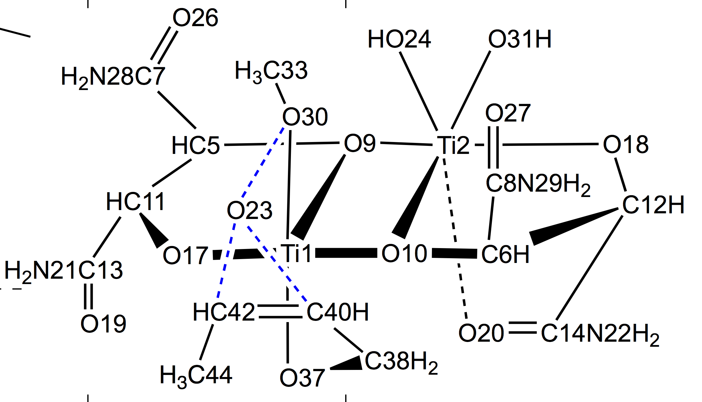
1
2
3
4
5
6
7
8
formation of
epoxide bonds
peroxide bond
cleavage
allyl group
rotations
allyl group
rotations
Technically challenging; 800 – 1500 bfns, ca 45 s-units corresponding to 1500 path points

Slide 31
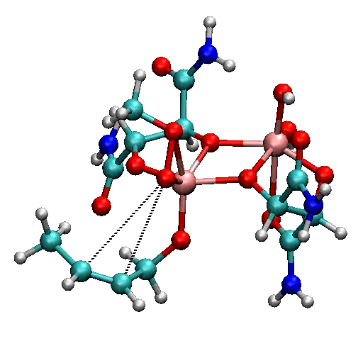
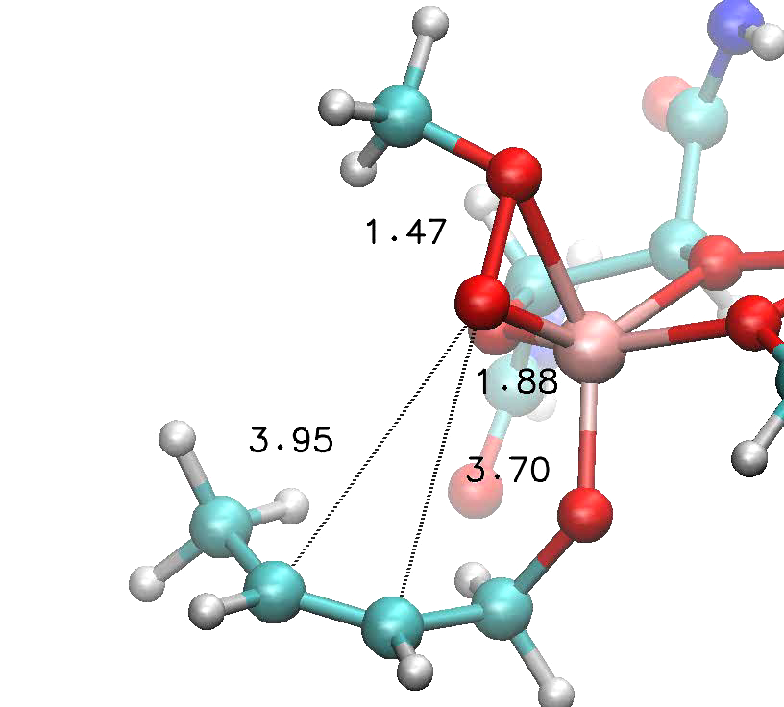
How does the reaction complex change along the reaction path?

Slide 32
Sharpless催化剂的活性基于：
空间位阻: 钛二聚体模拟的“表面”（非均相催化）辅助了反应物之间的相互接近
削弱被过氧化物的钛配合物断裂的O-O键

Slide 33
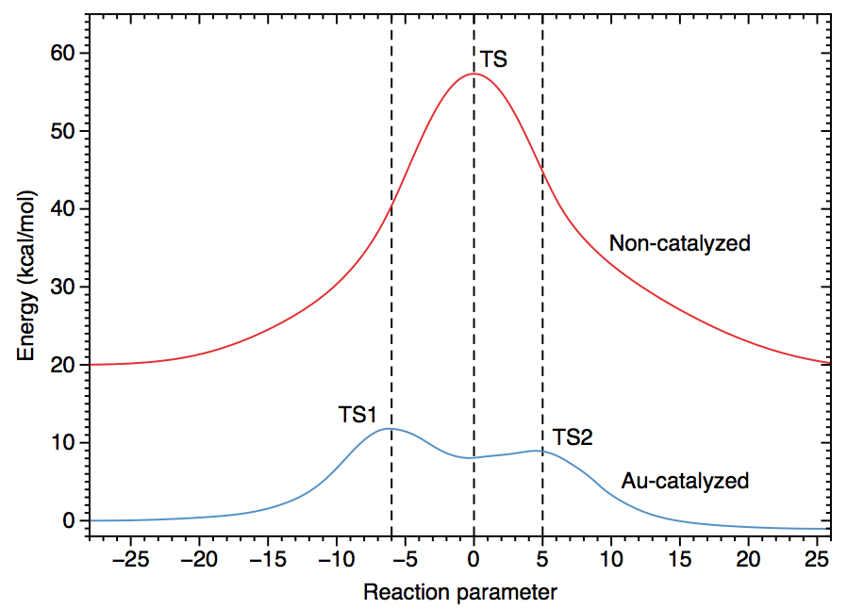
Gold Catalyzed Rearrangement Of Allylic Acetate
Energy

Slide 34
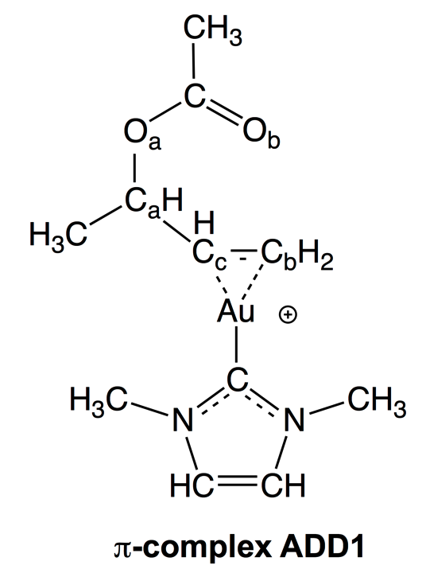
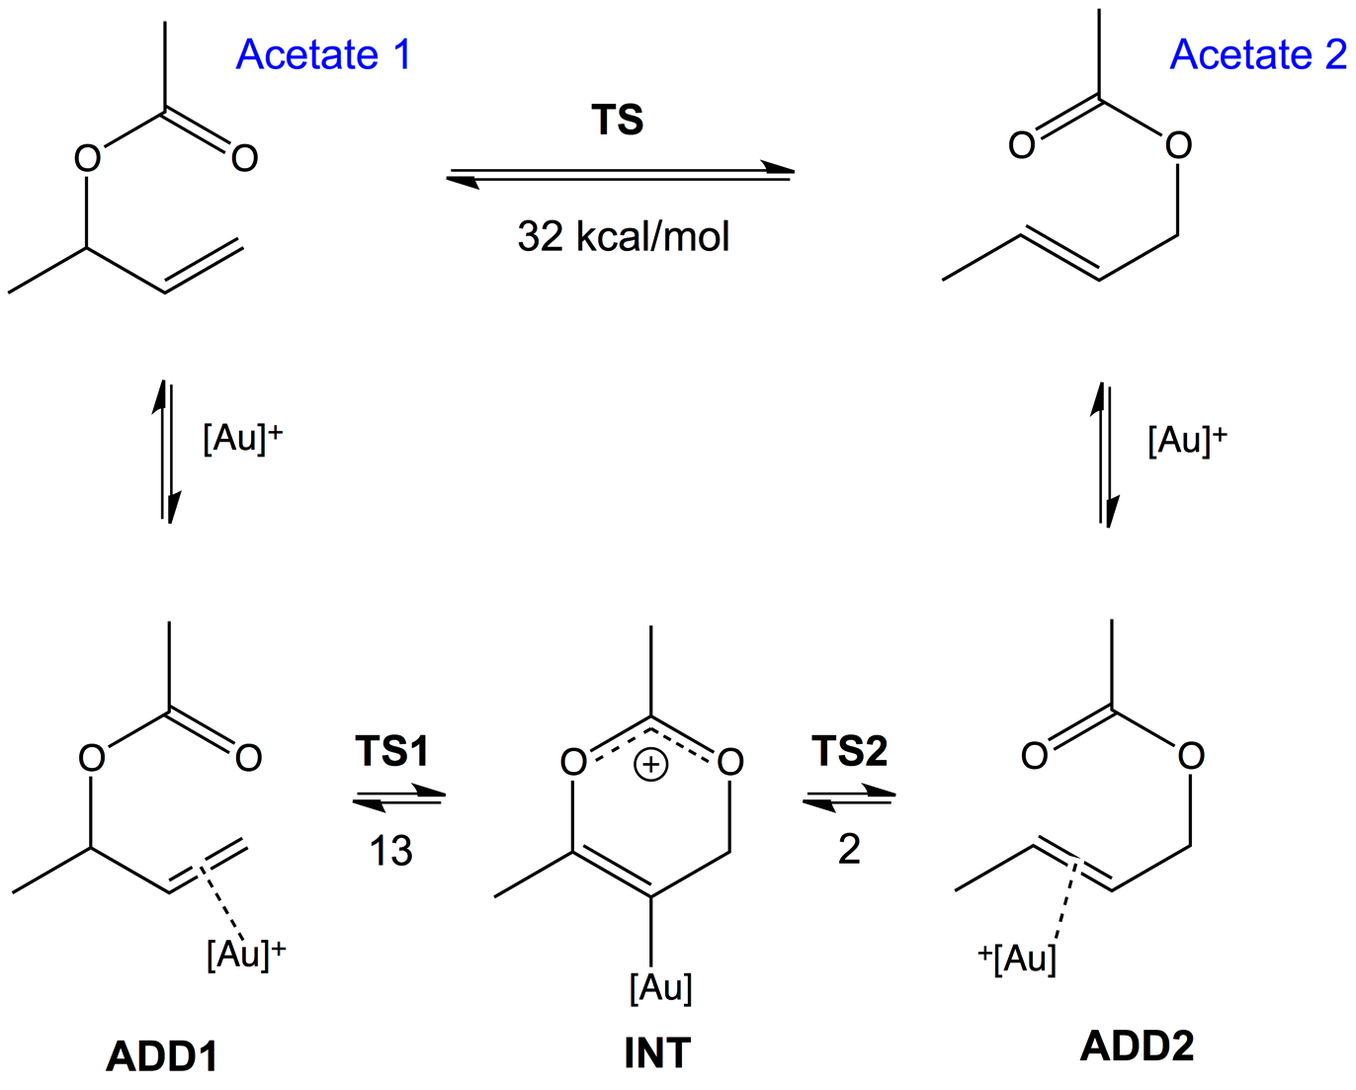
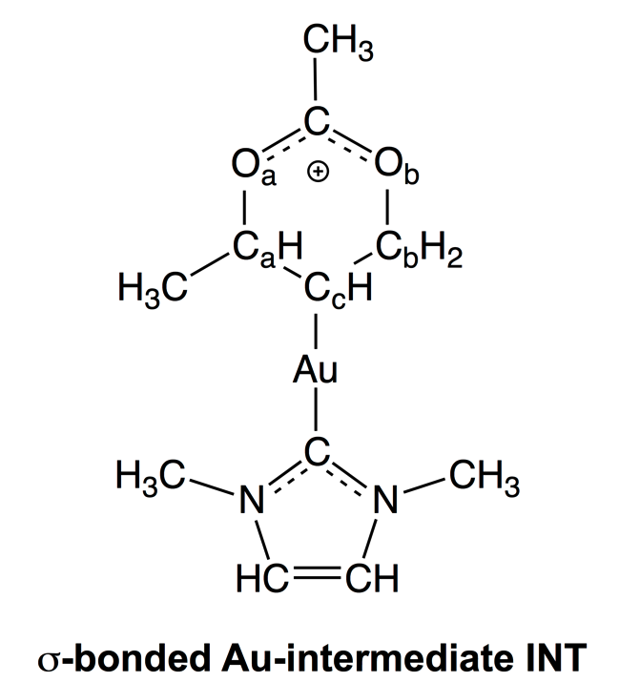
Uncatalyzed
Catalyzed

Slide 35
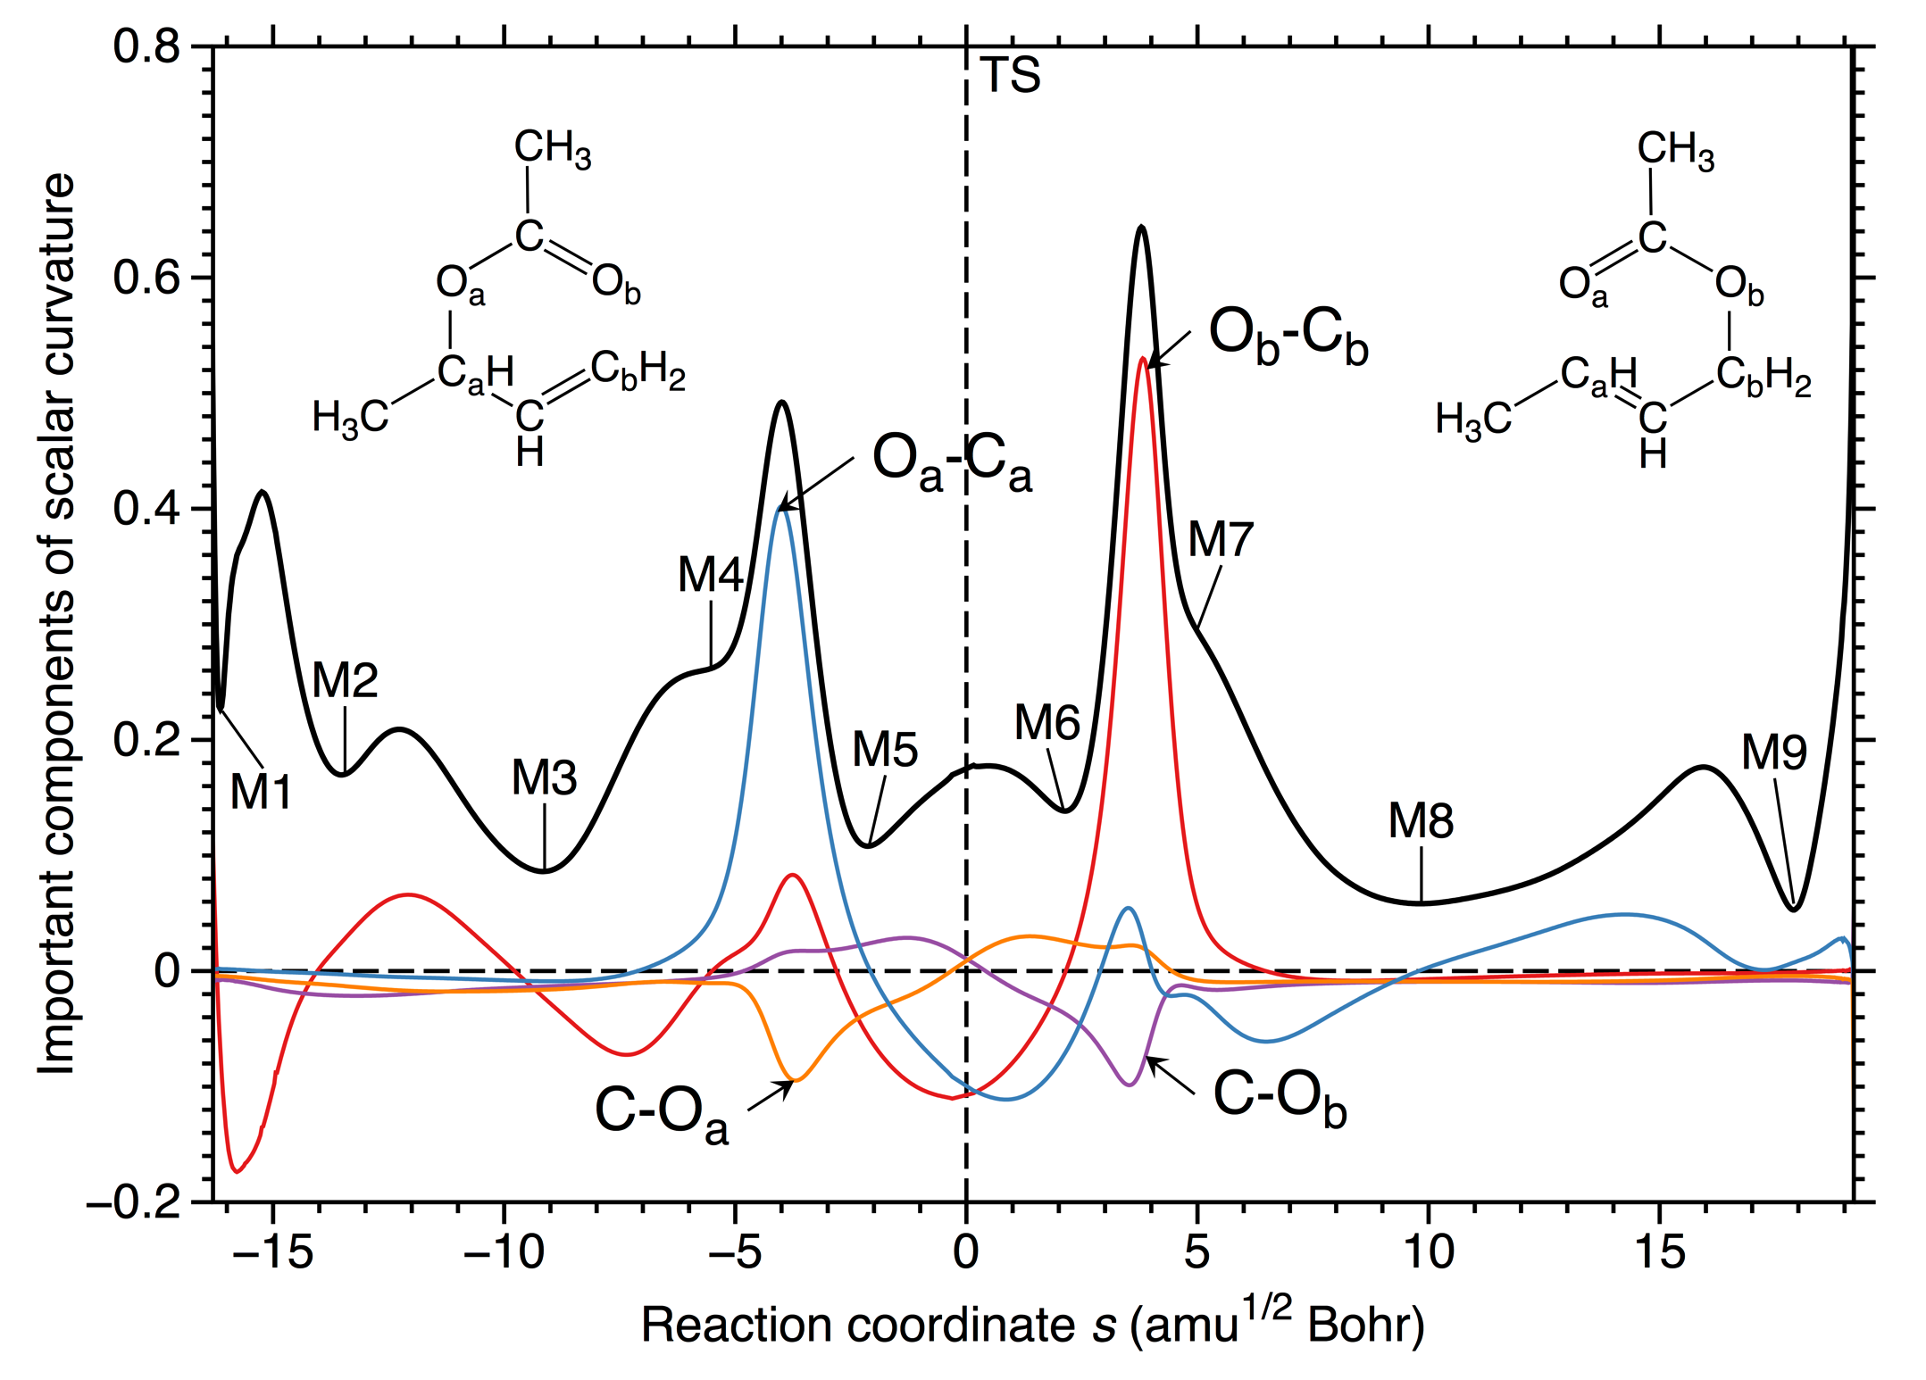
Uncatalyzed reaction
6
4
boat
1
2
3
7
8
9
twistboat
5
twistboat
rotations
rotations

Slide 36
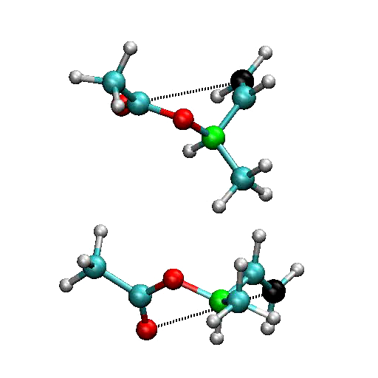
Uncatalyzed reaction via boat transition state

Slide 37
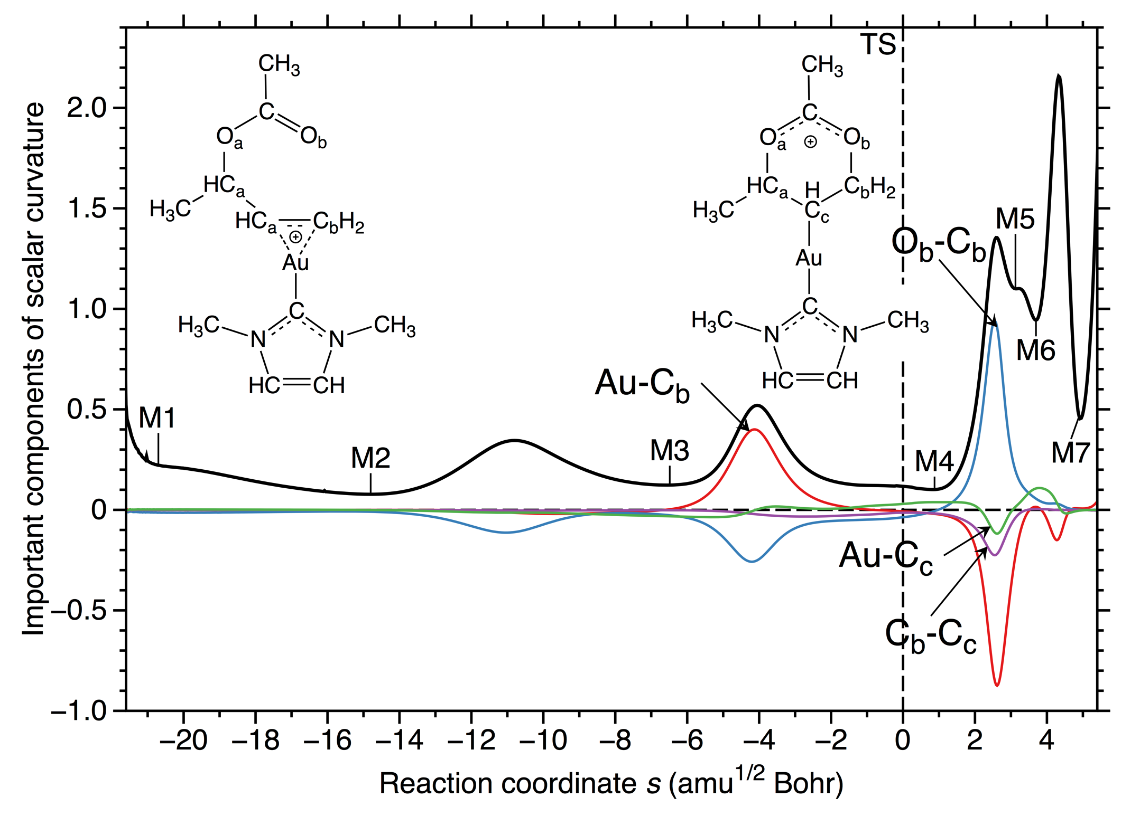
Step 1: conversion of π-complex in σ-bonded complex
7
6
5
1
2
3
4
Formation of C_{b}O_{b} bond leaving the C_{a}O_{a} bond
intact, no need for a boat form!

Slide 38
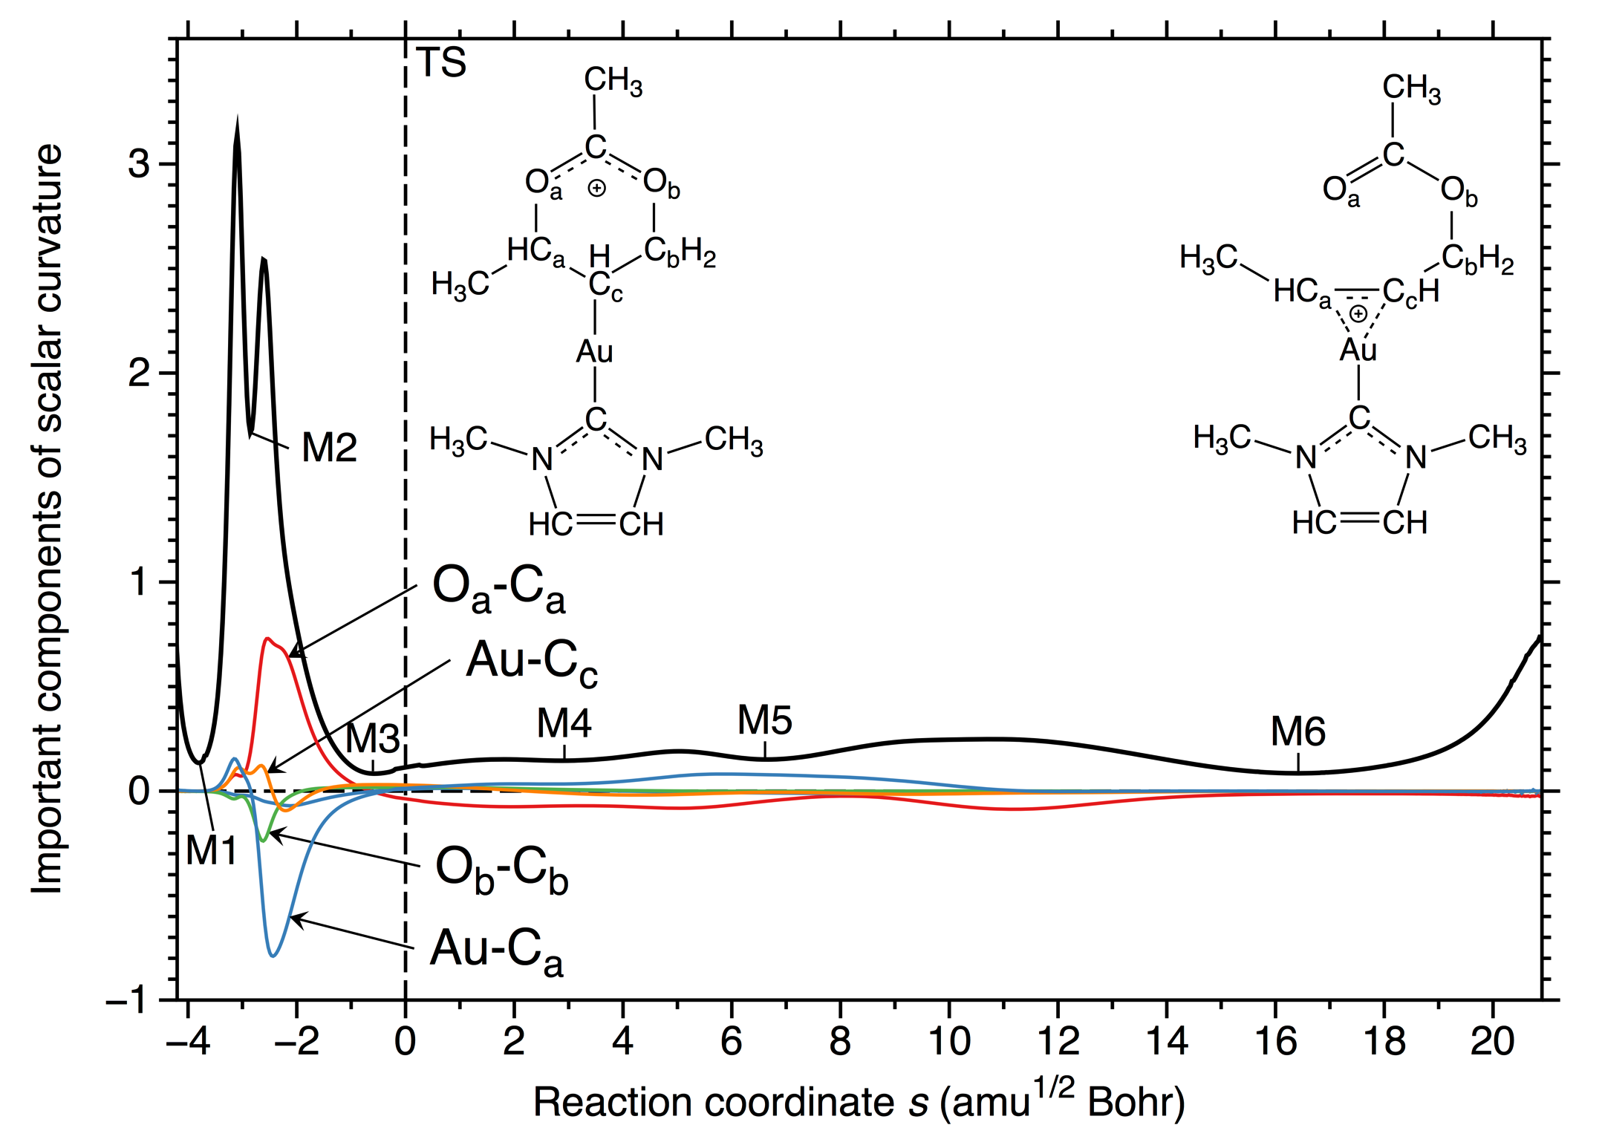
Step 2: regeneration of the more stable π-complex
1
2
4
3
5
6
7

Slide 39
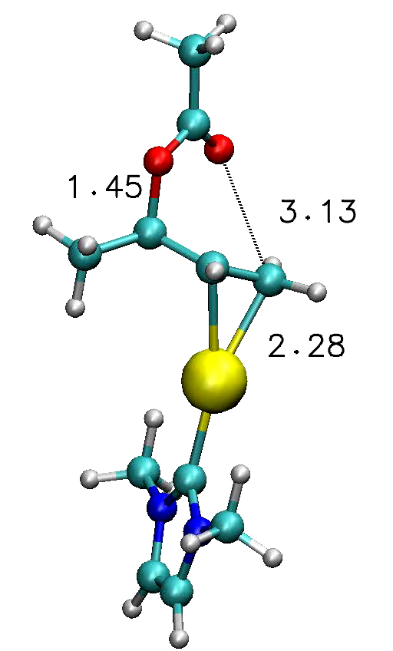
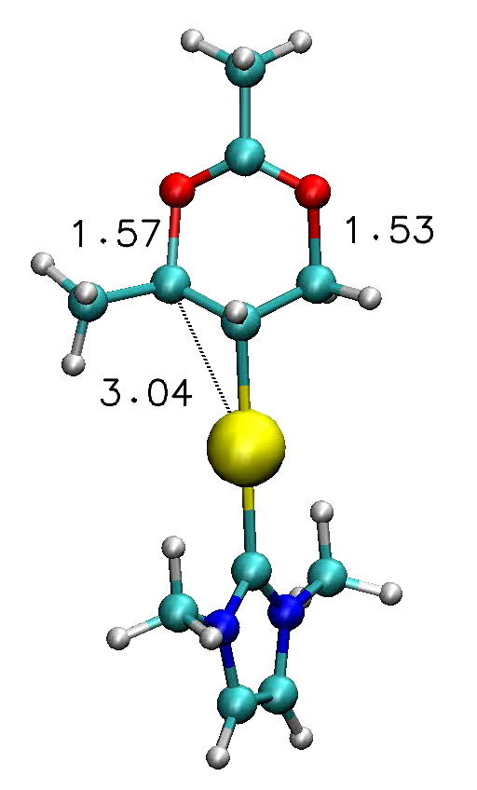
Au catalyzed reaction
Step1
Step2

Slide 40
金卡宾催化剂的特点
稳定的s键中间体的形成 (固定TS) 引发一个两步骤机理
简化环“假转动”的过程 (~7 kcal/mol)
辅助C-O键断裂过程以及C-O形成过程 (~12 kcal/mol)

Slide 41
Rhenium Catalyzed CO₂-capture
(Use of greenhouse gas CO₂ as chemical feedstock instead of sequestration)

Slide 42
Coupling of CO₂ with an epoxide
Product:
Cyclic Carbonate
37.6 kcal/mol
Most critical step
6.6 kcal/mol
13.3 kcal/mol
15.5 kcal/mol

Slide 43
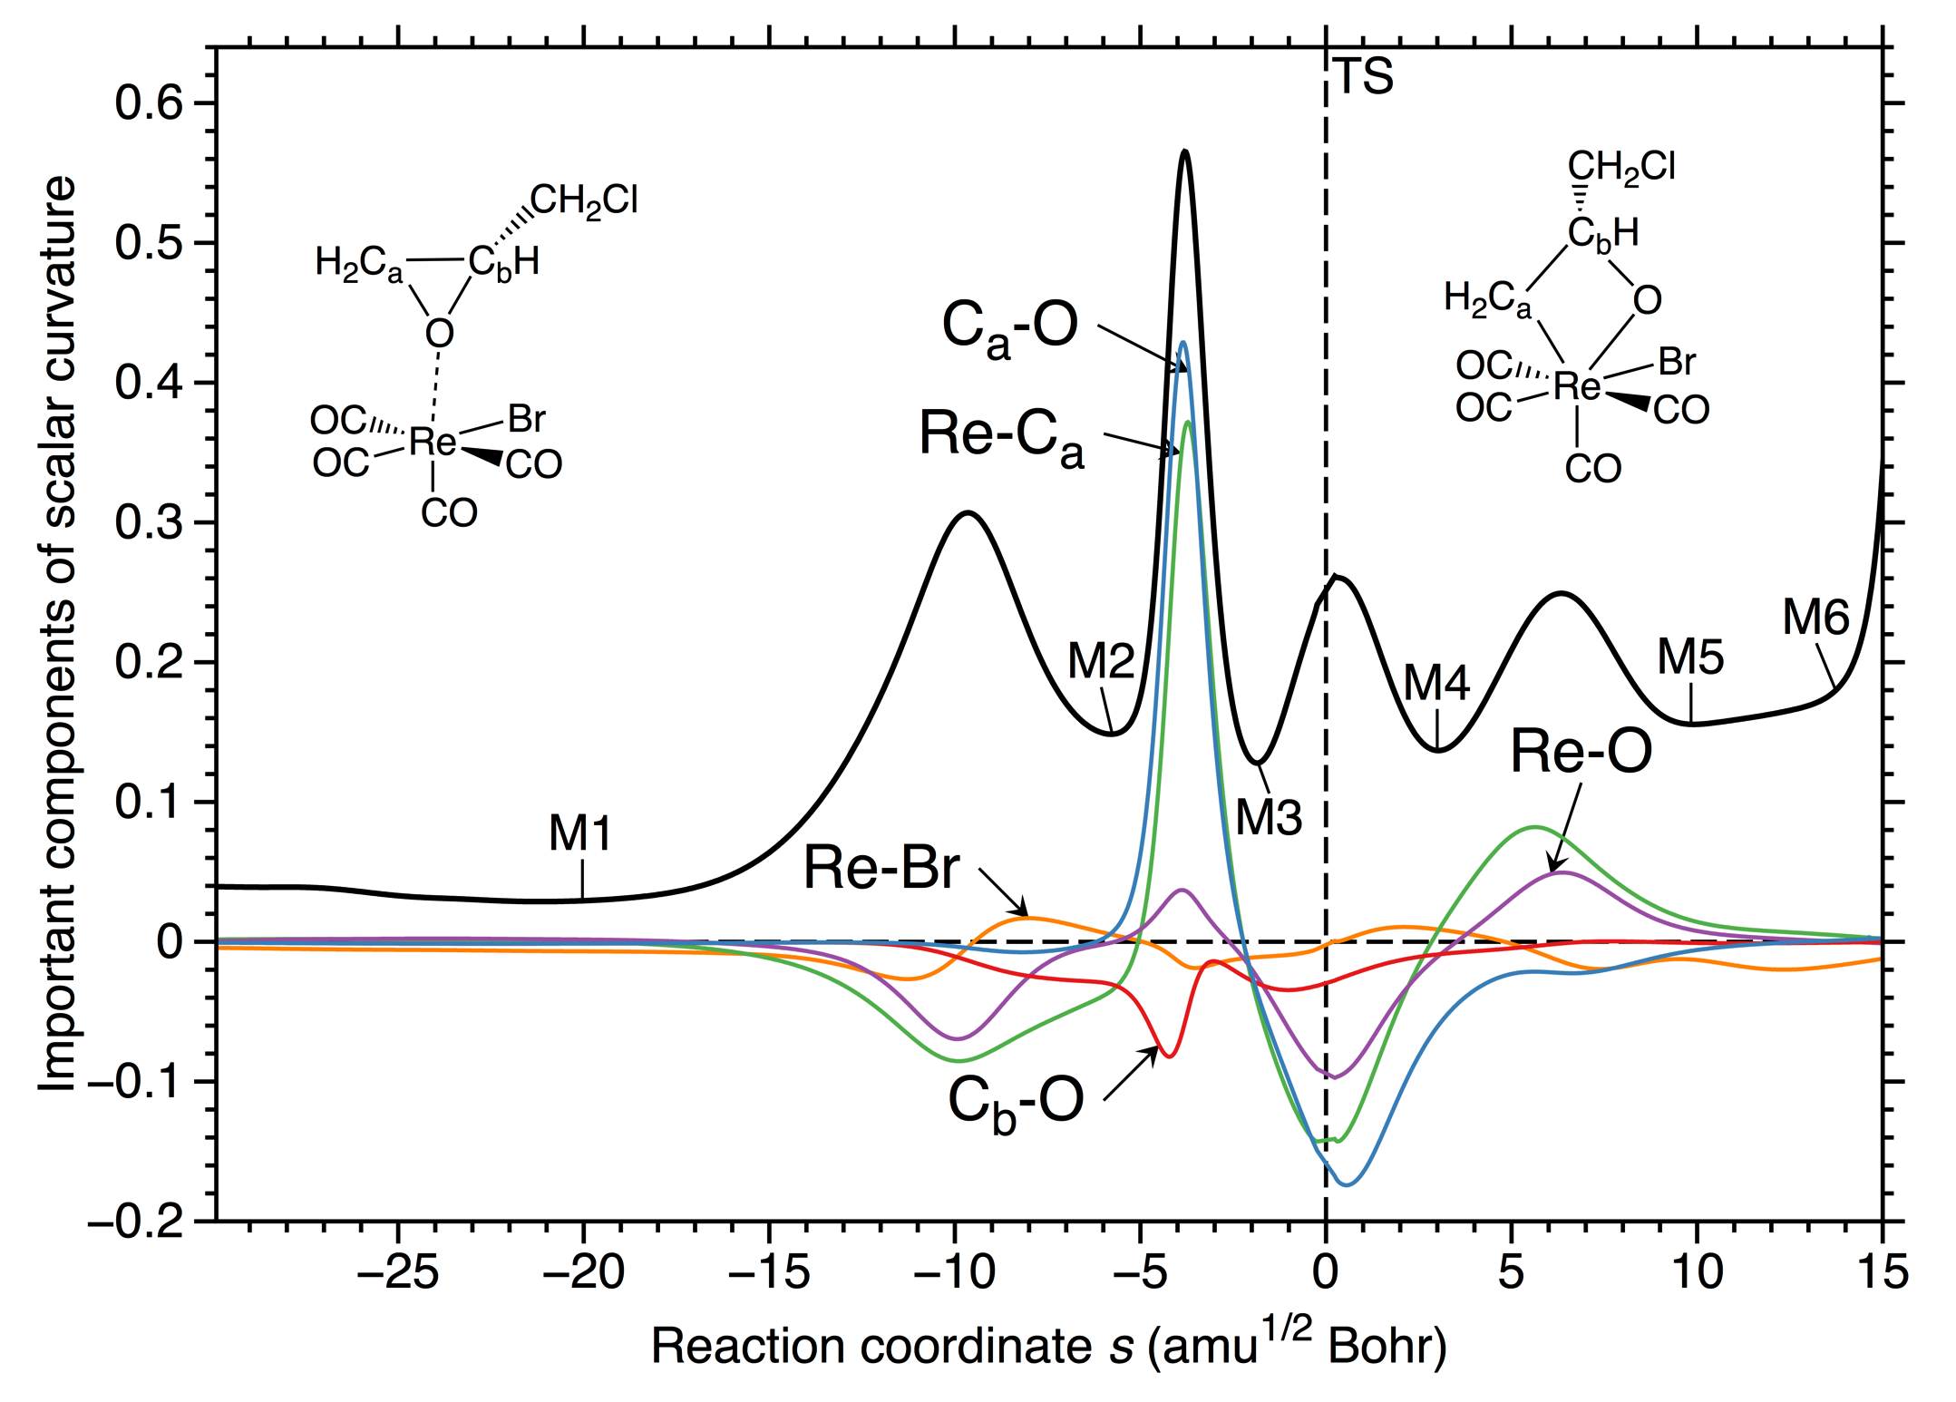
STEP 1: Epoxide coordination and ring opening
3
7
4
5
2
6
change in coordination
number
1
37.6 kcal/mol

Slide 44
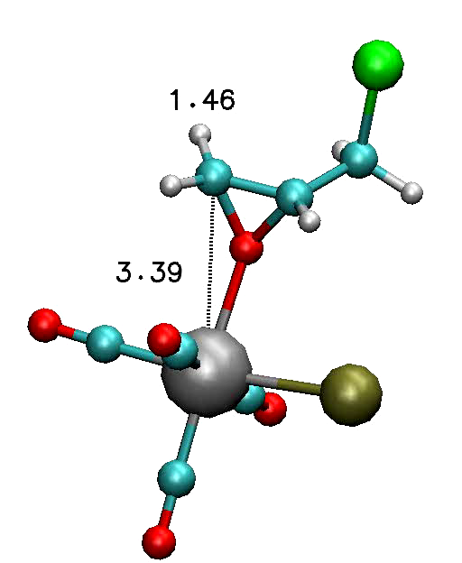
Rhenium Catalyzed CO₂-capture
Step 1:
Epoxide coordination
and ring opening

Slide 45
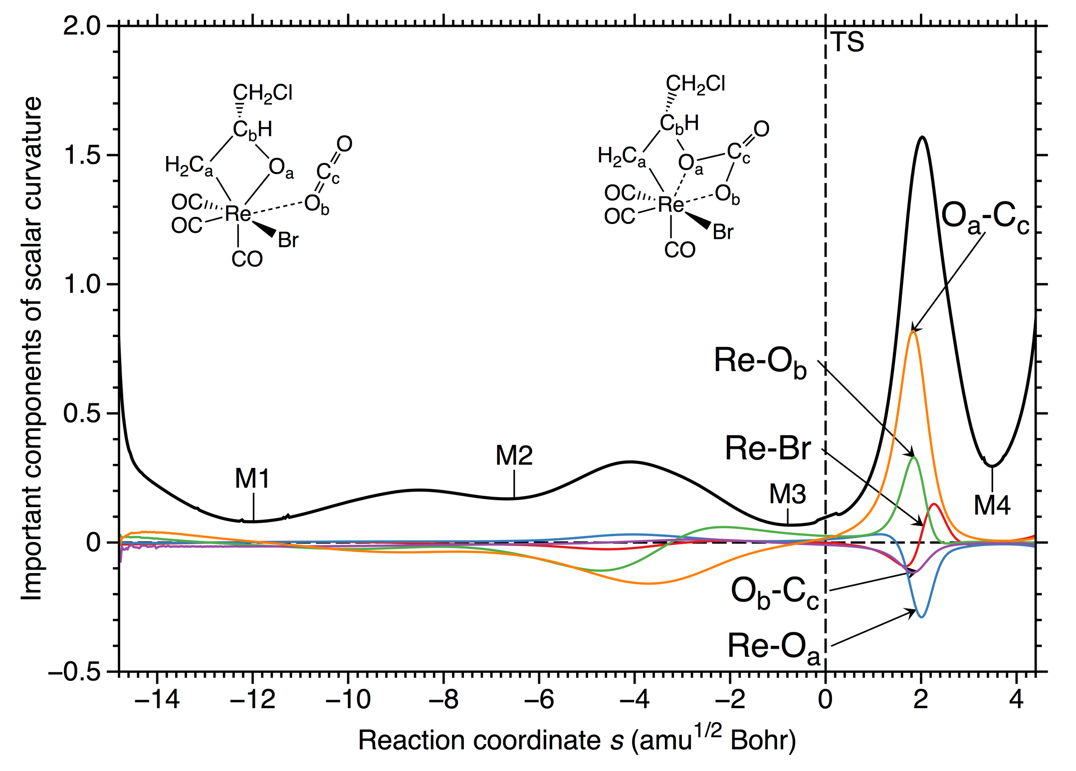
STEP 2: CO₂ insertion, part 1
5
4
after loss of one CO
3
1
2
6.6 kcal/mol

Slide 46
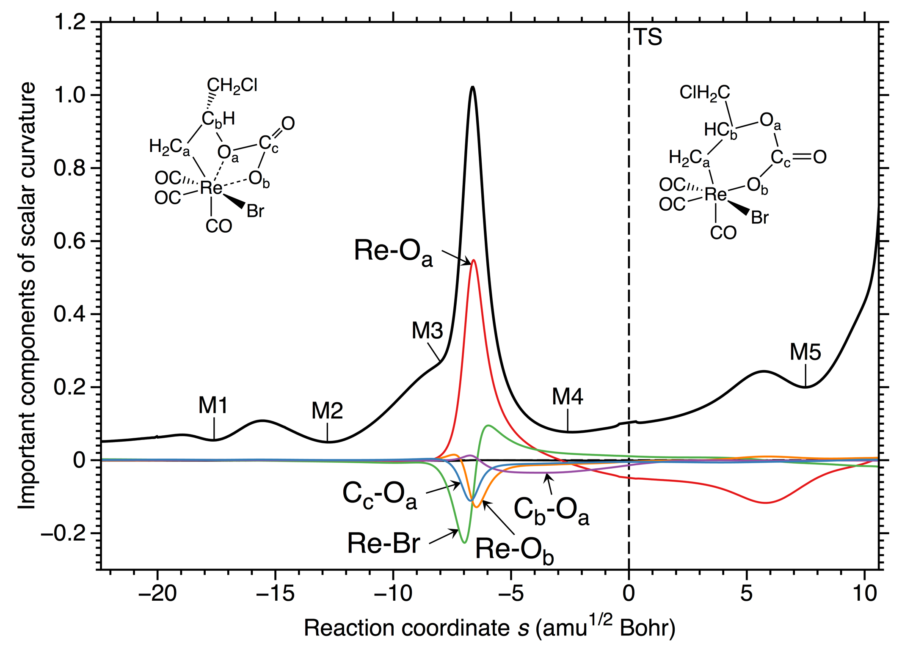
STEP 2: CO₂ insertion, part 2
4
6
3
5
1
2
distorted boat form
13.3 kcal/mol

Slide 47
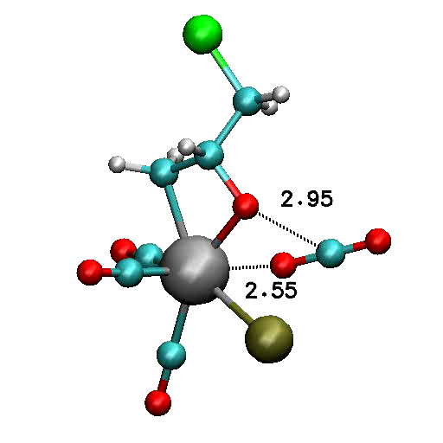
Rhenium Catalyzed CO₂-capture
STEP 2: CO₂ insertion part 1
STEP 2: CO₂ insertion part 2

Slide 48
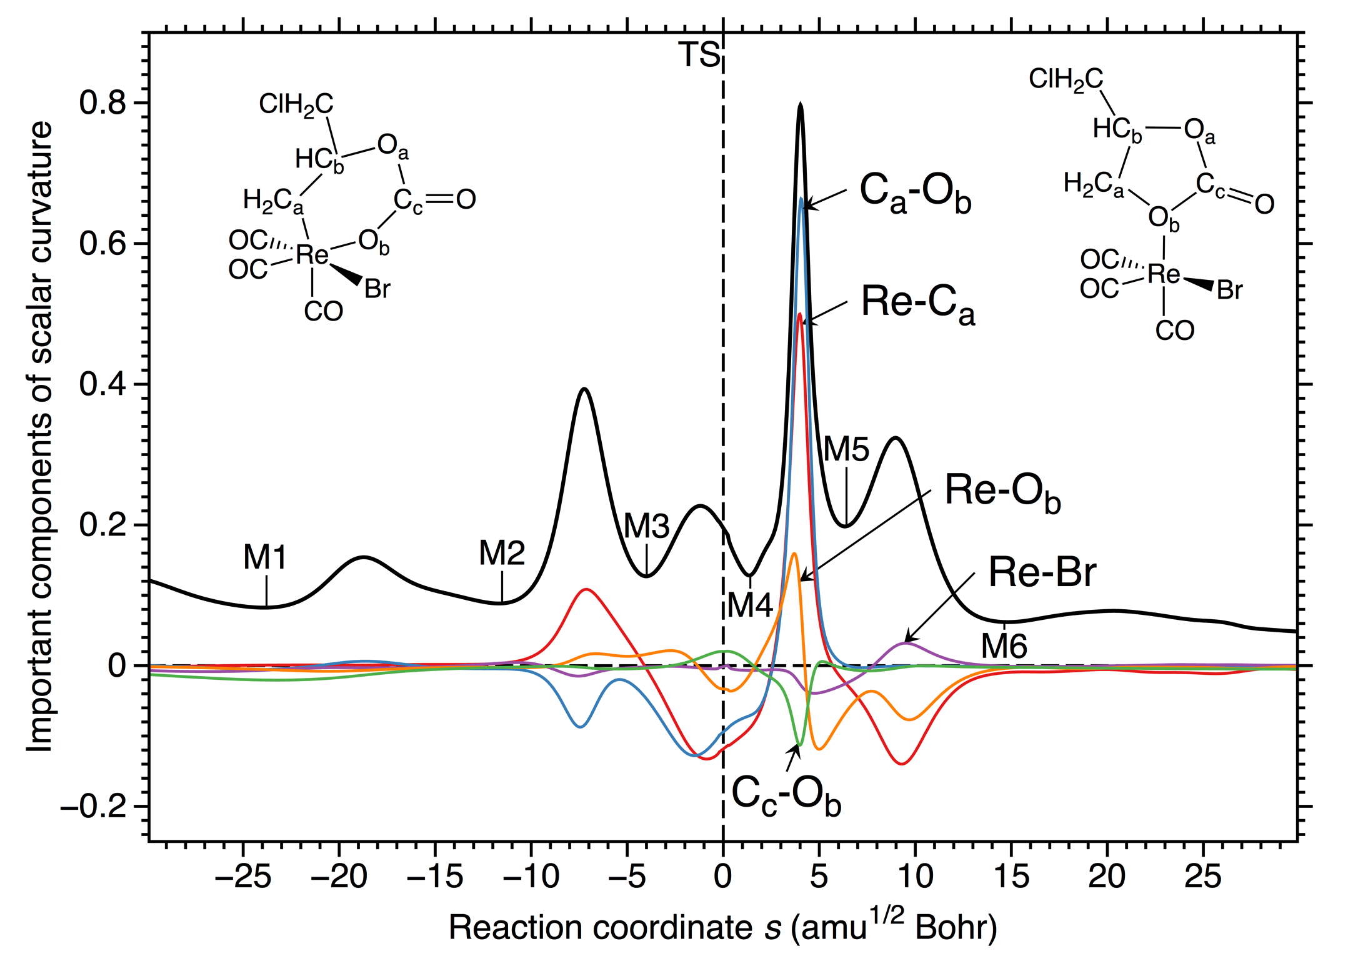
STEP 3: Formation of 5 membered ring carbonate
5
3
6
4
1
2
7
exothermic by
40 kcal/mol
15.5 kcal/mol

Slide 49
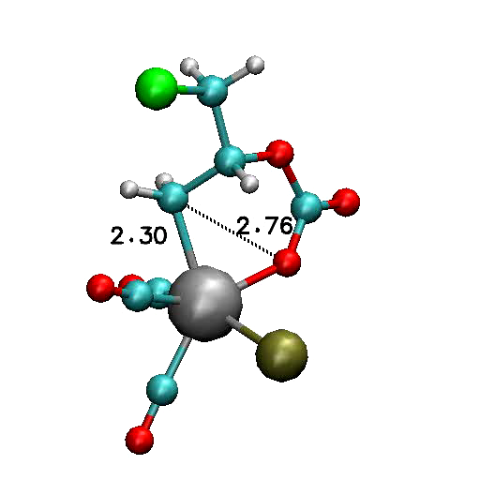
Rhenium Catalyzed CO₂-capture
STEP 3: Formation of
5-membered ring carbonate

Slide 50
STEP 4: Addition of CO
6
4
7
8
1
2
3
5
~ 1 kcal/mol

Slide 51
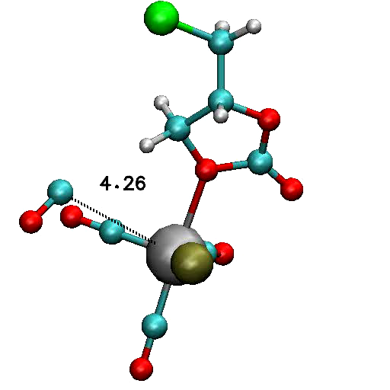
Rhenium Catalyzed CO₂-capture
STEP 4: Addition of CO

Slide 52
铼催化剂的特点
在数个反应相中降低Re-C键以及Re-O键形成和断裂时所需的能量
铼的配位层很容易改变，从而辅助偶和反应

Slide 53
Rhodium Catalyzed Hydroformylation

Slide 54
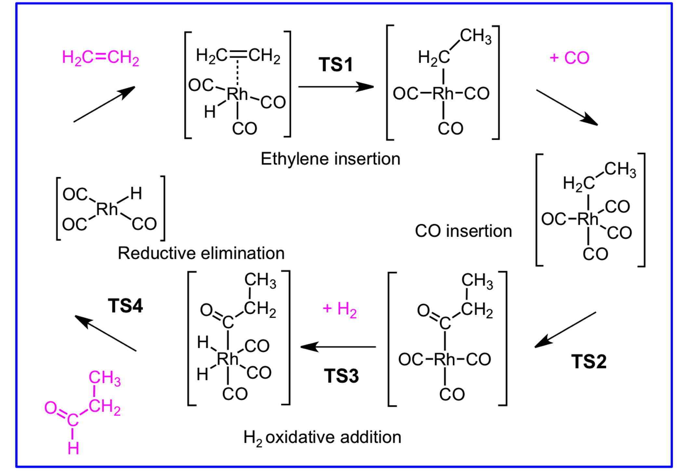
Catalytic Cycle: Rhodium Catalyzed Hydroformylation
11.5 kcal/mol
9.1 kcal/mol
11.7 kcal/mol
17.1 kcal/mol

Slide 55
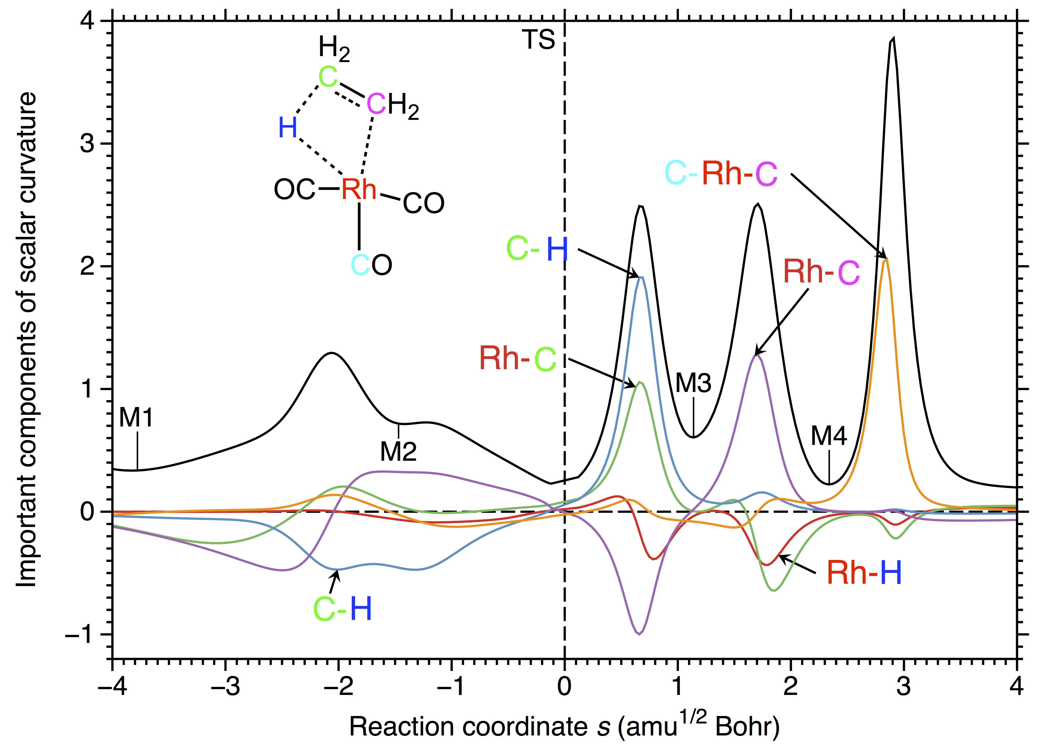
Step 1: Ethylene insertion into the Rh-H bond
distinct distortions of the
butterfly form of the starting
Rh complex
Catalysis
10-phases mechanism
5
6
4
1
2
3
7
8
9
10

Slide 56
“Quantization” of Rh-H bond cleavage
1
5
6
7
8
9
10
2
3
4

Slide 57
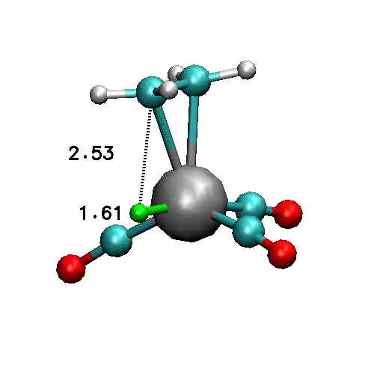
Rhodium Catalyzed Hydroformylation
Step 1:Ethylene insertion
into the Rh-H bond

Slide 58
“有效”Rh-H键断裂的特征
“抓氢键”以及“非抓氢键”来源于铑原子配位层中 “d-洞” (M-C键断裂中也有这两种键，例如，铼催化捕捉CO₂，以及在M-B键或M-Si键中)
在前（后）化学区域，铑配合物的配位层容易发生改变 (总体结论: 过渡金属的氧化态以及配位数都容易改变)

Slide 59
Fe Catalyzed Hydrogenation
Ketones and aldehydes ➔ alcohols
Synthesis
Asymmetric synthesis
Regenerate by H₂ or another alcohol
Reactions of several substrates were examined
Formaldehyde
Ethanal
Acetone
Benzaldehyde
Acetophenone
Notes:
(
ON SLIDE) Finally just a taste on a more complicated catalytic reaction. Ketones and aldehydes can be hydrogenated to form alcohols. Reductions such as these are valuable to synthesis, especially asymmetric synthesis to form chiral products.

Slide 60
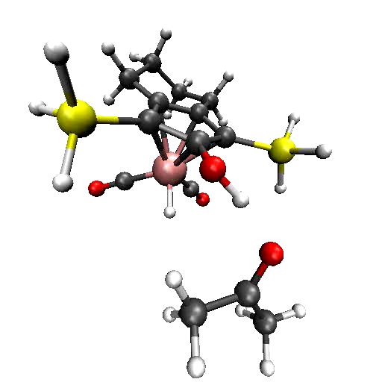
Fe Catalyzed Hydrogenation
Both H atoms transferred in one step
Carbonyl is polarized, requires polarized H₂
H^{δ+} from O
H^{δ-} from Fe
Notes:
Here you see in real time how the hydrogen atom is transferred.

Slide 61
过渡金属催化剂的如何作用的？
通过以下方法辅助化学键断裂／形成
固定
特定的结构化学
Sharpless反应
转化
成为多步骤过程
Au: 一步到两步
Re: 一步到四步
Rh: 一相到多相

Slide 62
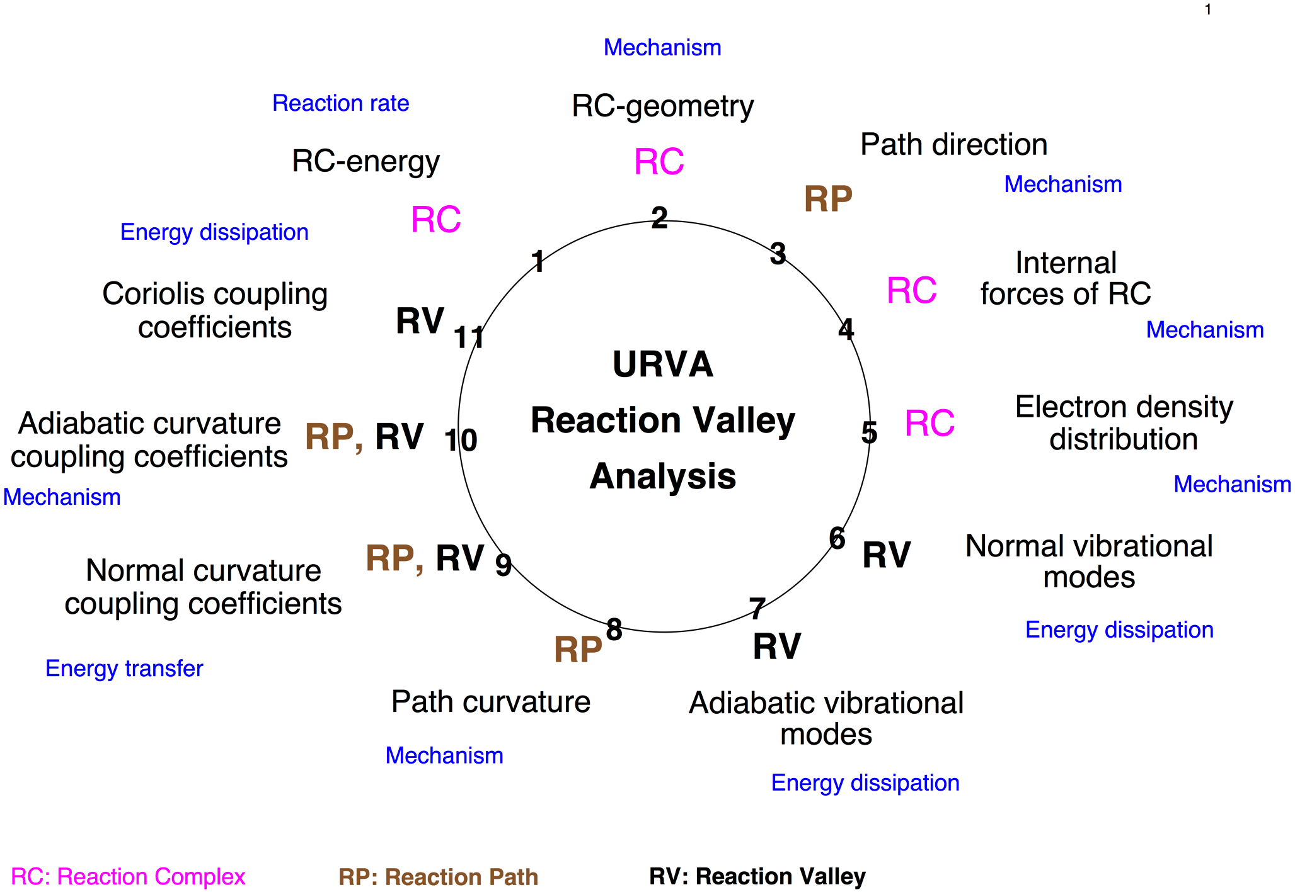
The 11 steps of URVA

Slide 63
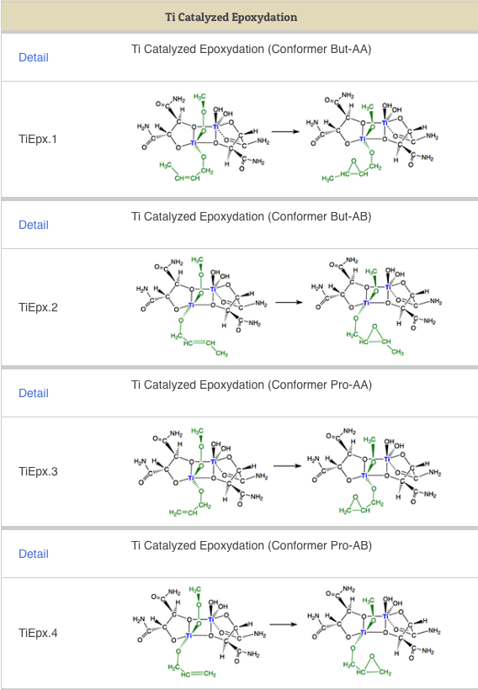
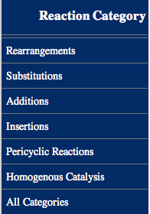
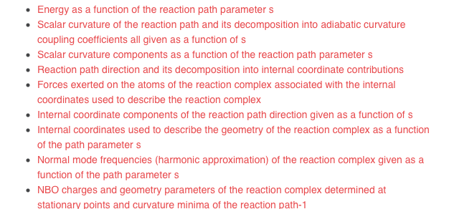
CATCO’s REACTION LIBRARY: More than 500 reactions are listed, ordered in groups
according to common chemical classifications
For each reaction:
Computational Details
Energetics
Discussion
Representative Literature
Graphics

Slide 64
后续的研究？
在URVA研究中引入溶剂 – QM-cluster方法 (隐性) 以及QM/MM方法 (显性) 中的URVA
对酶催化反应使用URVA方法
连接过渡金属催化和酶催化–人造金属酶
研究酶类似物 - 从头开始的酶设计

Slide 65
OC
Reactions
TM
Catalysis
Enzyme
Catalysis
URVA
Metallo-
Enzymes
Tutorials/
Workshops
Open Access
Reaction library
Stand-alone Programs
URVA, LOCAL
QM in Curvilinear
Coordinates
Protein Folding
Heterogeneous
Catalysis
De novo
Catalyst Design
Photochemistry
Method development
Relativistic Theory
Dirac-exact Methods

Slide 66

























Computational And Theoretical Chemistry Group, CATCO:http://smu.edu/catco/

Slide 67
Acknowledgements
National Science Foundation, Grant No. CHE-1152357,
and Grant No. CHE-1464906.
SMU High Performance Computer Center

Slide 68
Recent NSF Highlight

Slide 69
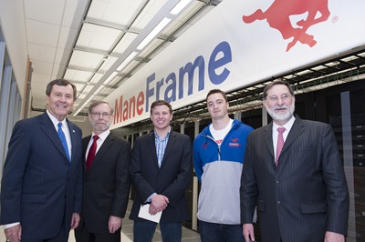
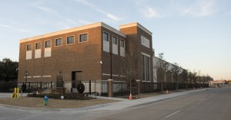

High-Performance Computing @ SMU
SMU’s latest addition to the computer computer facilities: ManeFrame
(ranked among the top 500 fastest supercomputers in the world)
Total Capacity in 2015: 10,900 cores, 120 teraflops, 1.5 PB storage
25,000-square-foot facility
housing both the high-
performance and general-
purpose computing equipment

Slide 70






SMU Campus

Slide 71
Two postdoc positions are available
in the CATCO group
1) METHOD DEVELOPMENT project in quantum chemistry, which
requires extensive programming in Fortan and C.
Possible topics: Design and programming of the reaction valley approach
for an implicit or explicit inclusion of solvent effects;
2-­component relativistic methods for the investigation of “relativistic”
systems; new QM/MM methodologies for the description of chemical
reactions in an enzymatic environment.
2) ADVANCED APPLICATIONS including standard quantum
chemical calculations, QM/MM calculations as well as high­-accuracy
calculations with CASPT2, CCSD(T), and MRCC methods including
relativistic effects; working in a HPC environment, scripting.
Possible starting date: September 1st
Please contact Elfi Kraka, ekraka@smu.edu; Dieter Cremer, dcremer@smu.edu

Slide 72
Thanks

Slide 75
Paradigm Shift
Reaction Complex
Reaction Path

Slide 76


1
5
6
4
3
8
2
7
8
9
10
7

Slide 77

Catalysis
6
4
5
3
7

Slide 78
Cremer Pople Globe
Boat and half-chair
Conversion in the exit
channel

Slide 80

MA + BD
The catalyst lowers
the energy barrier
but how ?
MEC

Slide 81


K2
Without catalyst longer
preparation phase
bond
formation
K1/K2 = 0.14
K1
orientation
pyramidalization
planarization
K2
The catalyst increases the electron
withdrawing ability of MA making
the new CC bond formation easier!
K1
K1/K2 = 0.28
less exothermic, smaller barrier

Slide 82

With catalyst
Without catalyst

Slide 83
Relationship between Reaction Path Curvature and Energy
Investigation of Substitution reactions
XH_{n} + H₂ XH_{n+1} + H
X = H; F, Cl, Br, I; O, S, Se,Te;
N, P, As, Sb, Bi; C, Si, Ge, Sn, Pb

Slide 84

NBO charges along the reaction path

Slide 85


Slide 86


Slide 87


Slide 89




endothermic
exothermic
Energy [kcal/mol]
more
endothermic
strongly
endothermic
Reaction coordinate (amu ^{1/2} Bohr)
Reaction coordinate (amu ^{1/2} Bohr)

Slide 90

XH_{n} + H₂ XH_{n+1} + H

Slide 91
Quantification of the Hammond-Leffler Postulate
Exothermic reaction:
early TS (reactants like) and a small barrier;
Endothermic reaction:
late TS (product like) and a large barrier
Problem: How can ‘early’ and ‘late’ be
defined and quantified?

Slide 92
References: Shift Δs of the position of M1 with regard to TS
Δs = s(M1) – s(TS)
K1
endothermic reaction
M1
K2
s(M1)
0
s
Δs = s(M1) < 0 endothermic reaction (late TS)
> 0 exothermic (early TS)

Slide 93
Quantification of the Hammond-Leffler Postulate
XH_{n} + H₂ XH_{n+1} + H

Slide 94


Slide 95
Choice of Reaction Path
The reaction complex can follow an infinite number of trajectories, therefore we need a representative path:
For reaction with a barrier we use
the Intrinsic Reaction Coordinate (IRC) of Fukui,
the steepest descent path in mass-weighted Cartesian
Coordinates.
For reactions without a barrier we use
the Newton Trajectory Growing String (NT-GS) method
developed by
W. Quapp, E.Kraka, D. Cremer, J. Chem. Phys. A.. 2007, 111, 11287.
H. Joo, E. Kraka, W. Quapp, D. Cremer, Mol. Phys., 2007, 105, 2697.
Notes:
95
This is my opening slide. I have to check what else it should conmtain

Slide 96
The Unified Reaction Valley Approach (URVA)
Reaction Path Hamiltonian
Handy, Miller, and Adams, J. Chem. Phys. 1980, 72, 99.
Exploration of reaction path and reaction valley
E. Kraka, D. Cremer, Acc. Chem. Res. 2010, 43, 591.
D. Cremer, E. Kraka, Curr. Org. Chem. 2010, 14, 1524.
E. Kraka, Interdisciplinary Reviews, Wiley, 2011, p 53.
Local (Adiabatic) vibrational mode concept
D. Cremer et al., Int. J. Quant. Chem. 1998, 67, 1; 11; 29; 41.
E. Kraka et al., Int. J. Quant. Chem. 2012, 112, 3174.
D. Cremer et al., J. Chem. Phys. 2012, 137, 084114.
http://smu.edu/catco/
Notes:
96

Slide 97
We need new mode vectors, which do no longer depend on the normal vibrational modes.
Previously we used the internal coordinate modes to describe the translation along
the reaction path:
These basis vectors are non-orthogonal, but normalized. They span the 3N-L-space.
We have to project out the part (anti)parallel to the reaction tangent and (anti)-
parallel to the curvature vector.

Slide 98
You should know what a
B-matrix is and how a
b-vector is defined
Notes:
98
This is my opening slide. I have to check what else it should conmtain

Slide 99
We need new mode vectors, which do no longer depend on the normal vibrational modes.
Previously we used the internal coordinate modes to describe the translation along
the reaction path:
These basis vectors are non-orthogonal, but normalized. They span the 3N-L-space.
We have to project out the part (anti)parallel to the reaction tangent and (anti)-
parallel to the curvature vector.

Slide 100
Analysis of the Reaction Path Direction
The path direction components, we used previously are just the squares
of what we use now.
In this way, we have restored the sign information and can distinguish
between supporting (+) and resisting (-) translational modes along the path.

Slide 101
Analysis of the Reaction Path Curvature Vector
We get a contribution to the curvature (term 1) and a mixed contribution
in the path direction.

Slide 102
Local vibrational modes

Slide 103
Complication:
Normal modes are generally delocalized because of mode-
mode coupling (electronic coupling, mass coupling)
We need local modes which fulfill the following requirements:
They must be related to both experimental and calculated normal modes
They must be independent of the internal coordinates used for the description of the molecular geometry
They must be independent of the isotope composition of the rest of the molecule
Mini Course VII, …..

Slide 104
Complication:
Vibrational modes are generally delocalized because of mode-
mode coupling (mass coupling, electronic coupling)
Langrangian in internal coordinates q
mass coupling
non-diagonal
G elements
electronic coupling
non-diagonal
F^{q} elements
G: Wilson G matrix, F^{q}: Force constant matrix in internal coordinates q

Slide 105
Suppression of electronic coupling:
Solution of the Wilson equation
F^{Q} D = G⁻¹D Λ
leads to the diagonal force constant matrix K given
in normal coordinates Q
K = F^{Q} = D⁺ F^{Q} D
Λ: Diagonal matrix of vibrational eigenvalues, λ_{μ} = 4π²c²ω_{μ}²
D: Matrix of normal modes vectors expressed in internal coordinates

Slide 106
Complication:
Vibrational modes are generally delocalized because of mode-
mode coupling (mass coupling, electronic coupling)
Langrangian in internal coordinates q
mass coupling
non-diagonal
G elements
electronic coupling
non-diagonal
F^{q} elements
G: Wilson G matrix, F^{q}: Force constant matrix in internal coordinates q

Slide 107

Suppression of mass coupling: Mass-decoupled
Euler-Lagrange equations
Recipe: Only masses of the atomic fragment φ_{(n)} involved in the local
vibration described by an internal coordinate q_{n} are non-zero.
Leads to the local mode a_{n} describing the vibration of atomic fragment φ_{(n)}
Konkoli, Cremer, Int. J. Quant. Chem. 67, 1 (1998);
Int. J. Quant. Chem. 67, 29 (1998);

Slide 108
Special features of the local modes of Konkoli and Cremer
Local mode force constant:
k_{n}ª = a_{n}⁺K a_{n}
Local mode mass:
m_{n} = (b_{n}⁺M⁻¹ b_{n})⁻¹ = G_{nn}⁻¹
Local mode frequency:
Local mode infrared intensity
Zou, Kalescky, Kraka, and Cremer, J. Chem. Phys. 137, 084114 (2012); Zou, Cremer, Theor. Chem. Acc., 133, 1451-1 -1451 (2014)
Kraka, Larsson, Cremer, in Computational IR Spectroscopy, J. Grunenberg, Ed.; Wiley, New York, 2010, p.105-149.

Slide 109
Special features of the local modes of Konkoli and Cremer
Local mode properties are uniquely defined: force constant k_{n}ª, mass m_{n},
frequency ω_{n}ª, infrared intensity I_{a}
Can be derived from both experimental and calculated frequencies
There is a 1:1 relationship between the normal and local modes via an
adiabatic connection scheme (ACS)
Each normal mode can be uniquely decomposed into local mode
contributions (analysis of vibrational spectra)
Explanation of measured infrared intensities; determination
of effective charges and bond moments
Description of chemical bonds via local vibrational stretching modes
Mini Course VII, …..
Zou, Kalescky, Kraka, and Cremer, J. Chem. Phys. 137, 084114 (2012); Zou, Cremer, J. Chem. Phys., in press;
Kraka, Larsson, Cremer, in Computational IR Spectroscopy, J. Grunenberg, Ed.; Wiley, New York, 2010, p.105-149.

Slide 110
Water-dimer:
Experiment: Saykally et al. ( JCP, 2003) assigned the normal mode
frequency at 143 cm⁻¹ to the hydrogen bond stretching
Does this normal mode reflect the bond strength?
A normal mode decomposition into local modes will give us the answer.

Slide 111

Normal vibrational modes of the water dimer: Exp. frequencies
Normal vibrational modes of the water dimer: Exp.frequencies
red: stretches
green: bends
light blue:
torsions
dark blue:
HB stretch
6 inter-monomer modes
Normal mode vibrations are decomposed into local modes

Slide 112

Local modes
Normal Modes
390
H-bond stretch
avoided crossing
switch of mode
character
H-bond stretch
143
Adiabatic connection scheme of the
water dimer: Exp. frequencies
lower range
6 intermolecular vibrations

Slide 113


Water dimer
Normal O…H stretching mode, 143 cm⁻¹
Local O…H stretching mode, 390 cm⁻¹

Slide 114
Conclusion:
The measured frequency at 143 cm⁻¹ is associated with a mode that contains 58% hydrogen bond stretching and 42% bending character.
The local mode hydrogen stretching frequency is 390 cm⁻¹.
The ACS between local and normal vibrational modes reveals that the lowering is due to mass coupling and an avoided crossing with local HOH bending modes.
The local mode stretching force constant is related to the strength of the hydrogen bond.

